Slide 1
Connections: Scholarly Multi-Tasking in a Mobile Virtual World, Part 3 Based on a presentation given: October 22, 2011, 9th Annual Community Systems Foundation conference, Ann Arbor.
Sandra L. Arlinghaus, Adj. Prof. SNRE, Univ. of Michigan, Ph.D., Geography
AKA “Archimedes” in the Google 3D Warehouse
William E. Arlinghaus, President, Greenscape Inc., Expert Cemeterian.

Slide 2
General Context: Projects in overlapping categories
Geography Projects
Mathematics Projects
Non-traditional Projects
The Perimeter Project
Mathematical Geography Projects

Slide 3
The Perimeter Project: Spatial Edges--Overview
Protect Fragile Lands using Cemetery Zoning or Memorialization—Perimeter: land/water interface
Golf Course Genealogy Gardens—Perimeter: 18 state “nation” with edges.
Collaboration with existing pacemaker recycling project—Perimeter: extending the edge, in temporal quantity and human quality, of life.

Slide 4
The Perimeter Project: 2011.
Protect Fragile Lands using Cemetery Zoning or Memorialization
Pilot project: Chapel Hill Memorial Gardens, Grand Rapids. COMPLETE
Bundling of Archived Memorials Online with sale of cemetery plots, cremation service, etc.
Creation of Virtual Cemetery using Google Earth
Land acquisitions.
IN PROGRESS
Expansion of pilot project to other cemeteries—in progress.
Extension of idea to include golf course perimeter lands—viewing the golf course as a nation of 18 contiguous states.

Slide 5
The Perimeter Project: 2011.
Land Acquisitions. In Progress
Expansion of pilot project to other cemeteries—in progress.
Magnolia Cemetery, Meridian, Mississippi. Acquired, January 2011
Meridian Memorial Park, Meridian, Mississippi. Acquired, January 2011
Extension of idea to include golf course perimeter lands—viewing the golf course as a nation of 18 contiguous states.
Creation of QRcodes as memorials.
Golf Course Genealogy Garden:
Proposal

Slide 6
Mississippi Cemeteries
Meridian properties:
Acquisition strategy
Physical differences in maintenance in cemeteries in the Deep South.
Local management issues
Local political issues
Local cultural issues
Possible acquisition targets elsewhere.

Slide 7
Mississippi Cemeteries
Memorial webpages physically linked to sites or grave markers using QR Codes engraved on bronze plaques (as “Memory Medallions”) are in current use. Loved ones visit the cemetery and, with their SmartPhones, can link to obituaries while standing at the gravesite!
Precedent for this practice is long-standing in Japan (where space is at a premium) and more recently in Haifa, Israel.

Slide 8
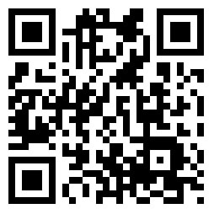
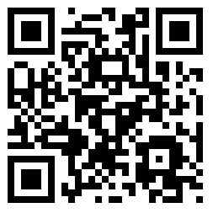
QR Codes: SmartPhone as Scanner
QR Code #1
QR Code #2
Two different patterns link to the same site: Many-One transformation (not the reverse).

Slide 9
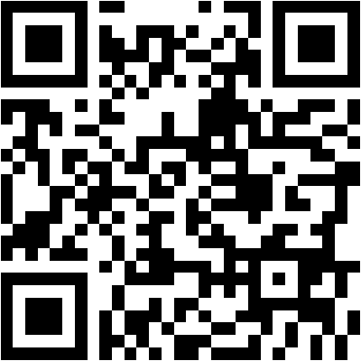
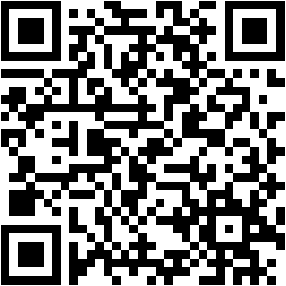
QR Codes: Link to a variety of formats
QR Code #1: Active webpage
QR Code #2: Archived image

Slide 10
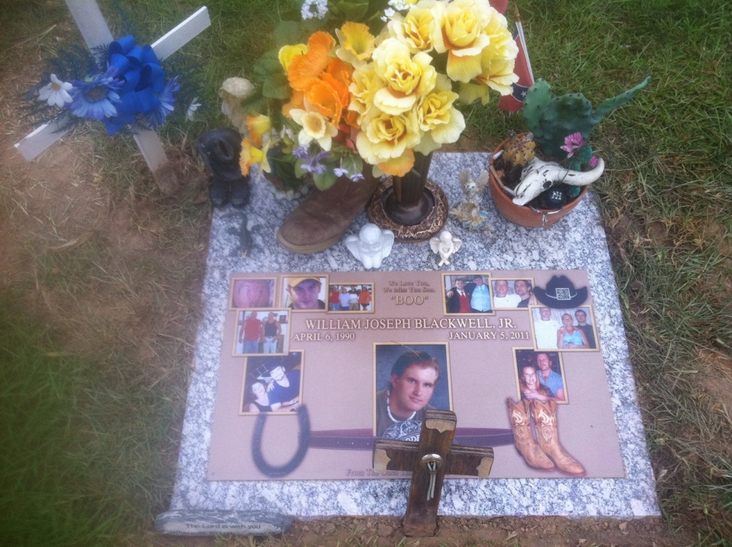
QR Code on a Gravestone— look in the hatband!

Slide 11
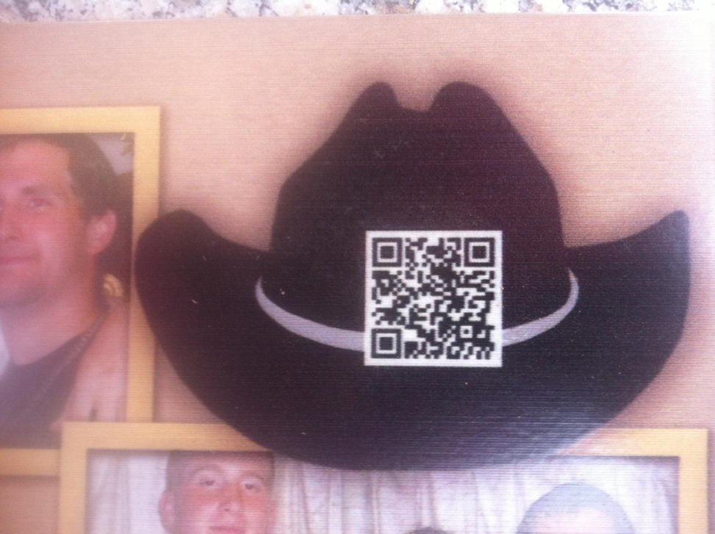
Close-up of QRcode

Slide 12
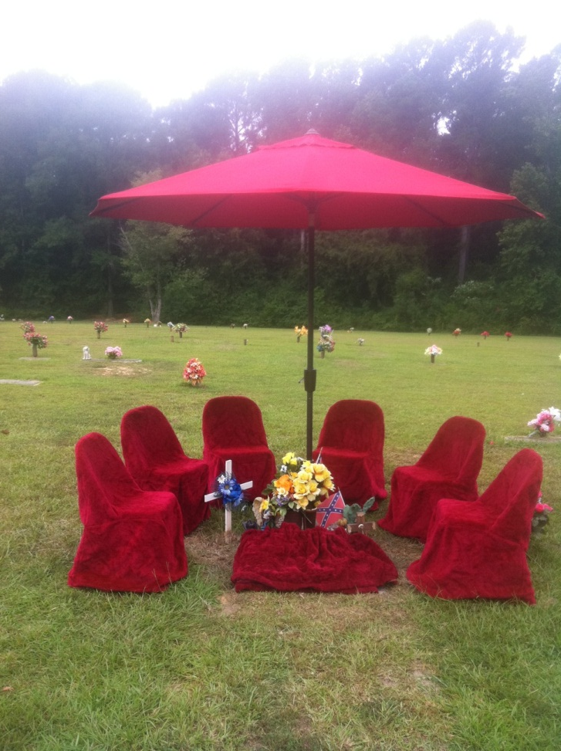

Slide 13
Golf Course Genealogy Garden
Much land associated with a golf course is not used directly for golfing purposes. Areas in the woods, sections off the trails between holes, and so forth, will be referred to here as “Edges.” Golfers typically do not walk on these Edges. They are the Perimeter of the golf course.
Might we find another, complementary, use for Edges? A use that will:
Not alter, in the slightest,
The appearance of the existing golf course
The existing usage pattern of the current golf course
Offer opportunity for increased year-long funding, above and beyond direct golf course revenues, for the owners/managers of the golf course.

Slide 14
Golf Course Genealogy Garden
One possibility is to dedicate Edges (part or all of) to genealogy/memorialization, independent of burial or scattering location. Visualize QRcodes mounted, perhaps, on trees in memory of a loved one. Or imagine a “family tree” with some codes for loved ones already gone and with codes leading to active sites of another’s current life. One can build his/her own memorial in this garden while still alive and have it live on after death.
Such use is complementary to golf course use from a fiscal standpoint
Golf course revenues are seasonal; death-care revenues are year-long
Ash scattering on golf courses may already take place by individuals with no revenue for anyone and no memorialization for the cremains of loved ones. Professionally managed memorials offer:
Professionally managed, and trust-funded, memorialization opportunities using the Internet (so not invasive of physical golf course lands).
Planning practice consistent with contemporary principles involving “mixed use.”
Extra funding for the golf course owners, managers, and memorialization experts.
Extra funding with no detrimental consequences to neighbors or golfers. No change in appearance of the course or its usage.
There is long-standing precedent to this general idea: one use of totem poles is this sort of application (albeit using different technology contemporary in different times).

Slide 15
Golf Course Genealogy Garden
Indication of fiscal possibility: Significant possibility for revenue upgrade.
Local cultural issues in the case of Ann Arbor: history of park bench memorials difficulties.
Possibility of implementing this idea in a variety of locales…under consideration.

Slide 16
Physical Memorial and Virtual Cemetery: Integration of two different worlds using QR Codes.

Slide 17
Collaboration with Existing Project— Project MyHeart/YourHeart, University of Michigan, Drs. Kim Eagle, Thomas Crawford, Timir Baman
Project My Heart/Your Heart is a program of The University of Michigan Cardiovascular Center. It is headed by Dr. Kim Eagle (Clinical Director of the Cardiovascular Center of The University of Michigan) who is working on it with Dr. Thomas Crawford and Dr. Timir Baman. It has a simple, but powerful, focus: recycle used pacemakers to individuals in developing nations or to others in need. Pacemakers may extend both the quantity and quality of life.
Nations without strong health care programs cannot offer such wonderful life-extending devices to most of their residents. We can--as one individual to another. The U. of M. team is establishing procedure for sterilizing used pacemakers so they can be safely transplanted from a cadaver to a living individual. They are also developing training programs for medical personnel so that target developing nations become self-reliant in moving forward to improve cardiovascular health. According to the Project My Heart/Your Heart website, “each year 1-2 million individuals worldwide die due to a lack of access to pacemakers. Meanwhile, almost 90% of individuals with pacemakers would donate their device to others in need if given the chance.” What helps one person, and one nation, helps the world. Pacemakers extend the perimeter of life.
Cremation experts note that pacemaker removal is critical prior to cremation (lest the crematorium explode). Pacemakers removed prior to cremation, or conventional burial, are generally simply trashed. How sad—many have "life" (battery and/or mechanical life) left in them that might be transferred elsewhere, to someone who could not otherwise afford it. An opportunity to save or improve someone else’s life is lost--what a shame.

Slide 18
Target Pilot Donor Groups—our role, in regard to “advanced planning” within the context of the existing project.
Large groups of individuals with a high mean chronological age might reasonably be expected to have a greater density of pacemakers than a corresponding random group of similar size. We target one such group as a pilot project and then consider extending the lessons learned from the pilot to other groups.
The American Contract Bridge League (ACBL) has a population of over 165,000 with an average age of 69 years. Generally, bridge player members of this North American organization are affluent, well-educated, competitive individuals who presumably have good medical care and good medical implants when appropriate. Our pilot project centers on this group, partly based on its demographic characteristics and partly based on long-standing connection with the group.
Following the pilot stage, extension of strategy will be directed toward other large groups with similar demographic characteristics: retirement associations, and so forth.
More broadly, we would wish to work with Secretary of State offices, throughout the 50 U.S.A. states to encourage them to consider adding recycling of artificial organs to their existing programs that mark driver licenses for donors of natural organs.
Still more broadly, we would wish to extend the program globally, with an eye to developing a global census of pacemaker donors and recipients. There is no such census currently. Yet today’s pacemaker recipient may become tomorrow’s donor.

Slide 19
Pilot Project
A program to recruit ACBL donors is underway.
A Donor Card was created and is currently being disseminated.
An article, “Bridge to a Better World,” appeared in September, 2011 in the Contract Bridge Forum, p. 8.
A letter to the Editor, “An Opportunity,” appeared in the ACBL Bridge Bulletin in November 2011, pp. 6-7.
Other publishing opportunities are under investigation.

Slide 20
Beyond the Pilot Project
Target Pilot Recipient Groups—the other end of the equation:
Choose as targets, groupings of population with density of pacemaker need greater than in a corresponding random group—in regions of concentrated disease that has collateral cardiovascular damage for which a pacemaker is appropriate.
Return lat/long coordinates from such regions, either pinpointing locations of affected individuals or associated health care facilities and practitioners (or all of the above).
Create an Atlas employing state of the art mapping (in Google Earth and such) based on information returned from the field.
Some sort of synergistic connection between this project, on the “Perimeter of human life,” and existing international NGOs, such as Community Systems Foundation, might evolve. One might look in particular to such a connection developing in relation to tailoring existing international database management software to assist in future global pacemaker census efforts.
Fields in a database might include items such as contact information of recipient; name of donor; age of pacemaker; registration number of pacemaker, and so forth.
Others to be developed in conjunction with the medical community, both as concentrated donor populations and recipient populations.
Online components seem desirable both for recruitment and for tracking.

Slide 21
Cloud Computing facilitates connections!
QR Codes
Client Requests
Videos
Cloud Dropbox

Slide 22
Many Thanks to
The School of Natural Resources and Environment for room use;
Kris Oswalt of Community Systems Foundation (CSF) for advice.
Related Information
http://www.MyLovedOne.com
http://www.imagenet.org/
http://www-personal.umich.edu/~sarhaus/
Pacemaker Recycling: http://www.med.umich.edu/myheartyourheart/
Totem Pole: http://en.wikipedia.org/wiki/Totem_pole
Matthew Naud, Environmental Coordinator, City of Ann Arbor, for advice.
Gwen Nystuen, Commissioner, City of Ann Arbor Parks and Recreation Commission, for advice.
Contract Bridge Forum: http://www.contractbridgeforum.com/11/September/District17.htm
William C. Arlinghaus, Bonnie Bagley and Ken Monzingo, ACBL District Directors.
American Contract Bridge League: http://www.acbl.org/
Dr. Kim Eagle, Dr. Thomas Crawford, University of Michigan, Cardiovascular Center and Dr. Timir Baman.

