Slide 1
Spatial Mathematics:
Selected Examples
Sandra L. Arlinghaus
University of Michigan
sarhaus @ umich.edu
Joseph Kerski
Esri
jkerski @ esri.com

Slide 2

Tiling
In making 3D models or flat maps, one may wish to tile regions with pattern to create one visual impression or another.
The way that the tiles meet, at the tile boundaries, can create jarring or pleasing effects.
For example, consider the following simple rectangular tile; when two tiles are placed next to each other, as directly below, the pattern does not mesh. Look around…look at the wallpaper…?

Slide 3



Tile Orientation to Force Matching
Base tile; Vertical Flip
Horizontal Flip; Rotation through 180 degrees

Slide 4


Combine Pattern Elements—Spatial Only Approach
Vertical flip of base tile appended to base tile followed by horizontal flip. Are there other
combinations of pattern? It
appears not, but there is
no proof.

Slide 5
Are There Other Orientations? Non-spatial only approach
A 'group' is a mathematical structure that may exist on a set of elements with one operation. When elements are combined using that operation, the system is said to be a group if it is closed (no new elements are generated), if it is associative (grouping using parentheses is clear: a(bc)=(ab)c), if there is an identity property: a*I = a, and if there is a unique inverse for each element: a*a⁽⁻¹⁾ = I.
This definition is clear, in certain ways; it appears, superficially at least, as describing something in a non-spatial manner—only in terms of notation.

Slide 6
Klein 4-Group: Permutation Representations
Elements of groups can be represented as permutations, too. Consider the four elements, 1, 2, 3, 4. In the permutation, (12)(34), the elements 1 and 2 are interchanged, as are the elements 3 and 4.
One might also consider (13)(24) and (14)(23) along with a fixed permutation (1)(2)(3)(4). Permutations can be multiplied.
Thus, (12)(34)*(13)(24) = (14)(23). Read this process as 1 goes to 2 in the first permutation; the trace where 2 goes in the second permutation. It goes to 3. Thus, 1 goes to 3 in the product. With a bit of practice, one can perform this operation quickly. Look at a table composed of all possible permutation 'multiplications‘ on these four items. The column on the left is the set of 'first' permutations; the row across the top is the set of 'second' permutations.

Slide 7
Klein 4 Group: Table
* | (1)(2)(3)(4) | (12)(34) | (14)(23) | (13)(24)
(1)(2)(3)(4) | (1)(2)(3)(4) | (12)(34) | (14)(23) | (13)(24)
(12)(34) | (12)(34) | (1)(2)(3)(4) | (13)(24) | (14)(23)
(14)(23) | (14)(23) | (13)(24) | (1)(2)(3)(4) | (12)(34)
(13)(24) | (13)(24) | (14)(23) | (12)(34) | (1)(2)(3)(4)

Slide 8
Verify that we, in fact, have a group.
Verify that no new elements were created: all are displayed in the table. Verify that the associative law holds: for example, (12)(34)*[(13)(24)*(14)(23)] is the same as [(12)(34)*(13)(24)]*(14)(23). Show for each grouping; begin by working from within sets of parenthetically enclosed permutations. It is straightforward from the table that (1)(2)(3)(4) is an identity element; it is also straightforward from the table that there is no other identity element. Finally, read the table to see that each element is its own inverse: (12)(34)*(12)(34) = (1)(2)(3)(4), for example. Thus, this set of four permutations, representing rigid motions of a non-square rectangle, forms a group. It was discovered by Felix Klein and is referred to as the Klein 4-Group (Vierergruppe) and is often denoted V.

Slide 9




Putting the approaches together: Spatial Representation of the Klein 4-Group
The Klein 4-group may be represent spatially as the rigid motions of a non-square rectangle—a well-known fact. These correspond to the tiles shown earlier.
Base Tile (1)(2)(3)(4); Vertical Flip (12)(34)
Horizontal Flip (14)(23); Rotation through 180 degrees (13)(24)

Slide 10
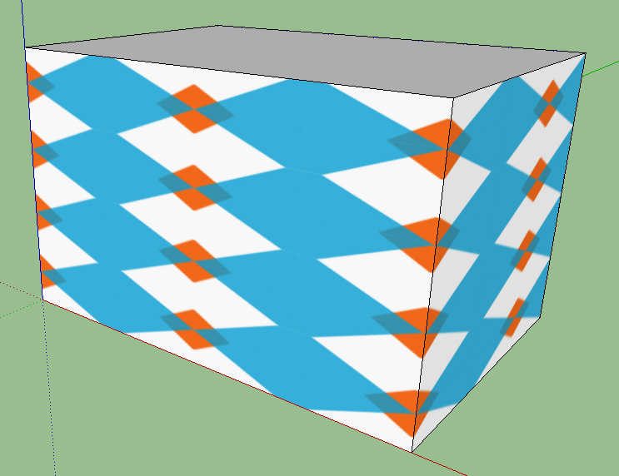
Application: Tiling of 3D Models
Wallpapers of various kinds are used on the surfaces of 3D models. In knowing how to make pattern mesh, it is useful to know the universe of discourse in which one might choose patterns.
Group theory has many applications in tiling.
Here is a tiling of a 3D model using the tile generated on previous slides.

Slide 11
Group Structure Proves All Possible Patterns Have Been Generated
Patterns can be generated associated with the four Klein-type tiles. Because the group structure can be verified, we know when we have them all. The group is a closed system. The four tiles presented above offer a complete, closed systems of tiles.
Thus, because the group structure is verified, there are no other patterns of the sort above (other than scale changes and such), based on a non-square rectangle, that can be used to generate a tiling of the plane.
This ‘proof’ was used in creating a virtual wall for a cemetery inside the Cadillac Assembly Plant in Hamtramck, Michigan; Chene Street History Project.
References are supplied to a few of the many references that deal with tilings and group theory.

Slide 12
Beyond the Group…
Category Theory offers a deep abstract structure designed to organize mathematical systems far more complex than the simple characterization afforded above.
The goal there is to create categories of objects and arrows that capture universal elements of a system so that one might look for common elements in seemingly disparate systems or so that one might discover new theorems about complex systems.
Research is underway to capture a GIS as a mathematical category to facilitate moving from one GIS to another as a way to ease users into mastering new software versions.

Slide 13
Challenge
Group theory showed us that we had all possible patterns of a certain style; invoking the theoretical non-spatial structure gave insight not otherwise available into spatial pattern. That is, it might have looked ‘obvious’ that all possible patterns were there from a spatial approach, but there was no proof. Combining the spatial and non-spatial, converted both to a spatial approach and created a synergy larger than the sum of the two individual components.
Challenge: think about what you know (mathematically) that appears non-spatial. Then, look for the spatial components in creative ways...at the frontiers of creation.
Now my colleague and co-author, Joseph Kerski, will show you how he combines the mathematical approaches he knows about with elements of spatial thinking.

Slide 14
Why Spatial Mathematics?
Spatial mathematics draws on the theoretical underpinnings of mathematics and geography. Spatial mathematics draws on geometry, topology, graph theory, modern algebra, trigonometry, symbolic logic, set theory, and others.
As maps become increasingly common media for communication, it is more important than ever to understand the mathematics behind them.
Mathematics influences the choices and decisions we make.
GIS provides an excellent way to teach mathematical concepts and skills: Patterns, relationships, functions, 2D and 3D properties, statistics, probability, change, models, measurements, connections, communications, and more.

Slide 15
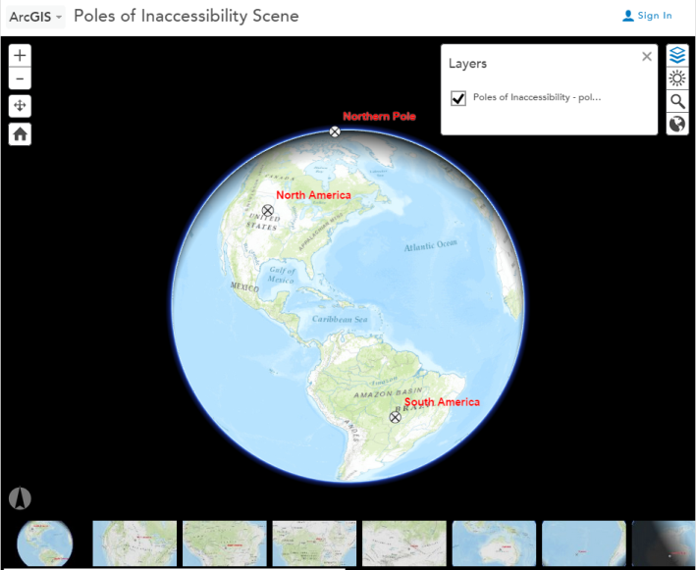
Poles of Inaccessibility
A pole of inaccessibility is the place most challenging to reach owing to its distance from locations that could provide access. On land, it is often referred to as the most distant point from a coastline, and in the ocean, the most distant point from any land.
Using 3D scenes in
ArcGIS Online ArcGIS Online

Slide 16
Poles of Inaccessibility
The three closest shorelines from the North American pole of inaccessibility are at Port Nelson on Hudson Bay in Manitoba, Canada; Everett, Washington, on the Pacific Ocean; and the shoreline of the Gulf of Mexico between Galveston and Port Arthur, Texas. The distance from the pole of inaccessibility of North America is approximately 1,030 miles (1,657.6 km) to any of these three locations. The error of uncertainty is estimated to be around 9 miles (14.5 km) due to ambiguity of coastline definitions and mouths of rivers.
This “uncertainty” makes for teachable connections about map scale, data quality, map projections, and more.

Slide 17
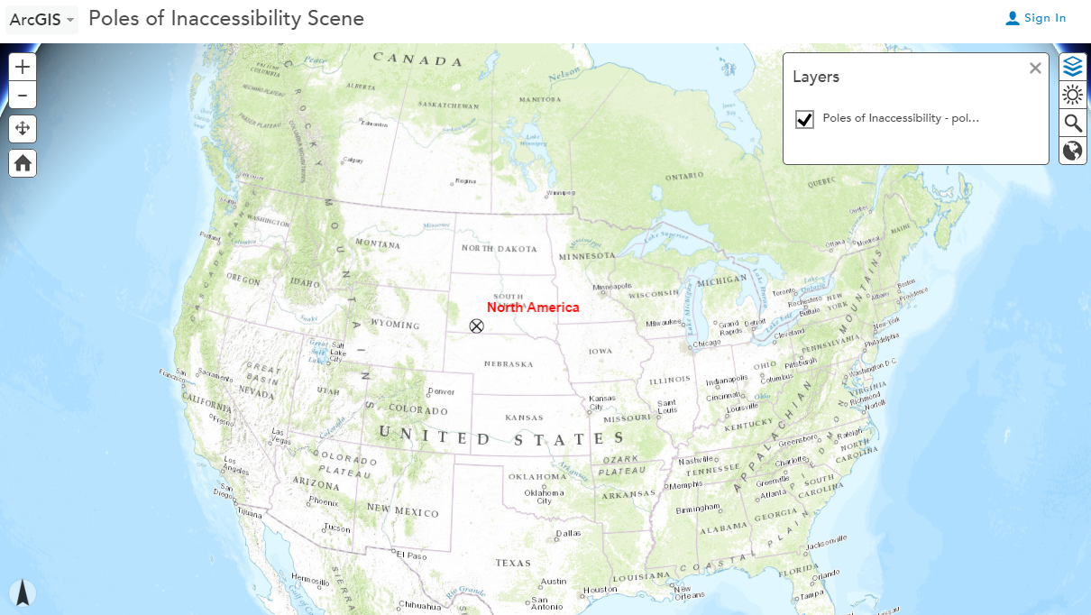
Poles of Inaccessibility

Slide 18
Analyzing Centers of Population
Analyzing the mean center of population by state, 1900-2010.
Objectives:
1) Understand the definition of and application of mean center and weighted mean center;
2) Understand the definition and use of a population weighted mean center in a GIS environment;
3) Learn how to calculate mean population centers for the USA and for individual states using GIS tools;
4) Understand the magnitude and direction of movement and key reasons why the US population center moved from 1790 to 2010;
5) Analyze how and key reasons why population centers for individual states moved from 1900 to 2010.

Slide 19
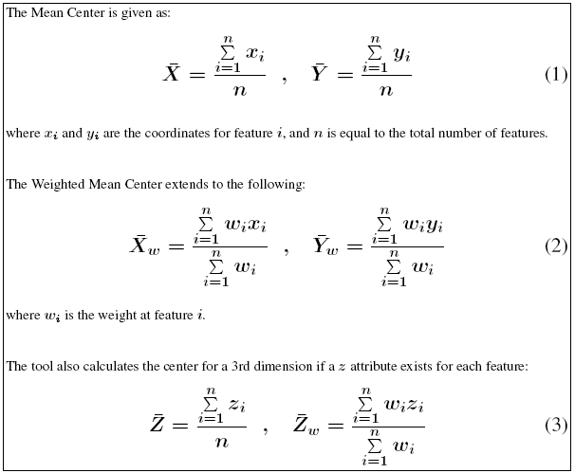
Analyzing Centers of Population
The mean center is the average x and y coordinate of all of the features in a study area.

Slide 20
Analyzing Centers of Population
Skills:
Calculating mean centers, selecting and using spatial and attribute data, and symbolizing and querying maps.
Connections:
The investigation of population change and population centers lends itself to discussions of job creation and loss, economic conditions, perceptions of place, the evolution of agribusiness and rural outmigration, urbanization, suburban sprawl, sunbelt migration, changes in the median age, changes from industry to services, international migration, and other issues.
Examining the population center for individual states allows students to consider how these issues operate on a state scale.
Integration:
Geography, GIS, mathematics.

Slide 21
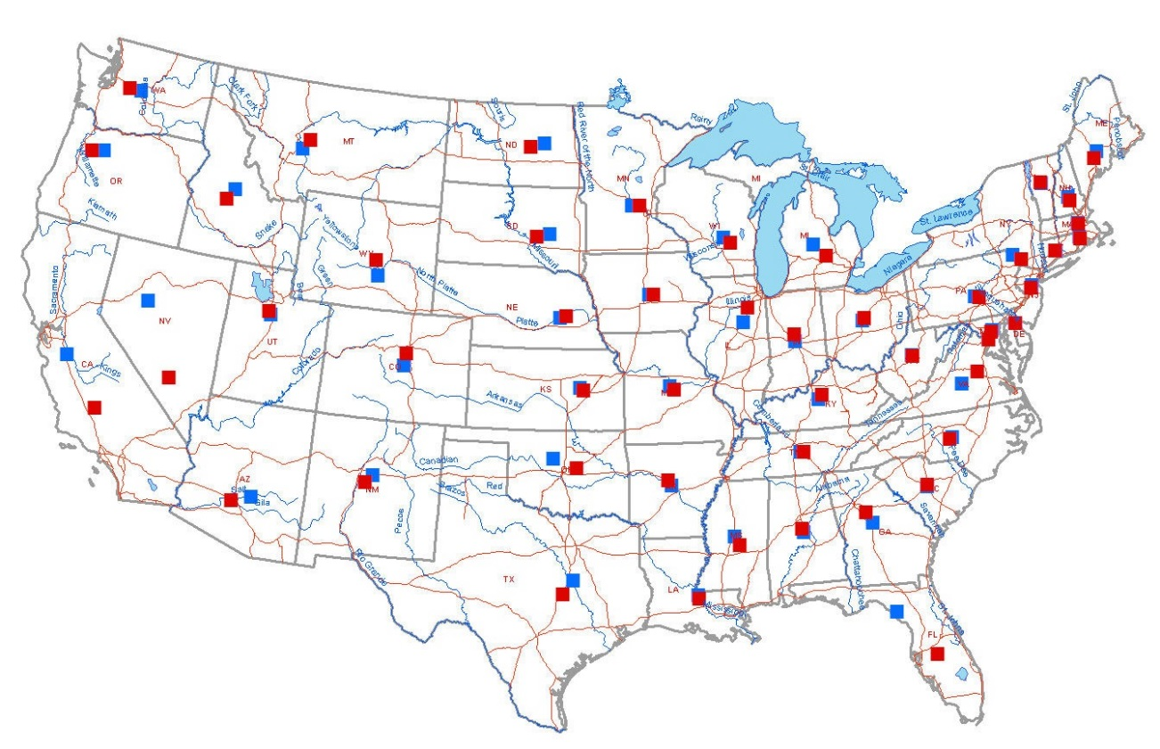
Analyzing Centers of Population
Analyzing the mean center of population by state, 1900-2010.
Population Centers by state map
Population Center mapArcGIS Online
1900 mean center
2010 mean center

Slide 22
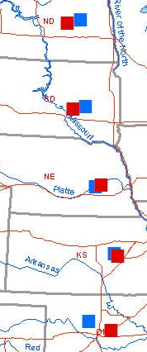
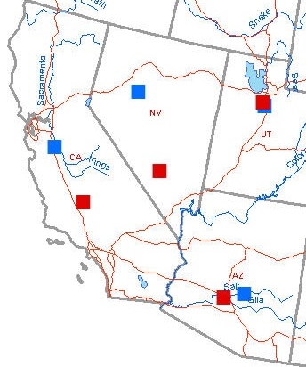
Southwestern States
Great Plains
1900 mean center
2010 mean center

Slide 23
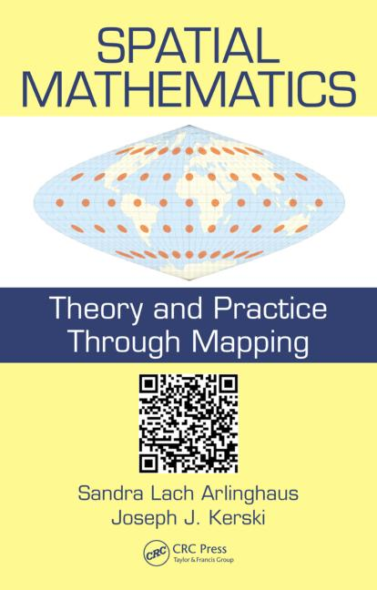
For further investigation:
Spatial Mathematics: Theory and Practice Through Mapping

Slide 24
Related Reading
Arlinghaus, Sandra L. Klein 4-Group: Beth Olem Cemetery Application. Solstice: An Electronic Journal of Geography and Mathematics. Vol. XXIV, No. 2, 2013.
Arlinghaus, Sandra L. and Kerski, Joseph. 2013. Spatial Mathematics: Theory and Practice through Mapping. Boca Raton: CRC Press.
Classical group theory texts
  G. Birkhoff and S. Mac Lane, A Survey of Modern Algebra. New York: Macmillan, 1941.
  Marshall Hall, Jr. Theory of Groups. New York: Macmillan, 1959.
  I. N. Herstein, Topics in Algebra. New York: Wiley, 1964.
Kerski, Joseph J. Off the Beaten Path: A 3D Scene for the Poles of Inaccessibility. Esri Education Community blog.
Kerski, Joseph J. 2010. Population Drift. ArcUser. Spring 2011.
Wikipedia.
  M. C. Escher
  Rigid Motions, Euclidean Group
  Symmetriein Quantum Mechanics
  Tesselation
  Category Theory

