Slide 1
Google Earth Day www.a2gov.org/data
Systems Planning
2011

Slide 2
3D and 2D mapping
3D model of city buildings
www.a2gov.org/data
Trees
eTRACKiT
MY PROPERTY
Solar
Stormwater
Citizen Requests
Green Energy
Park Capital Improvements

Slide 3
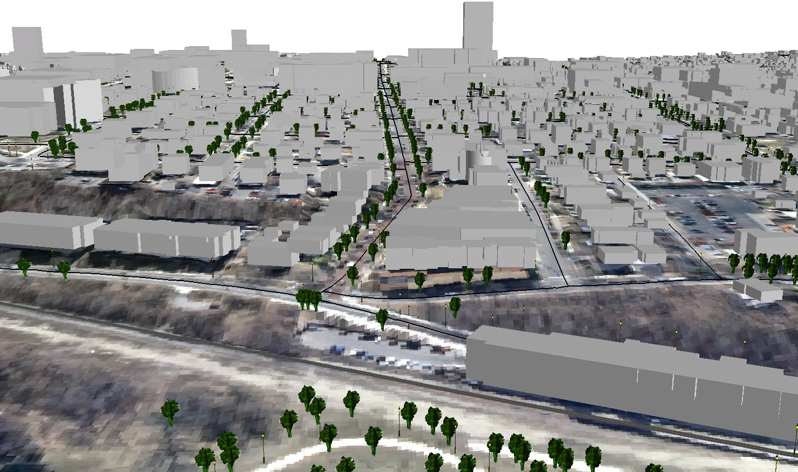

Slide 6
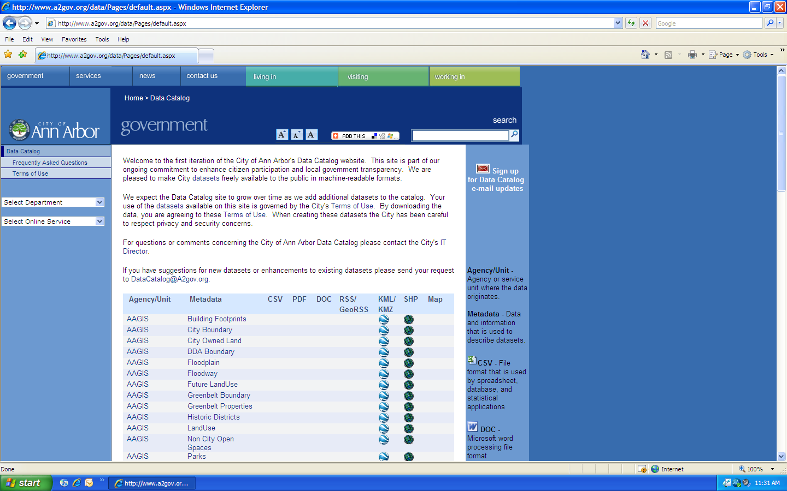
www.a2gov.org/data

Slide 7
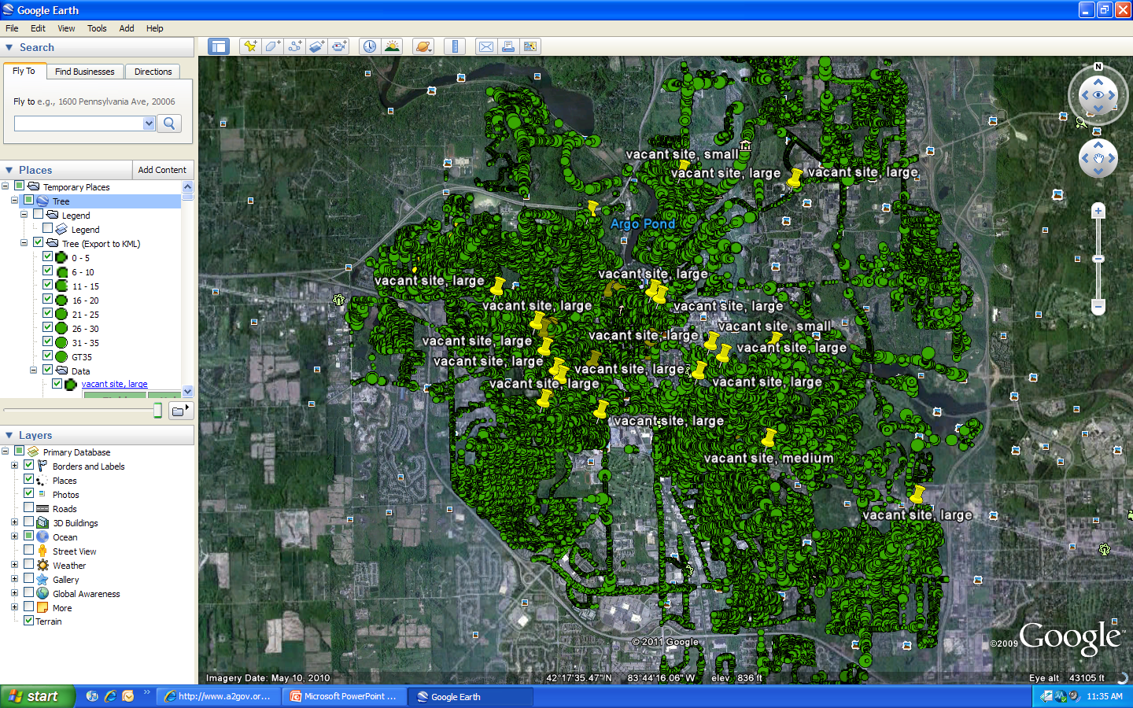
Street trees

Slide 8
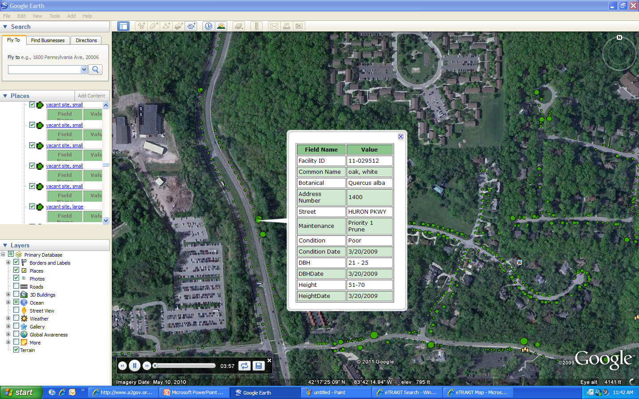
Tree Data

Slide 9
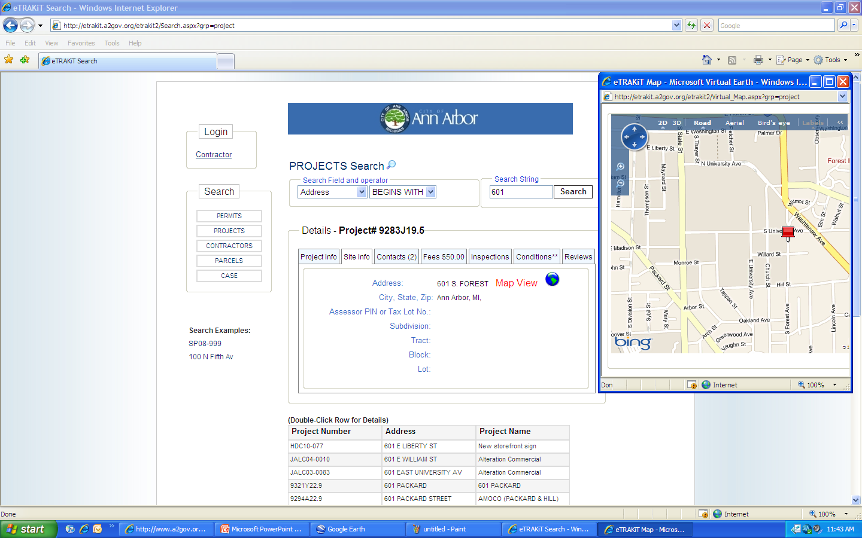
eTRACKiT

Slide 10
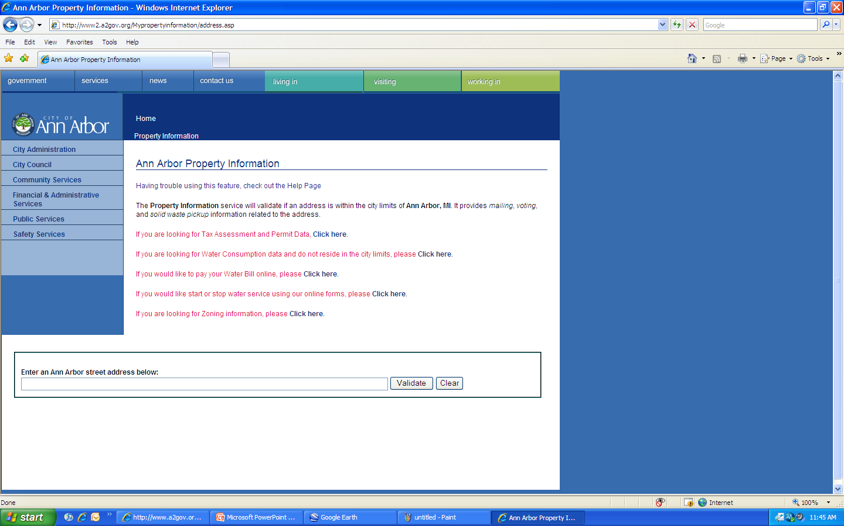
My Property

Slide 11
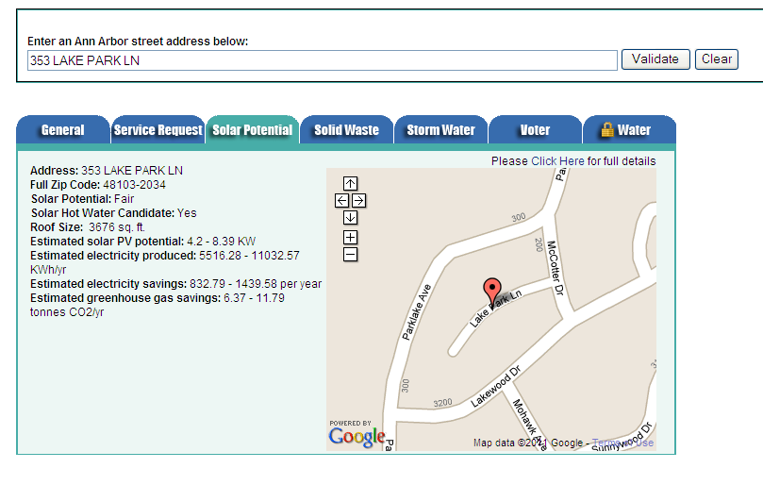
Solar Potential

Slide 12
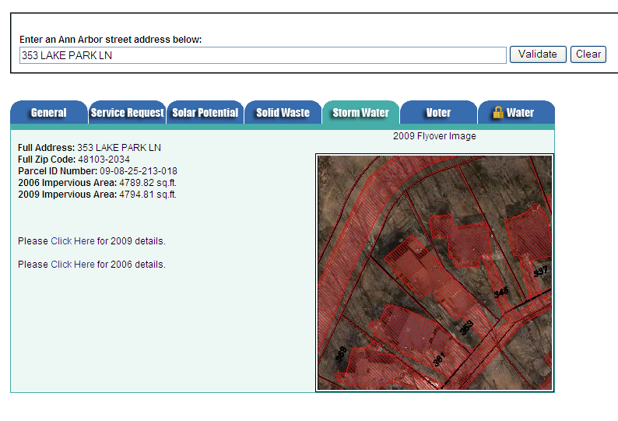
Stormwater

Slide 13
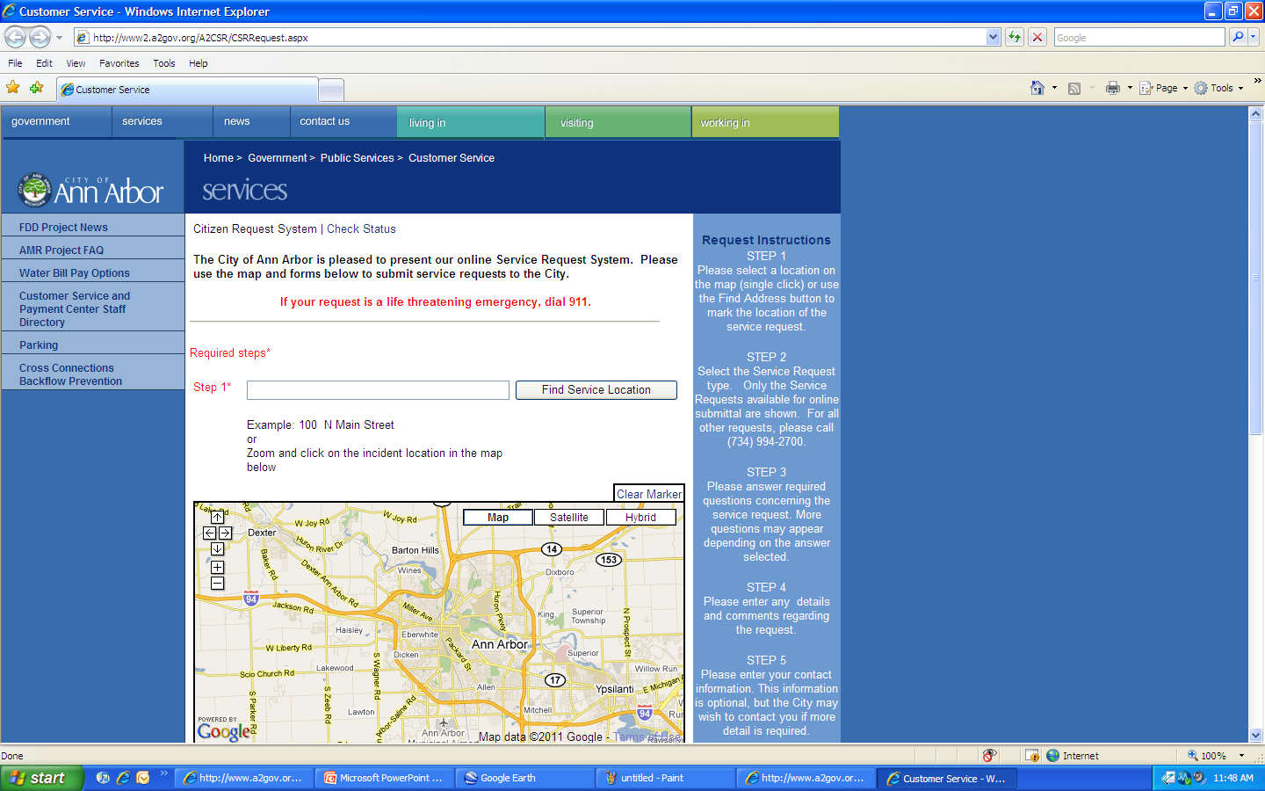
Citizen Requests

Slide 14
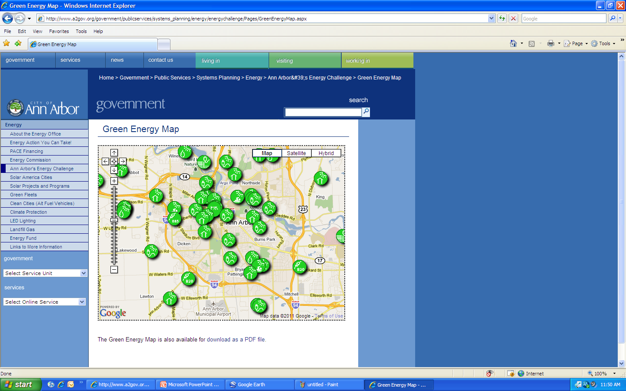
Green Energy Map

Slide 15
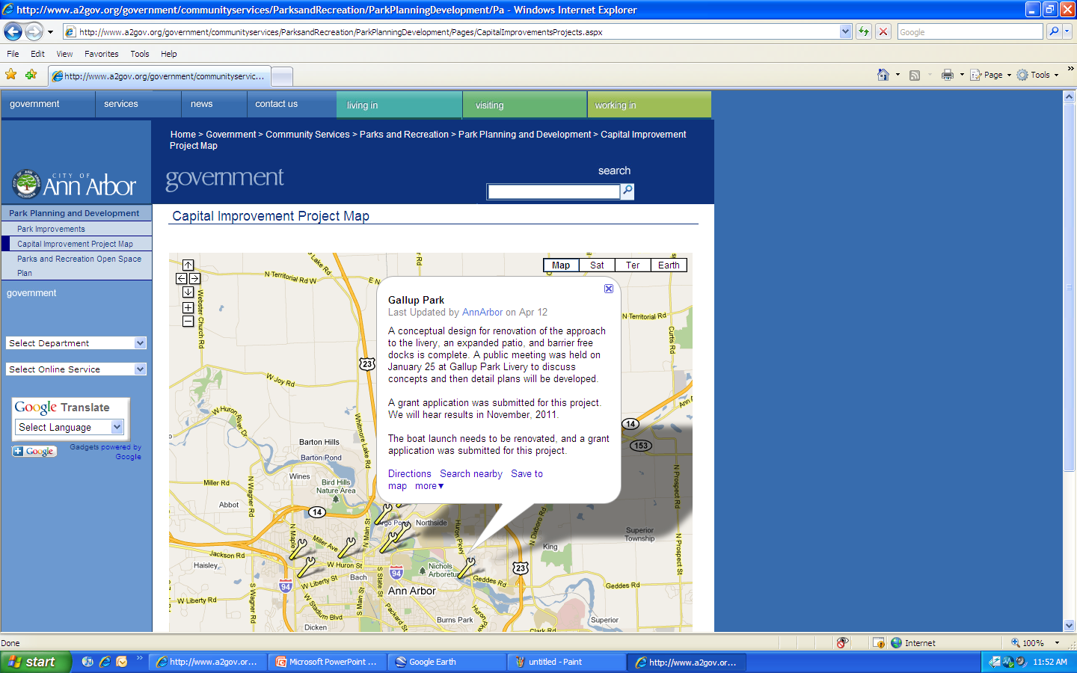
Park Capital Improvements

Slide 16
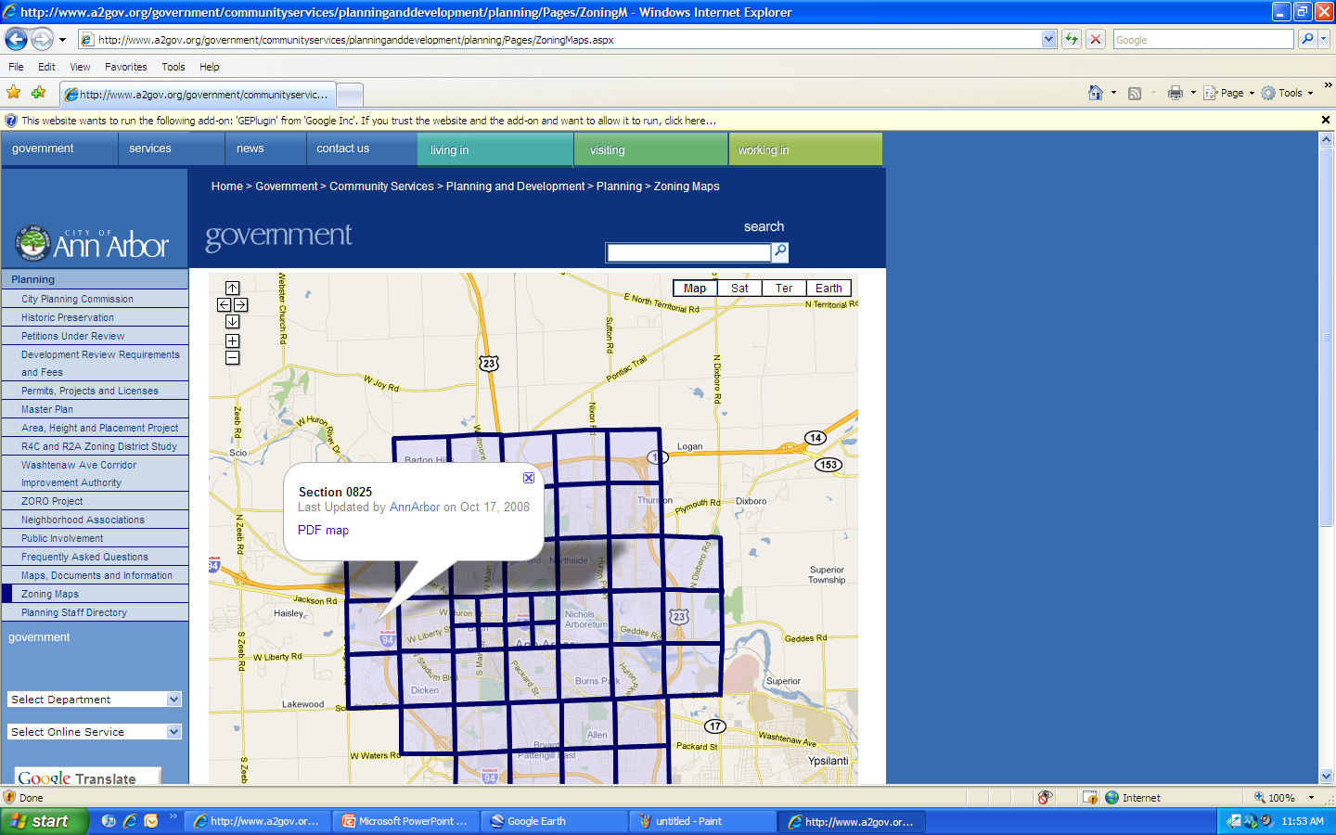
Zoning Maps

