Slide 1
The Perimeter Project: Cemetery Zoning Used in Fragile Lands Protection-- Part III
Sandra L. Arlinghaus and William E. Arlinghaus
Presented at the
Second Annual GooglEarth Day Conference
Held in 2024 Dana Building
School of Natural Resources and Environment
The University of Michigan
April 22, 2010
To appear in Solstice: An Electronic Journal of Geography and Mathematics. Forthcoming in Volume XXI, Number 1, June 2010 (copyright retained by the authors).

Slide 2
Conceptual Overview: US Burial Practice
Conventional US burial practice involving chemical embalming and cement vaults damages the environment.
Scattering of ashes following cremation removes this difficulty but offers little constructive to the environment. Indeed, cremation by fire adds to the carbon footprint.
Green or natural burial removes these difficulties and may offer even more to the environment when done with care.
Scattering and Green burial approaches offer few means for memorialization. The Internet does so, when website memorials are trust-funded in the same manner as conventional cemeteries. Such memorialization has the added advantage of integrating far-flung family members in virtual space.

Slide 3
Memorialization: Zoning Implications
One might employ online memorials as a means to encourage more environmentally-sensitive burial practice.
Furthermore, with such encouragement in place, one might turn the idea around and attempt to protect fragile lands by acquiring cemetery zoning for them (which is the most difficult to change--zoning can be a moving target that responds to the political whim of varying administrations).
An initial approach to protecting broad swaths of land might be to endow existing sets with cemetery zoning and dedicate parts of the existing land use to cemetery use—as a “mixed use development” in much the way that condos are clustered on one area of a parcel, all zoned for condos, while a large portion of the parcel is dedicated to passive parkland.

Slide 4
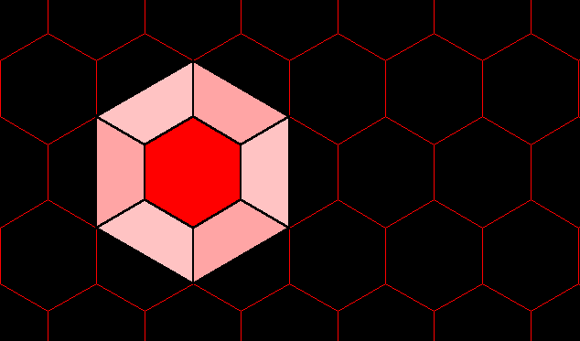
Mixed Use Visualization:
Abstraction of Seamless Integration of Disparate Landuse Types

Slide 5
Environmental Rationale: Cemeteries and Golf Courses: Creative Mixed Use Contemporary environmental science views golf courses as difficult uses of large tracts of land. Use golf course non-playing area, endowed with restrictive cemetery zoning, as a site for green and natural scattering or burial of remains. Integrate the uses now; as the baby-boomer population ages, the need to expand the cemetery land holdings may well increase dramatically. Instead begin now to use portions of existing large tracts (golf courses) for burial; natural burial may enhance the vegetative cover and make these grounds a showplace for variety in environmentally sound gardening principles

Slide 6
Golf courses: EPA data (http://www.epa.gov/oppefed1/models/water/golf_course_adjustment_factors.htm )—15,827 golf courses (March 2003) range in size from 110-200 acres. Consider 150 as a middle ground (many, but not urban or resort, 18 hole courses range in size from 150-200 acres). That would put total acreage at: 15,827 * 150 = 2,374,050 acres.
Cemeteries: The attribute table in ArcGIS 9.1.3 shows 126,166 cemeteries. We do not know the total acreage in cemeteries.
If the total acreage in golf courses equaled the total acreage in cemeteries, then the average cemetery size would be: 2,374,050 / 126,166 = 18.82 acres. Arlington National Cemetery is 254 acres and has 300,000 interred. (http://en.wikipedia.org/wiki/Arlington_National_Cemetery )
How big is the average cemetery? A typical cemetery plot is 4 feet wide by 10 feet long (40 square feet). Suppose a typical cemetery buries 365 people per year. That’s 14,600 square feet of land per year, excluding land for landscaping, interior surface routes, maintenance areas, houses for staff, chapels, and so forth. Over the entire country (126,166 cemeteries) that’s 1,842,023,600 square feet (42,287 acres) per year devoted to burial.
Over 50 years, that’s 2,114,352 acres of land in burial (only). Reuse of existing burial sites may take place, in many states, after 50 years. Cemetery requirements on land use are more restrictive than are others.
As the baby-boomer population ages, there may be more need, in the short run, for cemetery land.
It appears reasonable to assume that the acreage in cemetery use is similar in size to the acreage for golf courses (there are many more cemeteries than golf courses):
Entire 18 hole course: 2,374,050 acres – Burial sites only: 2,114,352 acres

Slide 7
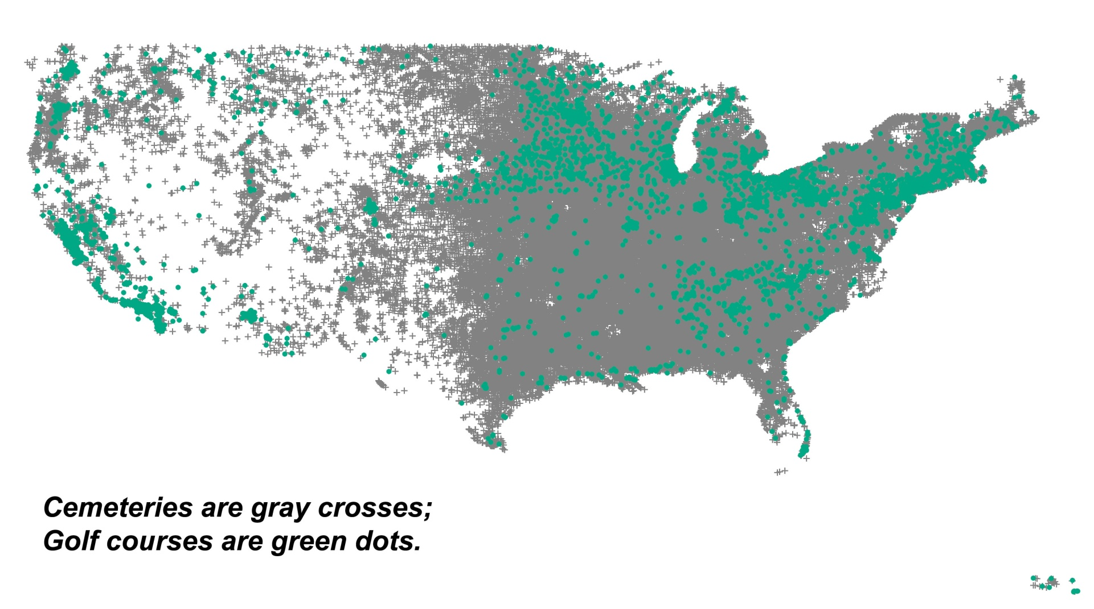
There are more cemeteries than golf courses.

Slide 8
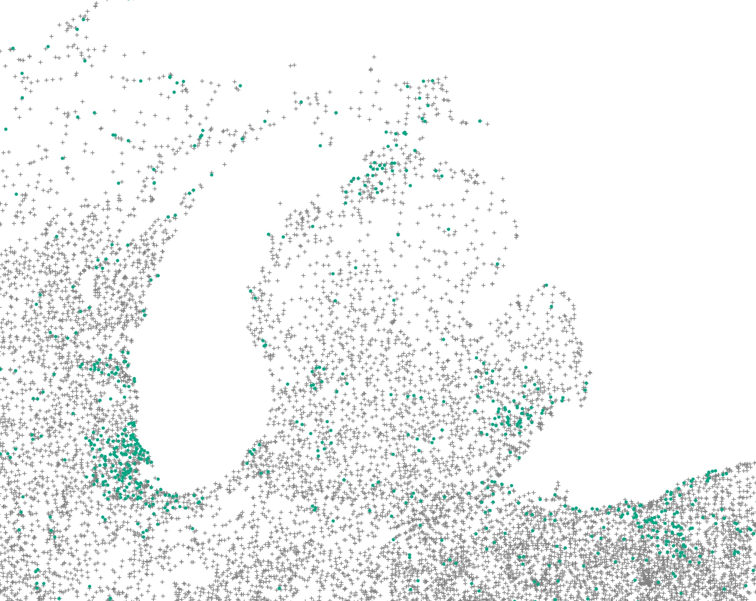
A closer look: the case of Michigan

Slide 9
However, the spatial distribution of cemeteries is more widely scattered than is the more clustered distribution of golf courses.
A tempting thought is to consider these as two sets and attempt to maximize their intersection in order to minimize impact on the land.
Currently, these sets are disjoint (have empty intersection), both in terms of
Actual use.
Zoning.
To create a non-empty intersection
Change golf course zoning to cemetery zoning (the more restrictive zoning).
Zone the entire golf course as “cemetery” use, but imagine the cemetery use clustered away from the fairways and such—much as condo complexes might cluster residential units in one area and parkland in another.
Use existing golf courses for recreational use as well as for cemetery use that offers constructive environmental input.
Scattering of cremation ashes in selected, protected areas.
Scattering of resomation (water extraction) waters in selected, protected areas.
Natural whole-body burial (no dangerous embalming fluids, steel, or concrete) in selected, protected areas.
At the outset, existing golf courses rezoned as “cemetery” might serve the needs of some urban and resort populations. Future planning might base locational decisions on some of the data shown in the maps above.

Slide 10
Mixed Use Visualization:
Cemetery use on Golf Course

Slide 11
Burial Alternatives: Cemeteries and Golf Courses Comments from William E. Arlinghaus, B. A. General Manager, Chapel Hill Memorial Gardens, Grand Rapids President, The Compass Group Cremation Resomation Natural Burial Legal, Perception, and Related Issues

Slide 12
Memorialization: Cemeteries and Golf Courses When remains are integrated into the environment, rather than compactly stored in a vault or similar object, memorial needs may change…no longer are there marble monuments clearly and directly associated with individual remains. The Internet offers direct, individual memorialization opportunity that becomes permanent when website maintenance is trust-funded as is traditional monument maintenance.

Slide 13
Pilot Project: Chapel Hill Memorial Gardens Grand Rapids, Michigan
A sample of the more than 300 online memorials appears in the trust-funded Virtual Cemetery of Archived Memorials Online (AMO). A small set of AMOs has been online since 2003 (and trust-funded since 2002)
The Pilot Project at Chapel Hill began January 1, 2009 as the first time integration of AMOs with an actual cemetery occurred
That project has generated hundreds of new Basic AMOs as part of the standard burial package.
Cemetery maps and actual lot locations, along with trees and 3D objects and memorial text and images are located in Google Earth.
http://www.ArchivedMemorialsOnline.com

Slide 14
Virtual Cemetery Visualized Using Google Earth and Google SketchUp
Associated cemetery maps are embedded on the Google globe
Balloons mark burial location
AMOs popup when clicked on within the Google Earth browser interface
Associated features add extra reality
Mausoleum buildings created in SketchUp
3D trees found online
Street views interior to the cemetery from field photographs—useful for site-benchmarking, as well.
Special events visuals of various kinds

Slide 16
Pilot Project: Planning of Memorialization
The materials already present in the Virtual Cemetery range in complexity from “basic” to “simple.” As there is a wide-range in traditional physical cemetery memorialization so too might there be in virtual memorialization.
Advance planning enables one to create an AMO while alive (where in this case “AMO”=“Active Memory Online”).
Simpler forms of this file might involve links to existing persistent files elsewhere on the internet.
Other more complex forms might involve the creation (by the individual) of a complete biography, in GEOMAT or other format, to be entered into the Virtual Cemetery at the appropriate time.
Sample ‘GEOMAT’ personal biography (in progress),
derivative of work over a period of a few years with Ann E. Larimore and Rob Haug: http://www.MyLovedOne.com/GEOMAT/Sandy/

Slide 17
Directions…Memorialization
Beyond the Basic AMO
Custom AMOs with added visuals or videos—possible associated contacts: PWilliams productions
Facebook—Personal Memorialization Wall,
in association with Jen Osburn, CHMG
Teaching of new staff and consumers
Handbook in progress
Online materials in progress

Slide 18
Directions…Related Pilot Projects
Extensions to other existing cemeteries might offer opportunities to learn more about database management and related issues
Municipal extension might involve
Matt Naud, City of Ann Arbor Environmental Coordinator
Roger Rayle, CSF Research Associate and Chair of Scio Residents for Safe Water
Allen Creek Greenway or other citizen groups
Regional extension might involve various groups, such as golf courses, in association with land acquisition and zoning issues.
The Memorial? Pebble Beach, Neptune Society, as well?
Contact with a variety of local and regional golf course and cemetery experts.
Work with software companies to integrate TV walls in golf course clubhouses to display internet archived memorials.
Land acquisition tied to locally unwanted land uses, such as water tower sites.
Publication of results in online and conventional media.
International extension to developing nations and database management issues will involve DevInfo and Kris Oswalt (CSF).

Slide 19
Directions…Connections and Feedback
In cremation it is necessary (lest the crematorium explode), and in green burial it is desirable, to remove pacemakers and other metal from the body. We have necessary contacts, from funeral homes, to handle such removals.
Kim Eagle, M.D. and Timir Baman M.D. (Cardiovascular Center, University of Michigan) have a pacemaker recycling project in progress in which pacemakers will be recycled in hospitals in developing nations.
When hospitals and online legal forms are ready from UM, we are prepared to supply pacemakers.
As both projects evolve, there may be further opportunity for synergistic effort in the international arena.
Possible discussions with others in the fields of golf course management and architecture, natural burial, and mortuary science—note audience members with such background.

Slide 20
Many thanks to: The School of Natural Resources and Environment for room use; Kris Oswalt of Community Systems Foundation (CSF) for software support; Google Earth for a software donation to CSF. CSF archive http://www.csfnet.org Information related to this topic http://www.MyLovedOne.com http://www.ArchivedMemorialsOnline.com http://www.ChapelHillGrandRapids.com

