Slide 1
Antique French Potato Steamer
From the Alma Lach Copper Collection
Acknowledgments
Ann Arbor Chapter Les Dames d’Escoffier, Alma Lach (deceased), Sandra Lach Arlinghaus, William E. Arlinghaus (Affiliate Member) Antoinette Benjamin, Linda Powell, and Donna K. Tope.

Slide 2
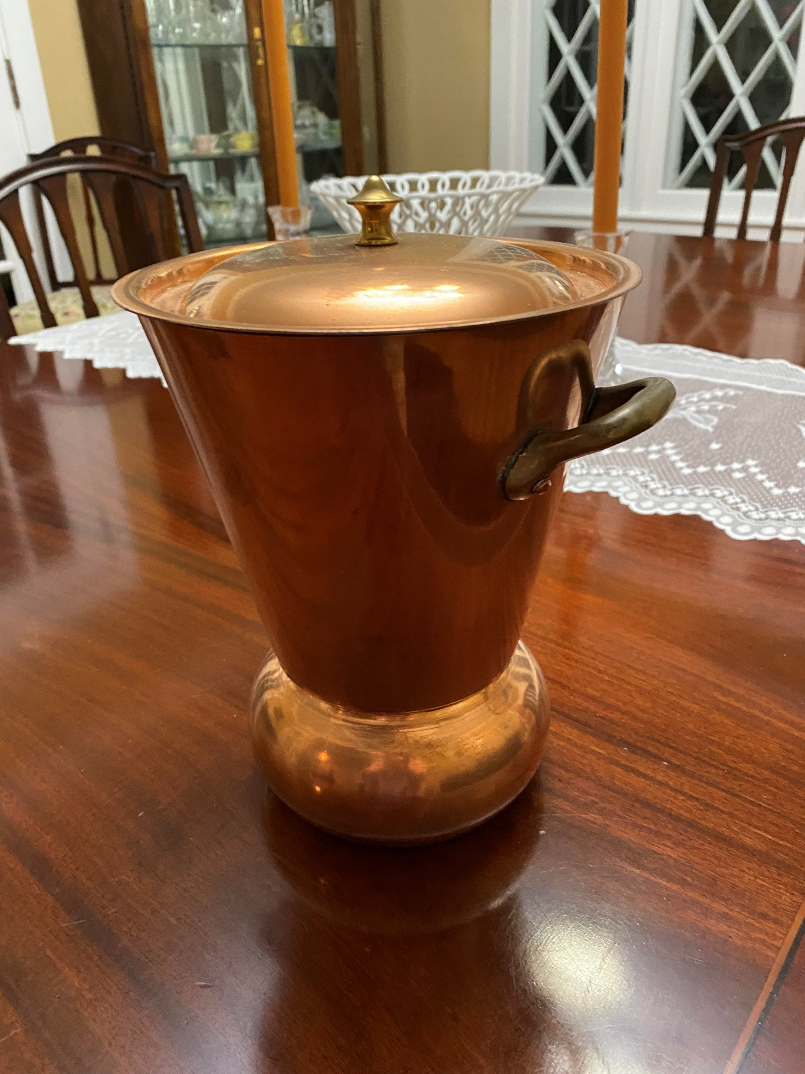
Take note of the circular cross section where welding has taken place.
The copper potato steamer has a lid, two opposing brass handles, and a base. The curved base is welded to the slanted upper part.
Alma purchased it in the 1950s in France. She used it occasionally at dinner parties she gave in Chicago.

Slide 3
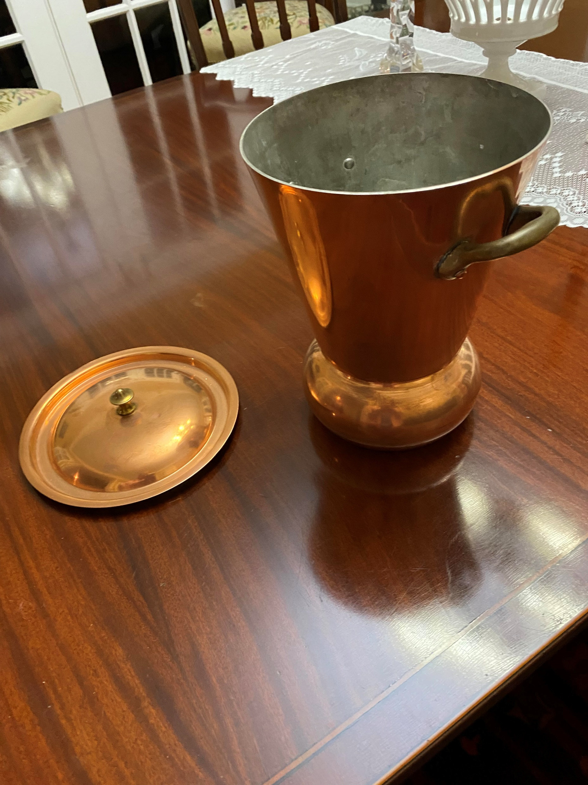
Remove the lid. What remains is a single solid piece.
Dimensions: about 8.5 inches from the table to the circular edge of the truncated cone; 6.25 inches diameter across the top. Manufacturer, perhaps Mauviel.

Slide 4
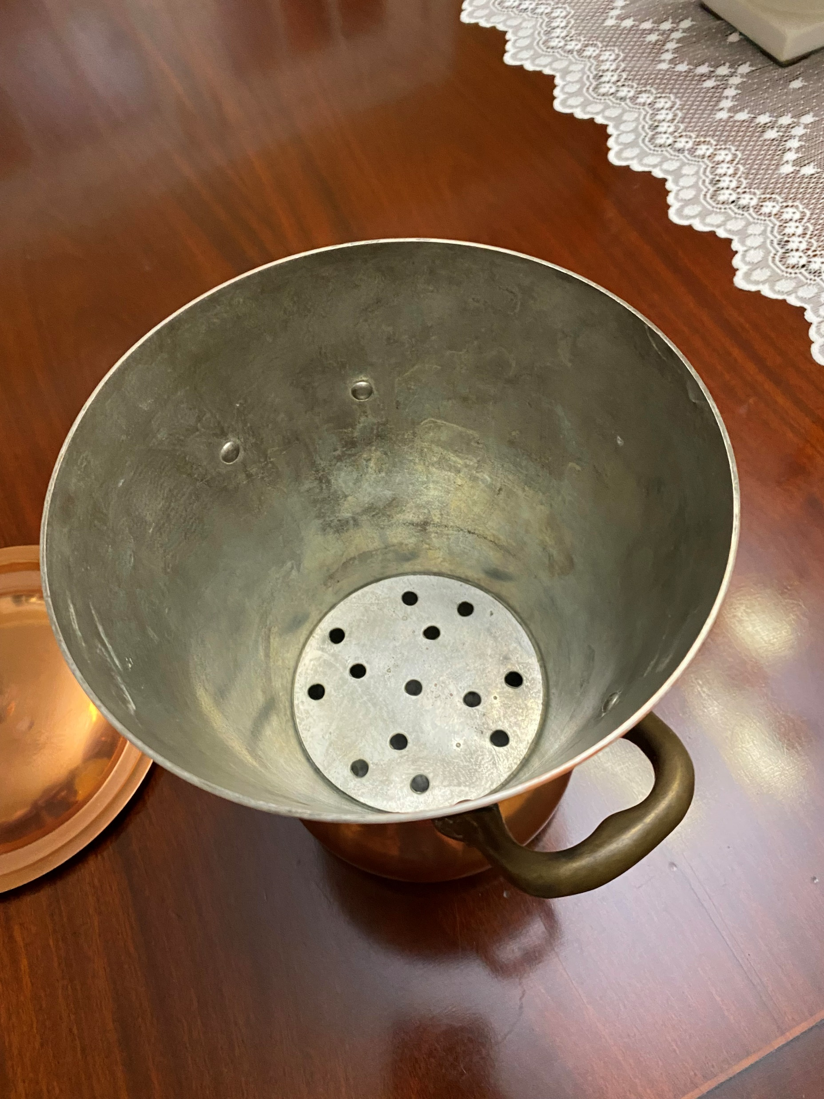
Notice the circular, perforated plate inside the steamer. The plate is loose and can be removed.
It is used to separate the potatoes from the water below it.

Slide 5
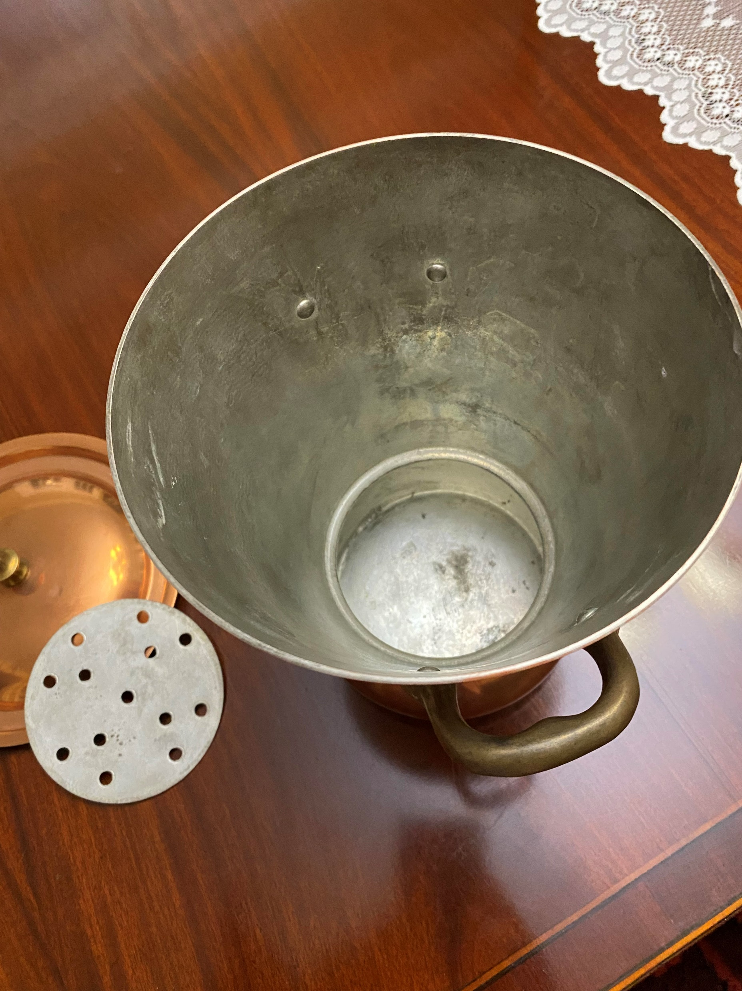
Remove the circular plate.
Then, fill the volume below the plate with water.
Do not allow the water to come up over where the plate was: the circular cross section where welding is.

Slide 6
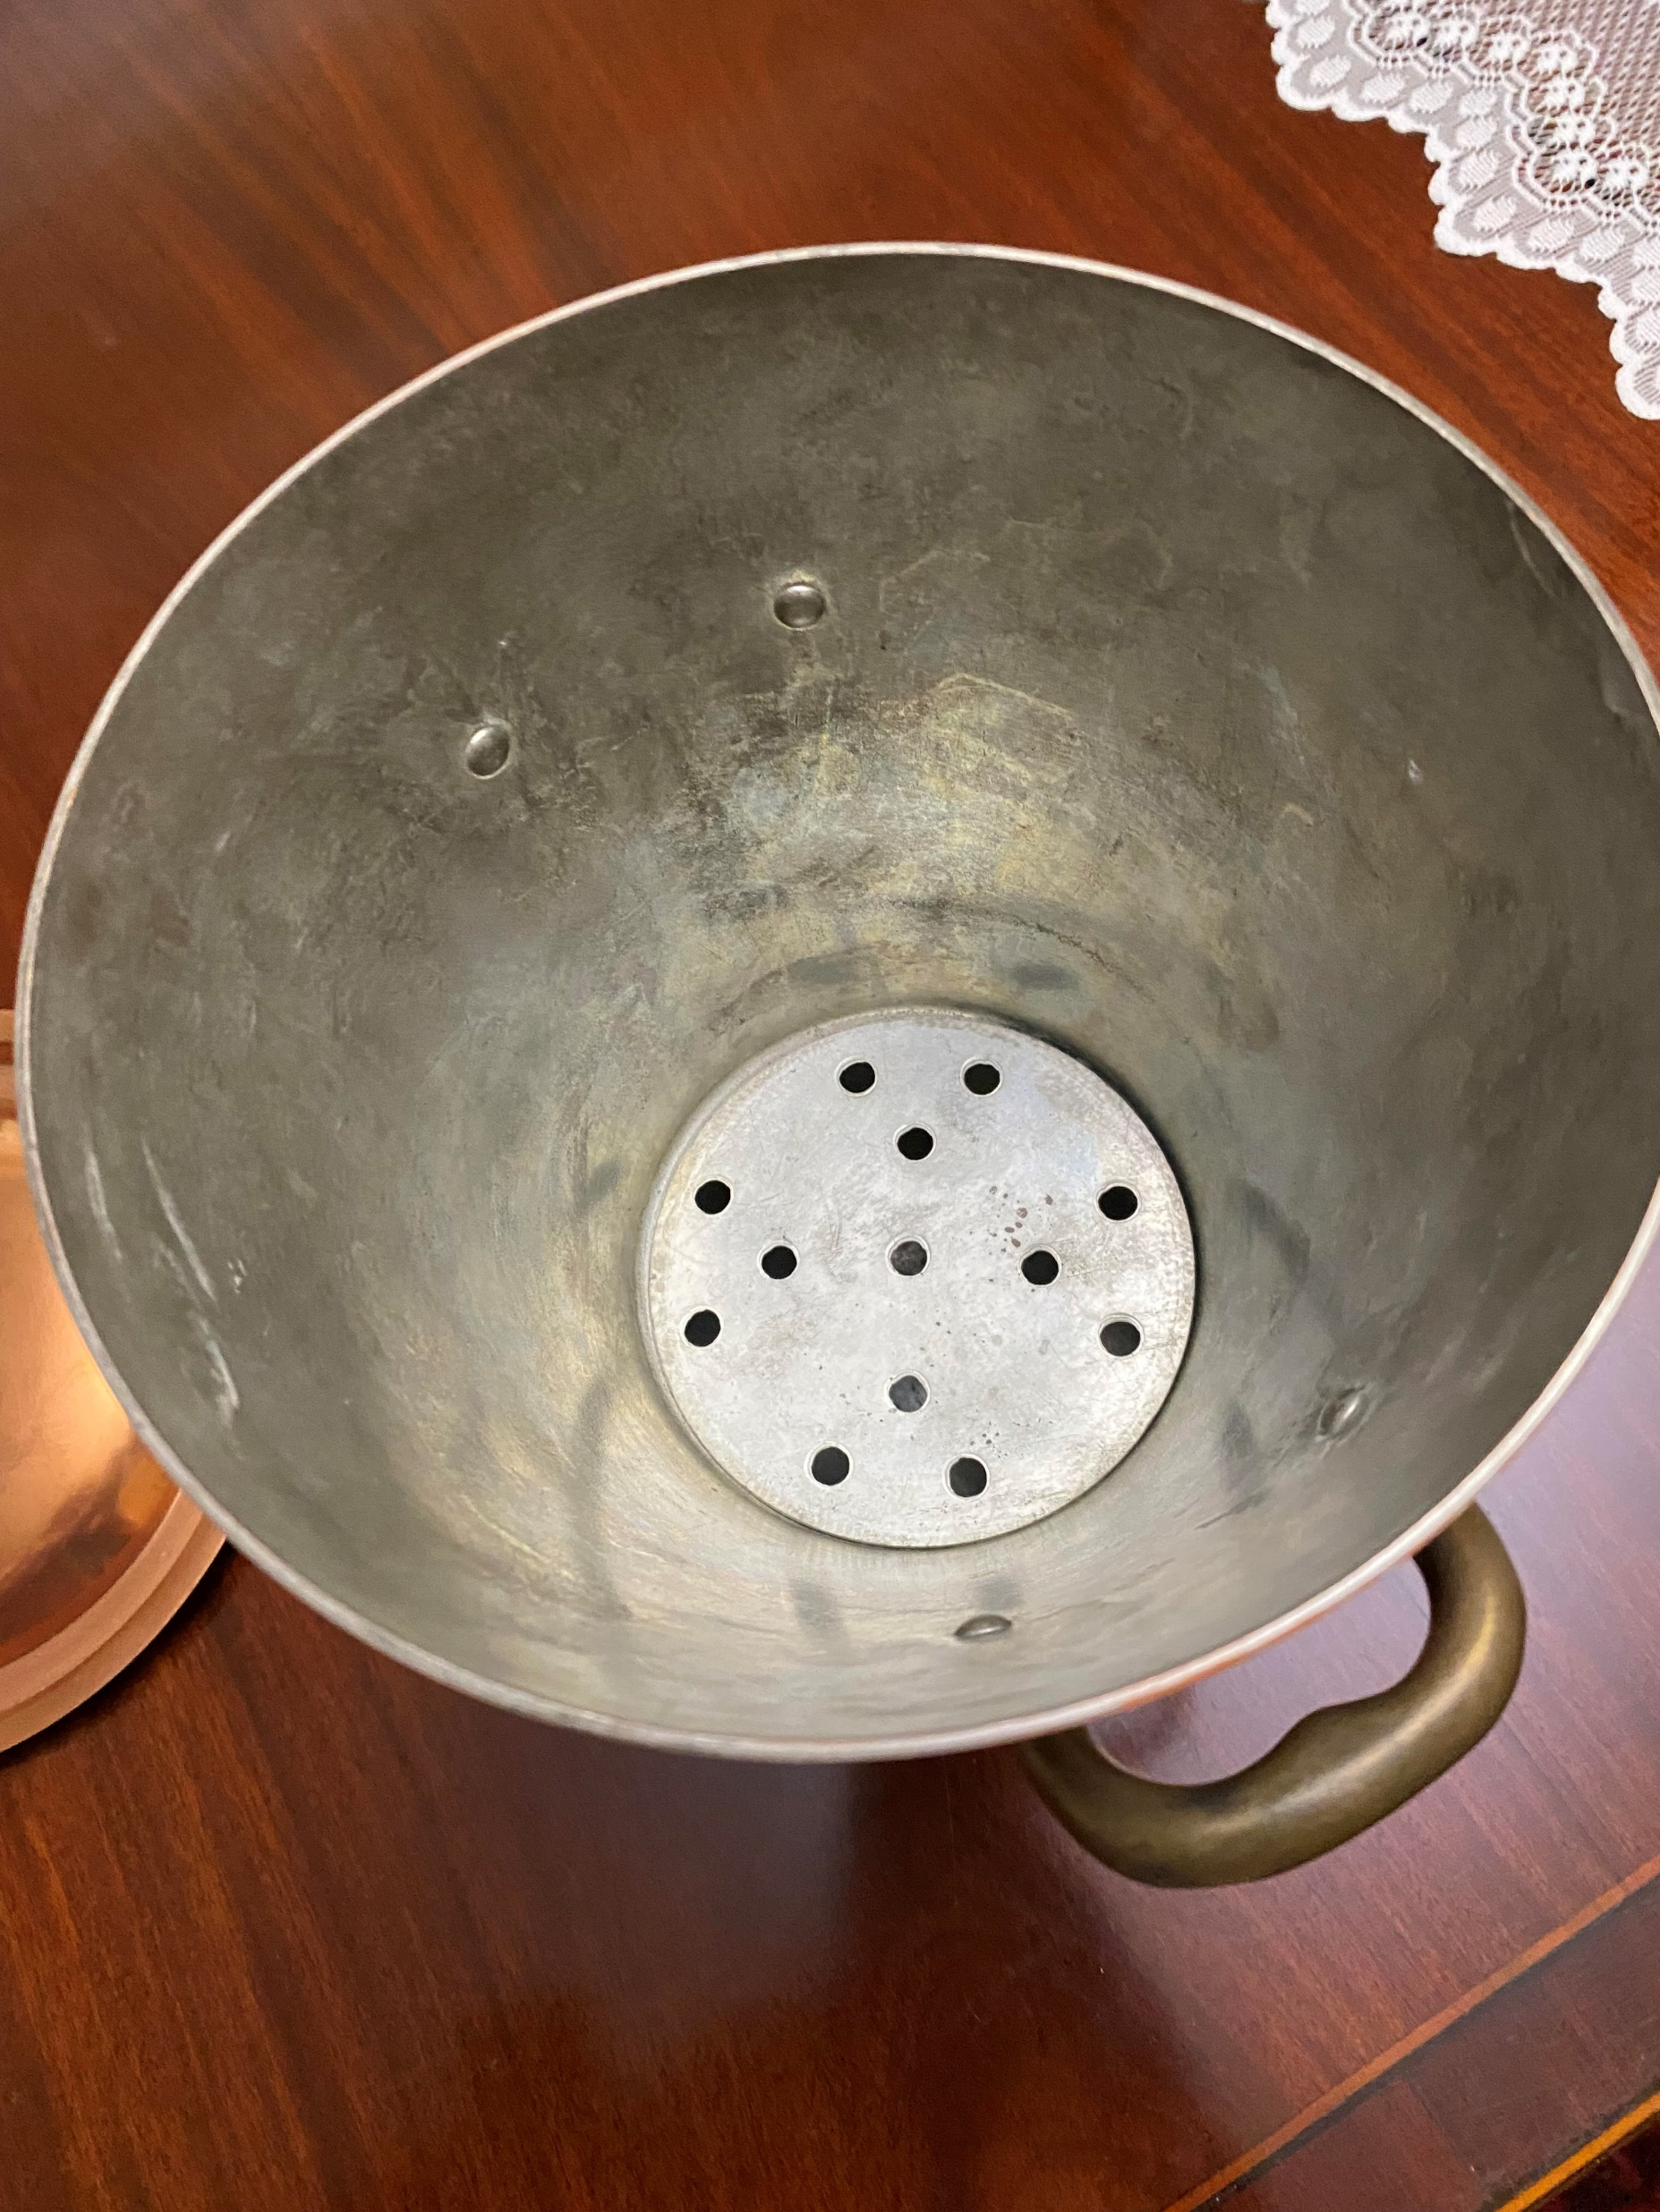
Replace the circular plate. Make certain it does not touch the water under it.
Now, insert some potatoes and other vegetables (carrots…) in the steamer above the circular plate. Some vegetables might be ‘carved’ (tourne) to enhance space-packing while leaving airspace.
Minimize the contact of the vegetables with each other. Try not to allow the potatoes to lean on the slanted sides of the container. The idea is to keep plenty of steam surrounding all vegetables.

Slide 7
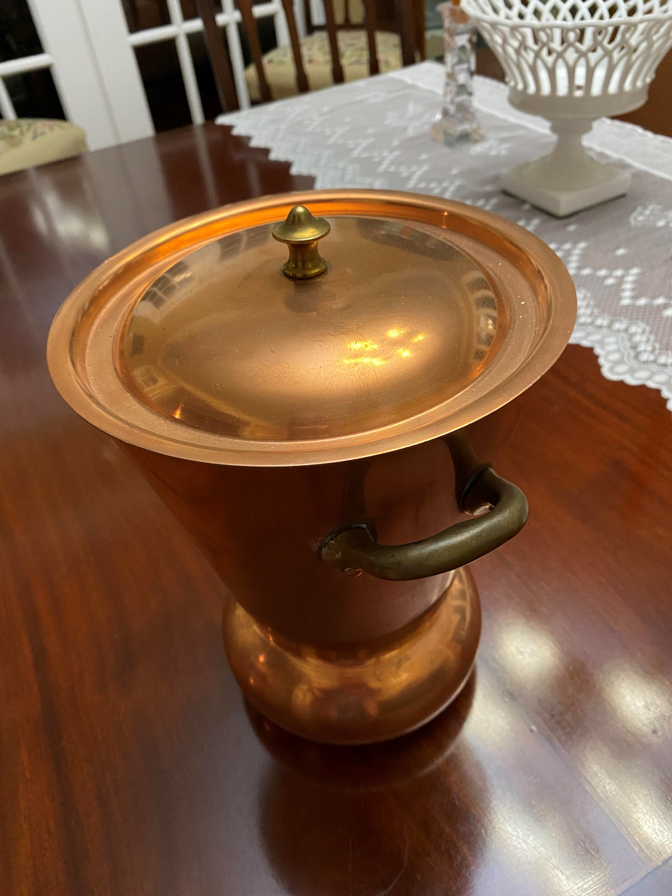
Replace the lid. Using the handles on opposing sides of the vessel, pick up the filled container and place it on the stove.
Turn on the heat; boil the water and let the potatoes and other vegetables steam until they are fully cooked.
Cook in it; then serve from it at the table (with a hot pad under it).

Slide 8
Geometry makes it work! The steamer is a closed system that cooks moist, but not soggy, potatoes. Water seldom touches the potato. Clever. Function follows form!
The water in the base boils quickly (there is not much of it).
Steam rises around the vegetables and condenses on the inside of the copper lid.
The shape of the lid guides the steam to the lid’s edge and down the slanted sides, back into the base

