Slide 1
Alma Lach Kitchen and Pantry
5750 S. Kenwood Ave. Apt. 3N, Chicago IL 60637

Slide 2
Various kitchens, as recalled by Sandra Lach Arlinghaus, Alma’s daughter.
1947 and earlier. Elmira NY. Irvine Place. Alma ran catering from her kitchen.
c. 1947. Chicago, (Hyde Park), IL. Barracks, adjacent to Billings Hospital; tiny kitchen. Propane heat.
Hyde Park. 6019 Ingleside, Apartment 802.
1949-1950. Paris, France, 96 (?) Boulevard Malsherbes, en pension with Madame Henri Bardel. Near Parc Monceau.
Hyde Park: 5529 University Avenue, small kitchen with an eat-in area.
1952-1953. Paris France, 72 Avenue des Ternes. Small kitchen, cold water only, no refrigeration.
Hyde Park: 5529 University Avenue.
1956. Paris France, 76 Rue d’Assas. Small kitchen, cold water only, no refrigeration.
1957 Hyde Park. 5529 University Avenue.
1958. Hyde Park: 5759 S. Kenwood Ave.; 3rd floor southeast corner (walk up; no elevator); kitchen remodeled; it became the Sun-Times Test Kitchen.
c. 1966. New Delhi, India. There on a Rockefeller Foundation Grant.
Hyde Park; 5759 Kenwood Ave.
c. 1969. Hyde Park: 5750 S. Kenwood Ave. Sun-Times test kitchen designation moved to this location.
Hyde Park: Shoreland; Resident Master apartment, fully remodeled kitchen designed by Alma and shown in the display case from the Regenstein Library exhibition. Lived there a few years and then returned to 5750 Kenwood.
To 2013. Hyde Park: 5750 S. Kenwood Ave.
2007-2013. Ann Arbor, MI. Nature Cove Apartments. Adequate kitchen. Also maintained 5750, but never returned.
Family: Alma Lach (deceased), Donald Lach (husband, deceased), Sandra Lach Arlinghaus (daughter), William C. Arlinghaus (son-in-law), William E. Arlinghaus (grandson); David E. V. Arlinghaus (great grandson); Edwin B. Arlinghaus (great great grandson); Adeline M. Arlinghaus (great great granddaughter).

Slide 3
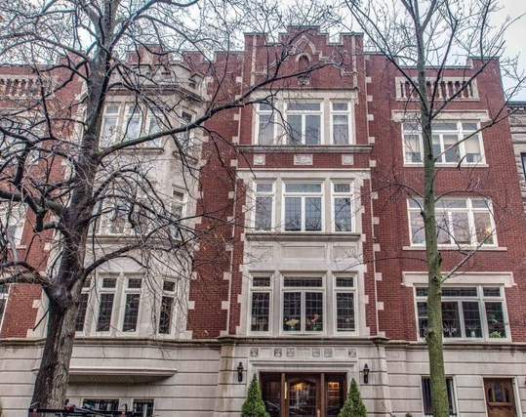
5750 S. Kenwood
Apartment of Donald F. and Alma S. Lach is 3N, on the top floor, the two sets of windows on the right (one set over the front door to the building). There are two apartments on each floor, one on either side of a central elevator, the shaft is to the left of the Lach apartment.

Slide 4
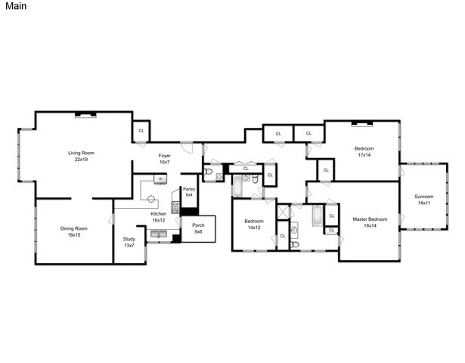
5750 S. Kenwood
Apartment of Donald F. and Alma S. Lach. Approximately 3000 square feet.

Slide 5
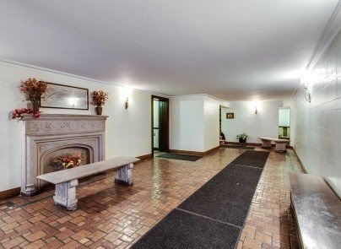
5750 S. Kenwood
Lobby to the building. Walk to the end of the long runner, turn left, and find the elevator. Take the elevator up to 3N.

Slide 6
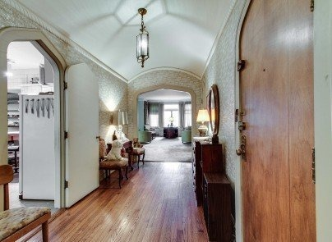
5750 S. Kenwood
Welcome to the Foyer of the Lach apartment!
Straight ahead is the living room with a view out onto Kenwood Avenue, over the front door entrance to the building.
On your left, is the entrance to the kitchen; notice the whisks hanging from the refrigerator.

Slide 7
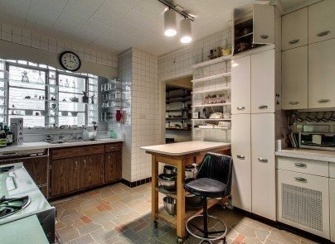
5750 S. Kenwood
Alma’s kitchen, a view from the door, taken next to the whisks observed in the last slide. Notice the doorway on the right. That will lead to Alma’s study and then to the dining room, adjacent to the living room.
Now, we take a more detailed look at the kitchen and will end that tour adjacent to the noted door.

Slide 8
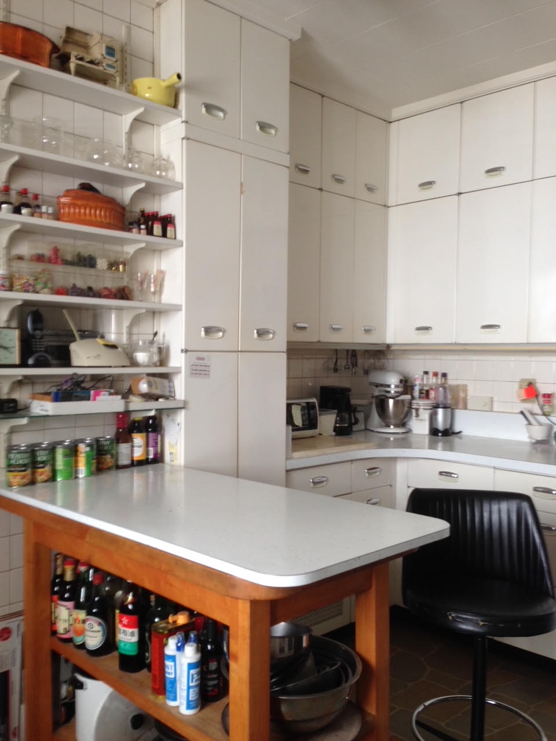
5750 S. Kenwood
General view, from door to study, around the counter corner. Note the peninsula corner sticking out into middle of kitchen. Alma sat on her chair and used this surface as her primary work station. There is a drawer in the table; she kept many sharp knives in it. She constructed this peninsula herself.

Slide 9
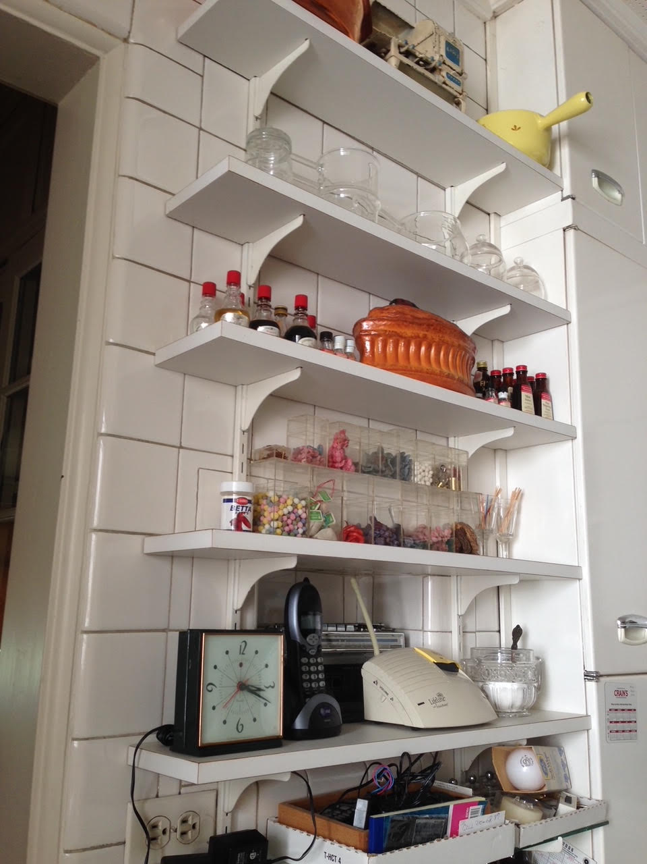
5750 S. Kenwood
Begin the tour just to the right of the door to the study. This book case over the kitchen peninsula contains a number of interesting items. The fluted casserole has a ceramic duck head on top of it. We gave that to the University of Chicago. Below the casserole are small containers with colorful items; many of these are candied flowers; the purple ones are violets. All are from flowers she grew and subsequently candied.

Slide 10
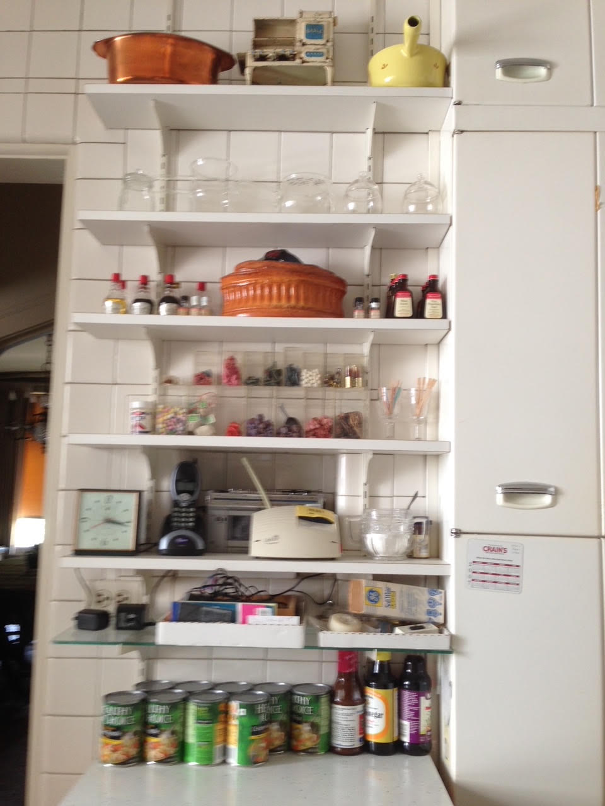
5750 S. Kenwood
The top shelf contains a copper pot (given to Alma’s neighbor Bob Epstein); her toy stove from when she was a child in downstate Illinois; and, a piece of Le Creuset cookware (given to our son).
The cabinets to the right are half of a broom closet. To the left, look through a small part of an arched doorway into the dining room (which has the other set of windows overlooking Kenwood).

Slide 11
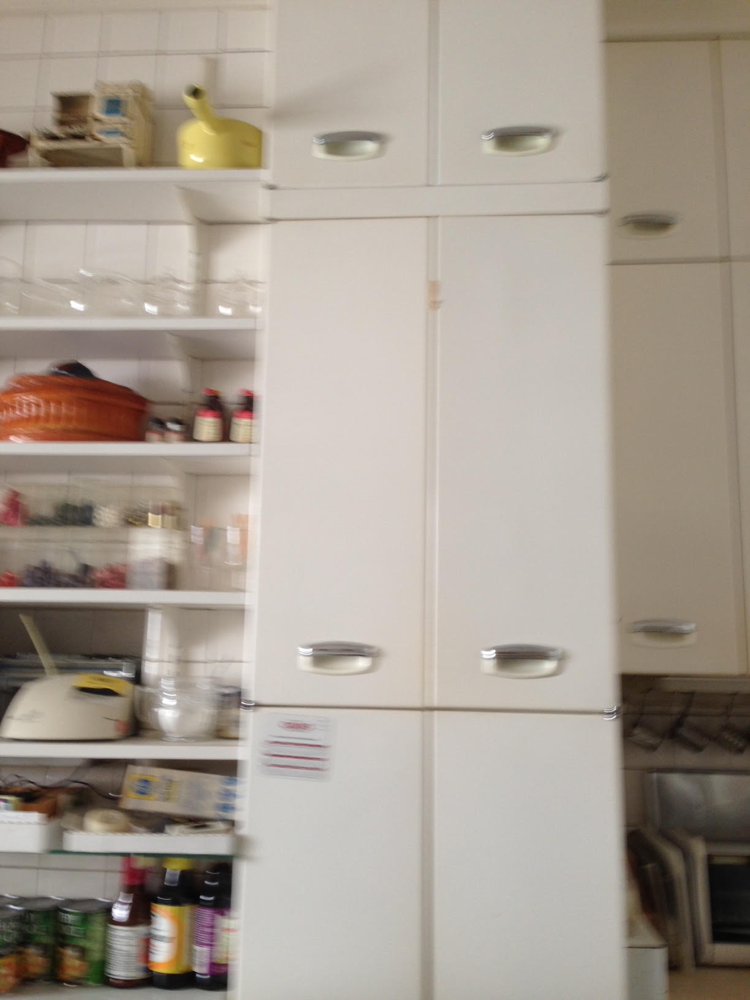
5750 S. Kenwood
Broom closet. The cabinets throughout the kitchen are metal and go from floor to ceiling.
To the right of the broom closet, the counter top begins.

Slide 12
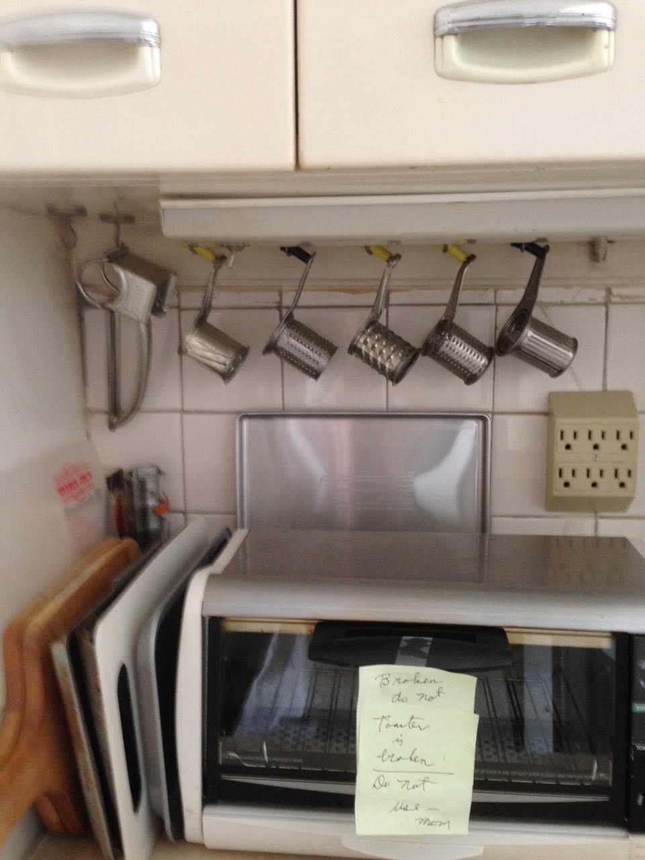
5750 S. Kenwood
Countertop applicance. There is under-cabinet lighting to illuminate things (in addition to ceiling lights). Notice graters of various sorts hanging from under the cabinet. Appliance is on the counter. Alma added electrical capability to the existing kitchen and brought in dedicated lines from the alley in back of the building.

Slide 13
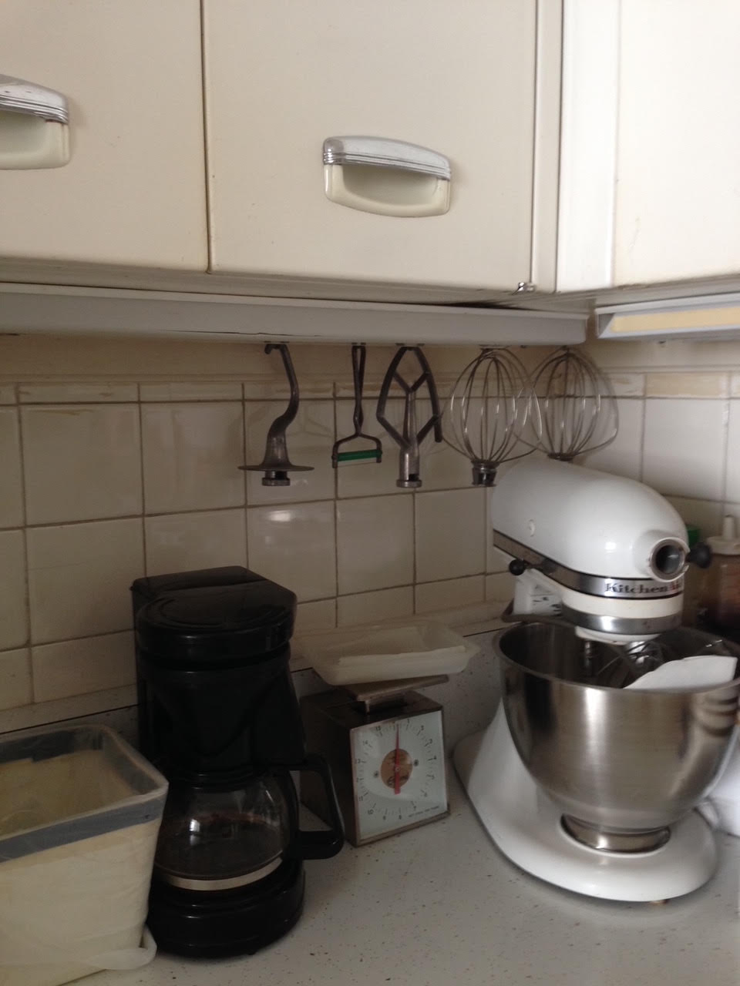
5750 S. Kenwood
Continuation of counter from last slide into corner. Mixer is situated in the corner. Note the efficient use of vertical space for easy storage and access.

Slide 14
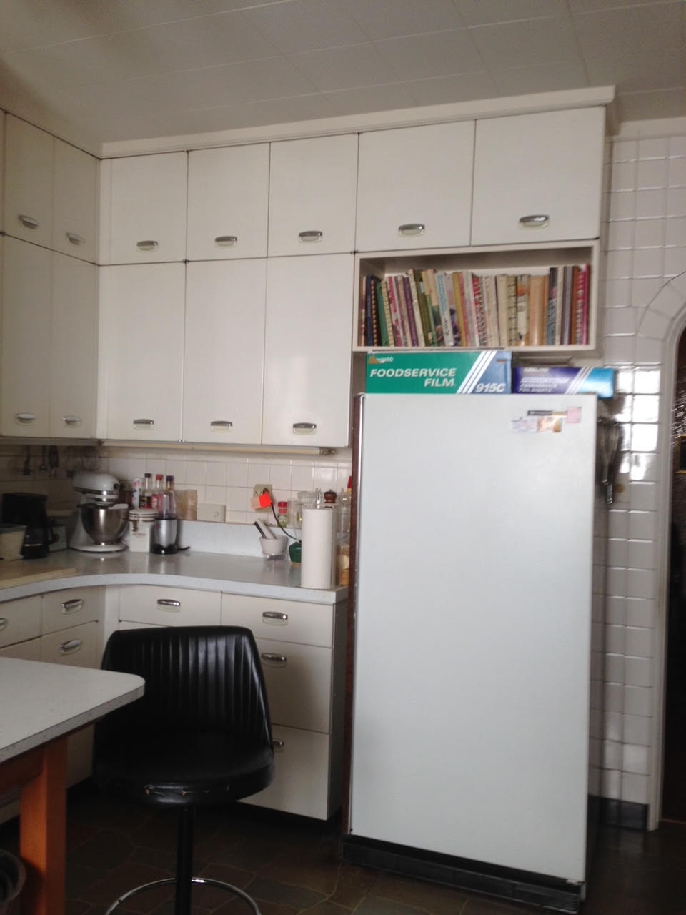
5750 S. Kenwood
General view, from the counter corner to the refrigerator.

Slide 15
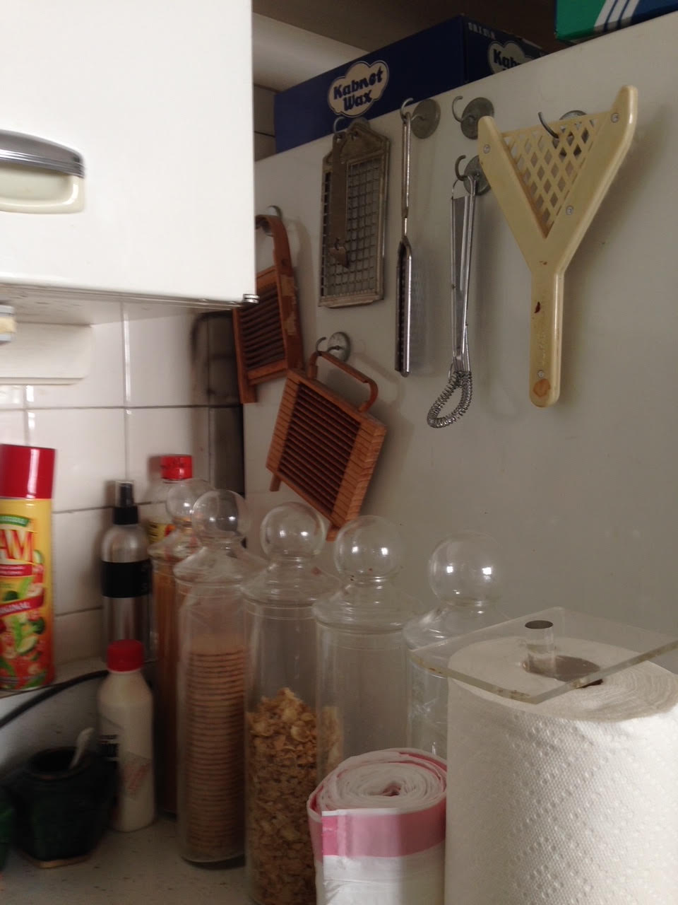
5750 S. Kenwood
Continuation of counter from last slide around the corner and to the left side of the refrigerator.

Slide 16
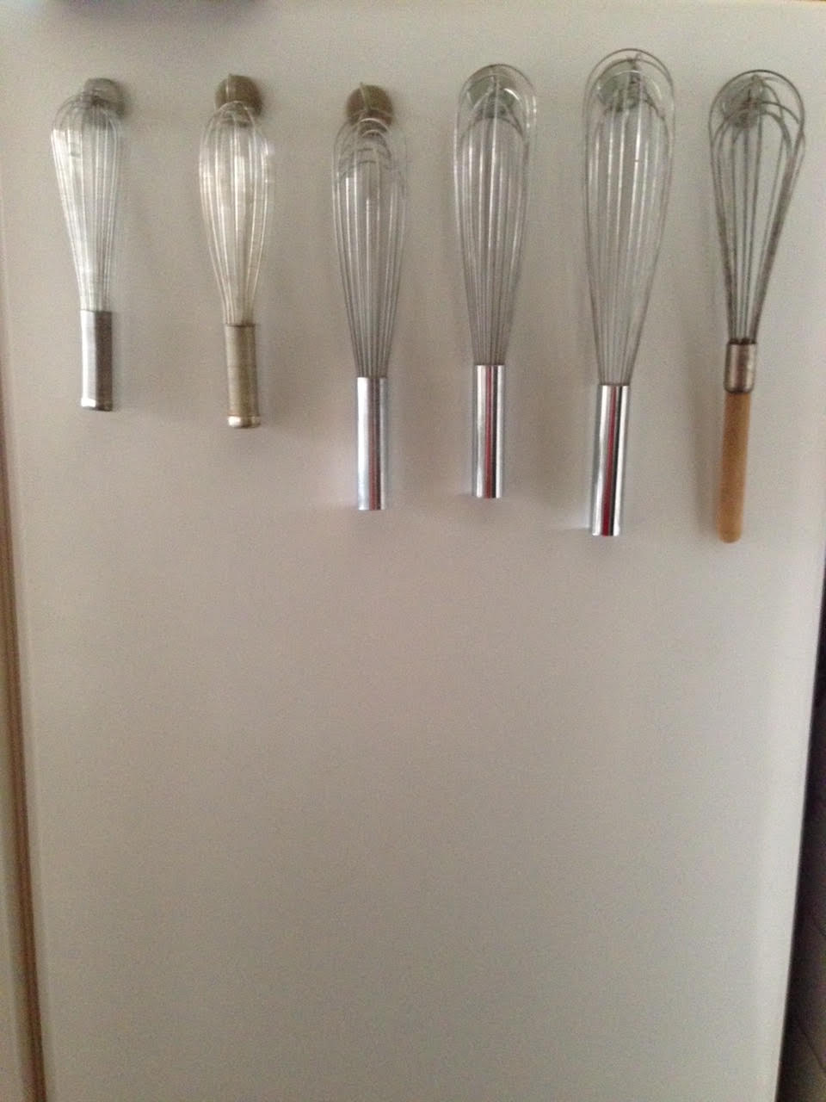
5750 S. Kenwood
Whisks hanging on magnetic hooks from the other side of the refrigerator.

Slide 17
5750 S. Kenwood
Notice the pantry just off the kitchen once one enters the kitchen from the foyer.
The pantry contained a chest freezer, and ice making machine, small appliances, and Alma’s copper collection and her mold collection as well as various older kitchen tools. Shelves were lined with exotic canned goods of all sorts. In many ways, it was the heart and soul of her kitchen.
In the next set of slides we enter the pantry and just look around…there is overlap among images to suggest continuity in visual experience.

Slide 18
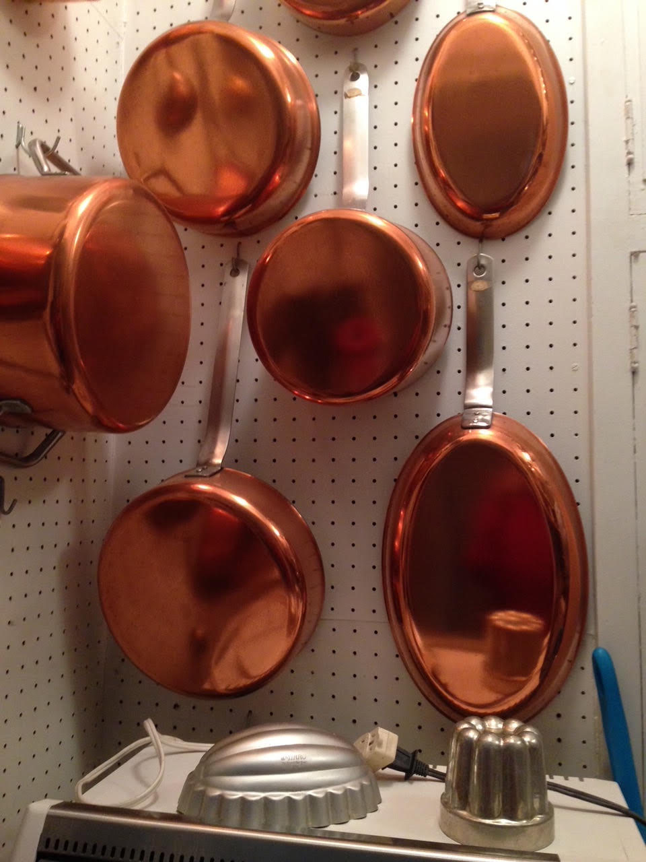
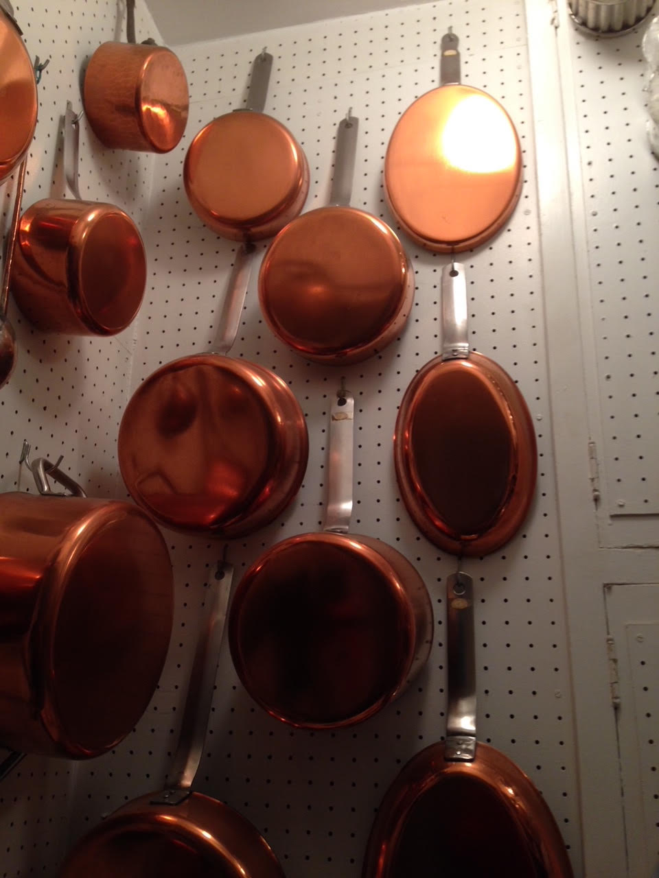

Slide 19
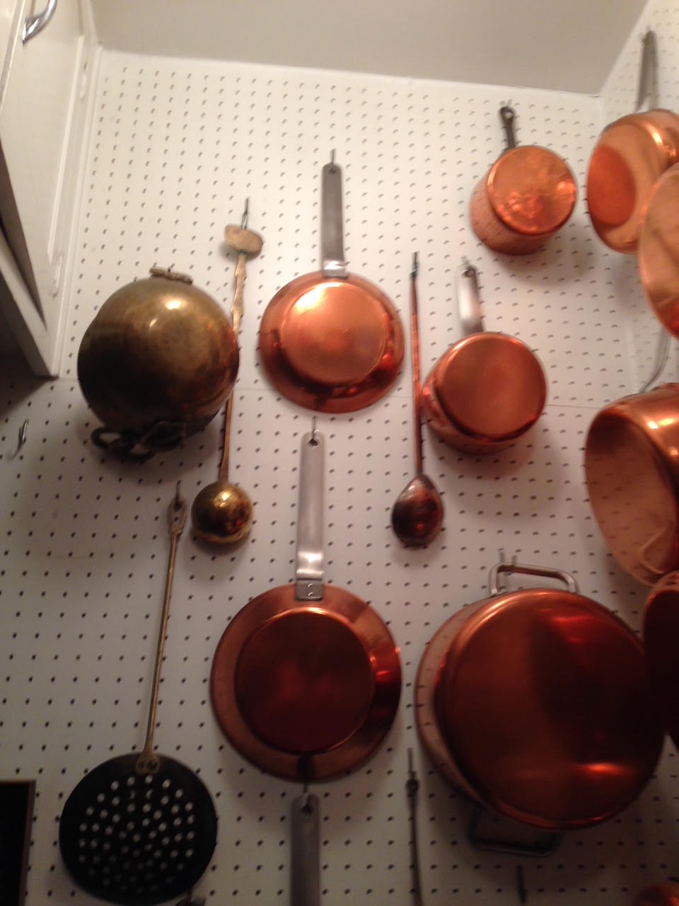
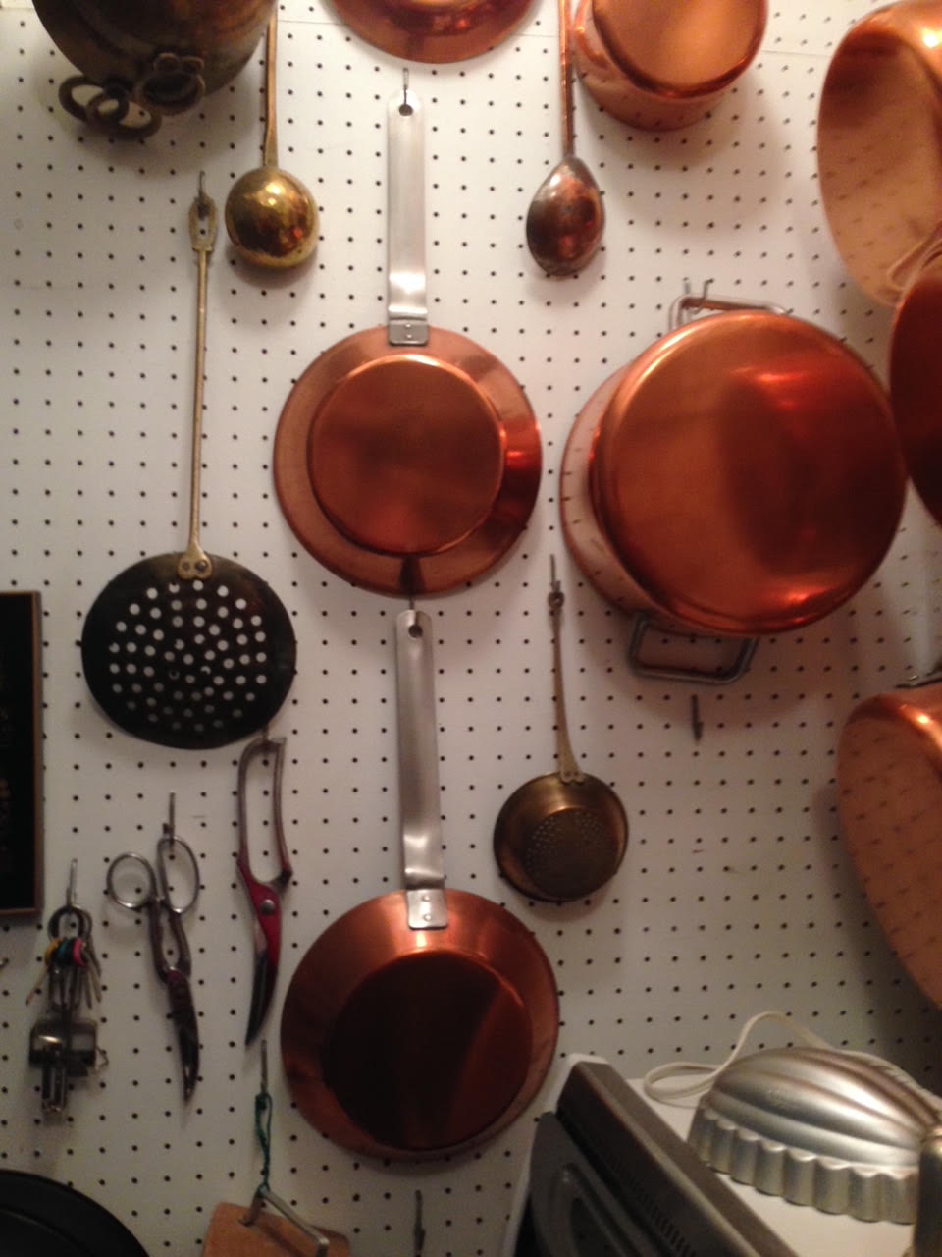

Slide 20
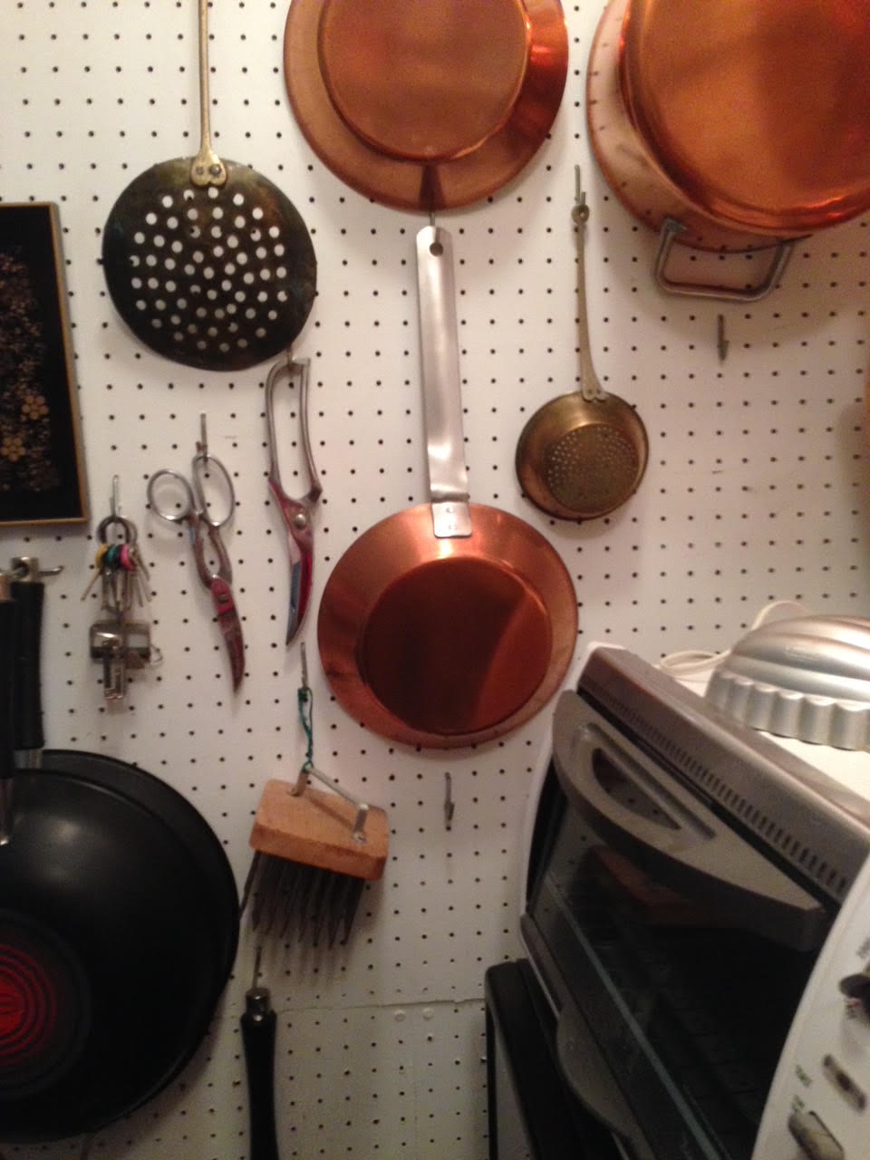
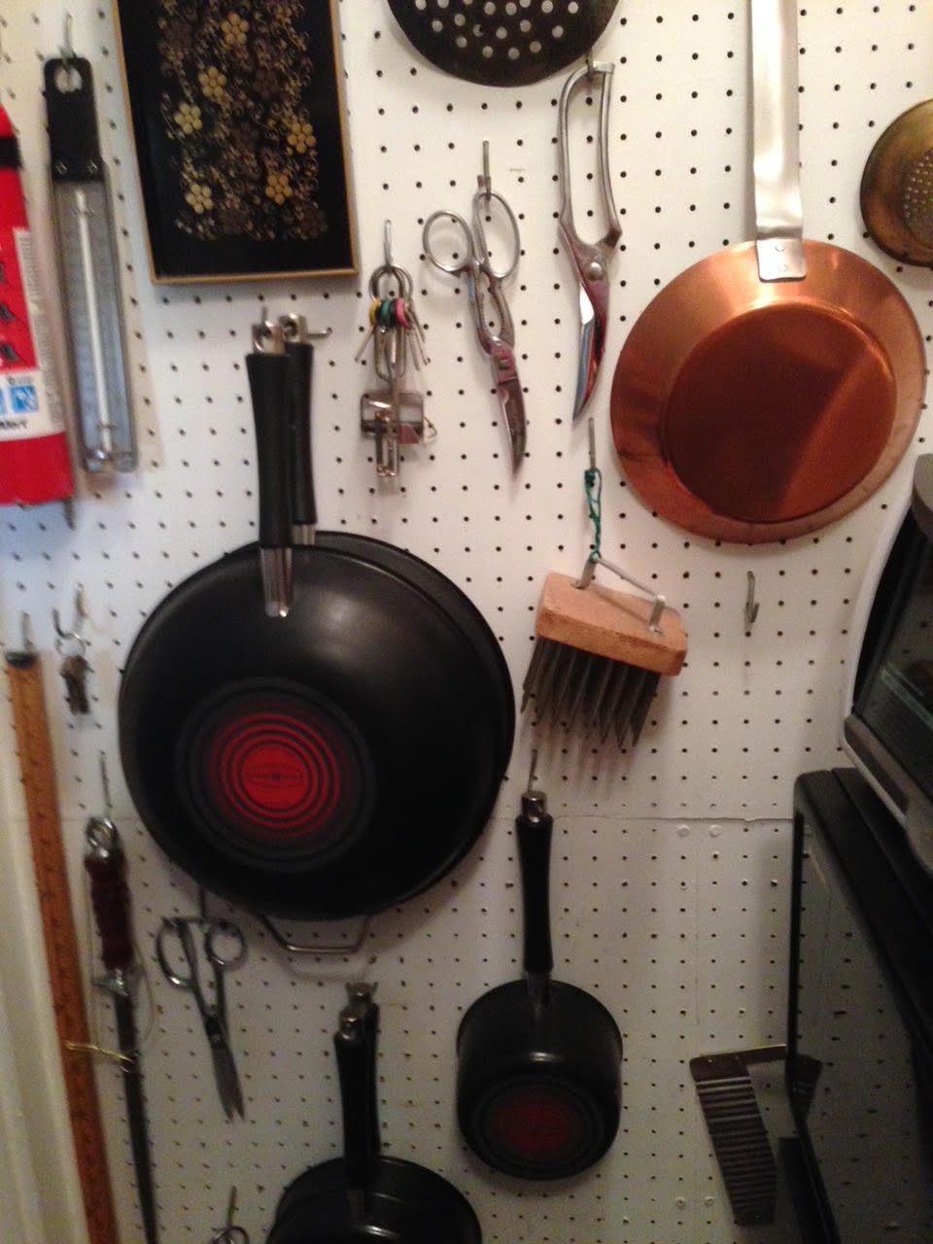

Slide 21
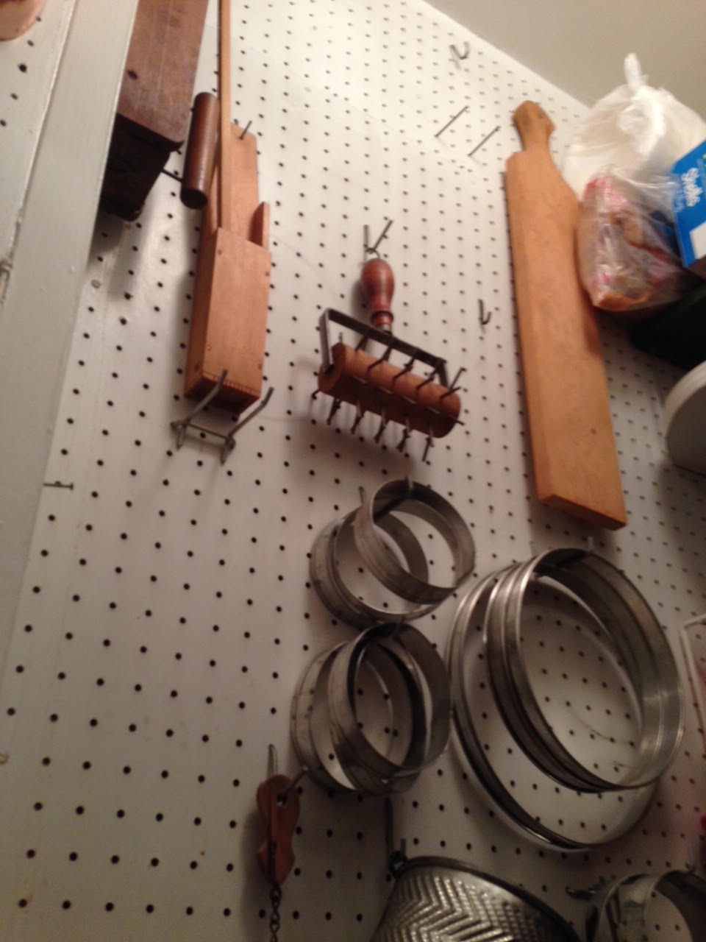
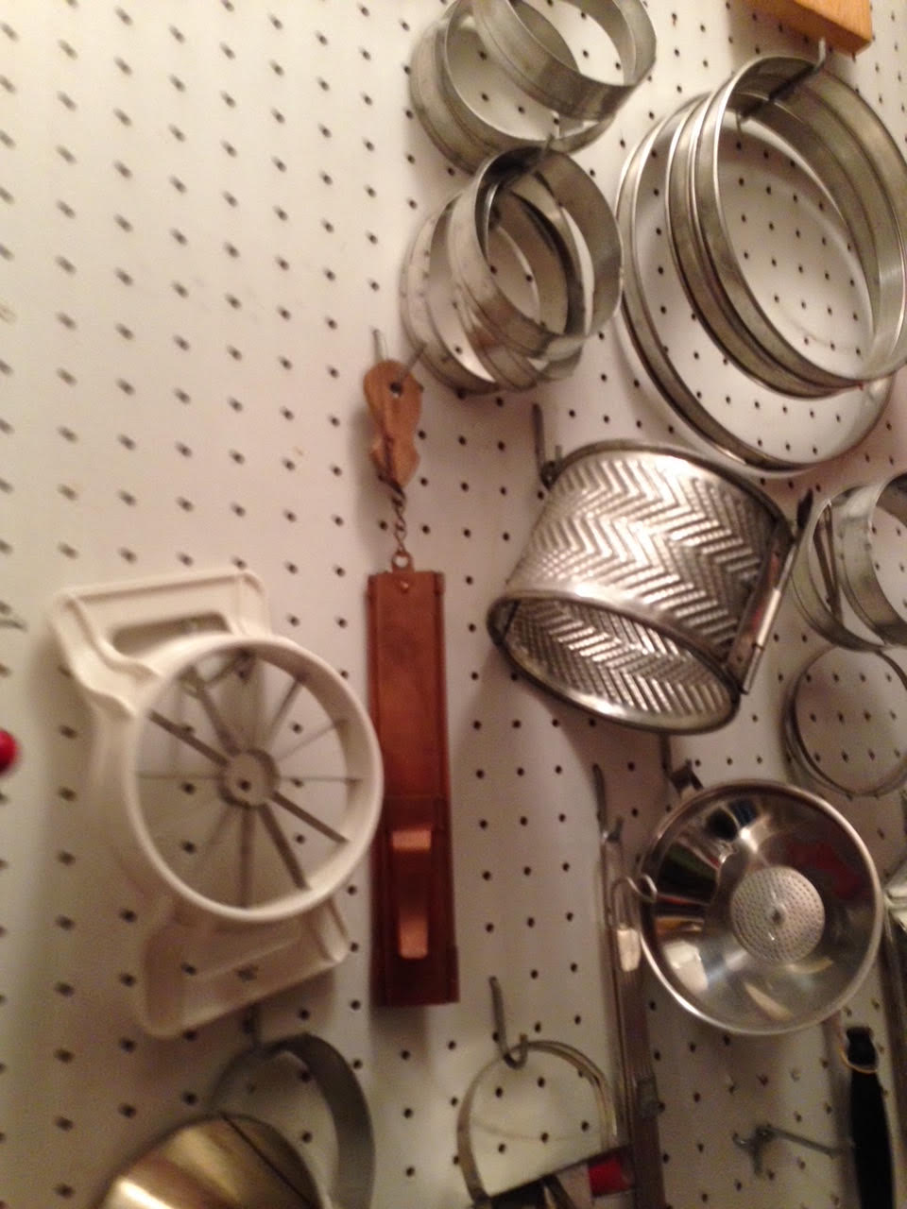

Slide 22
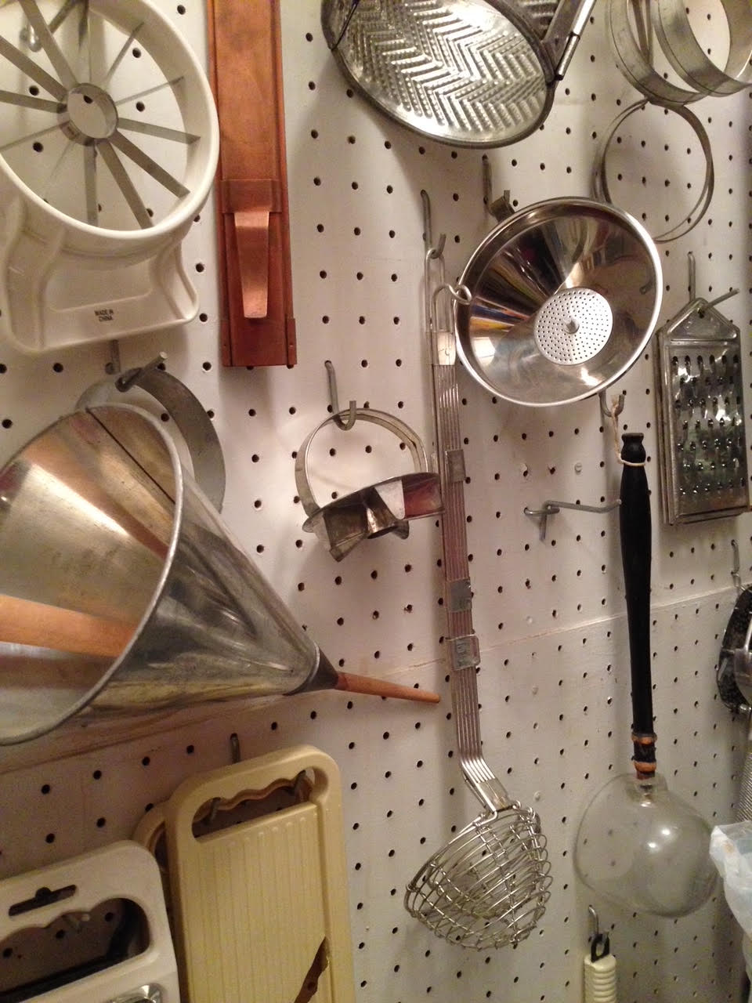
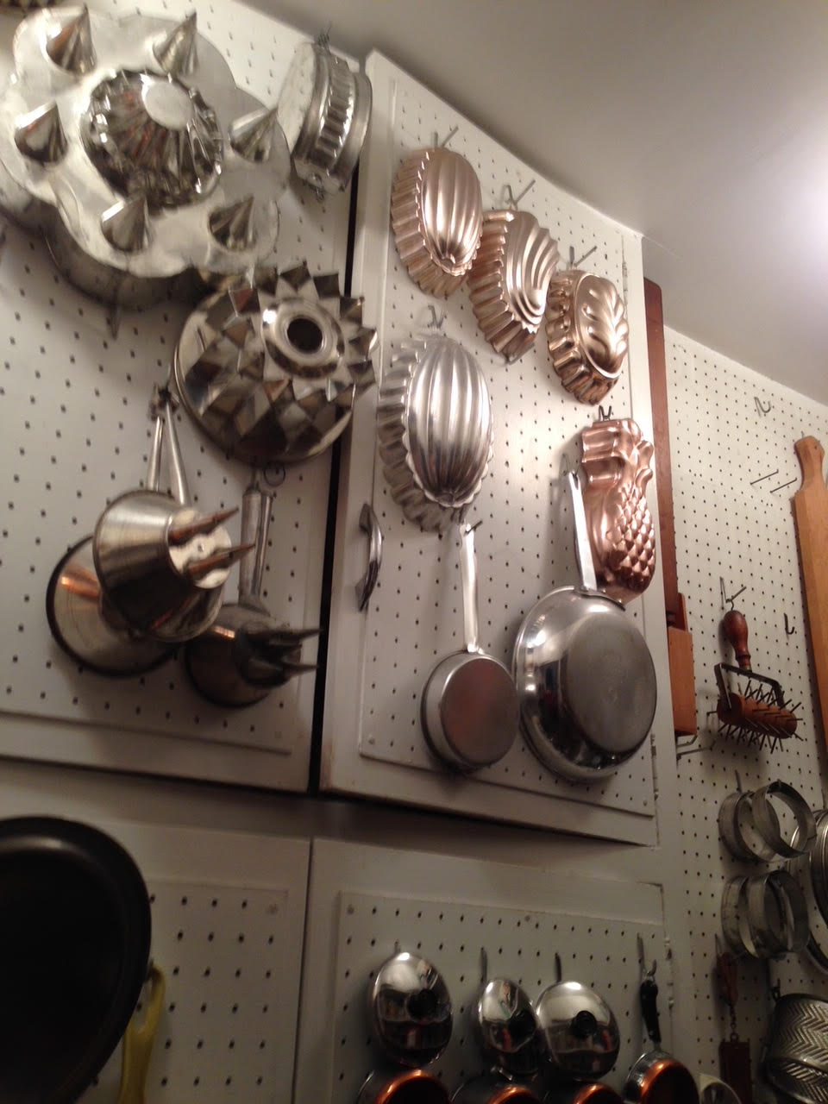

Slide 23
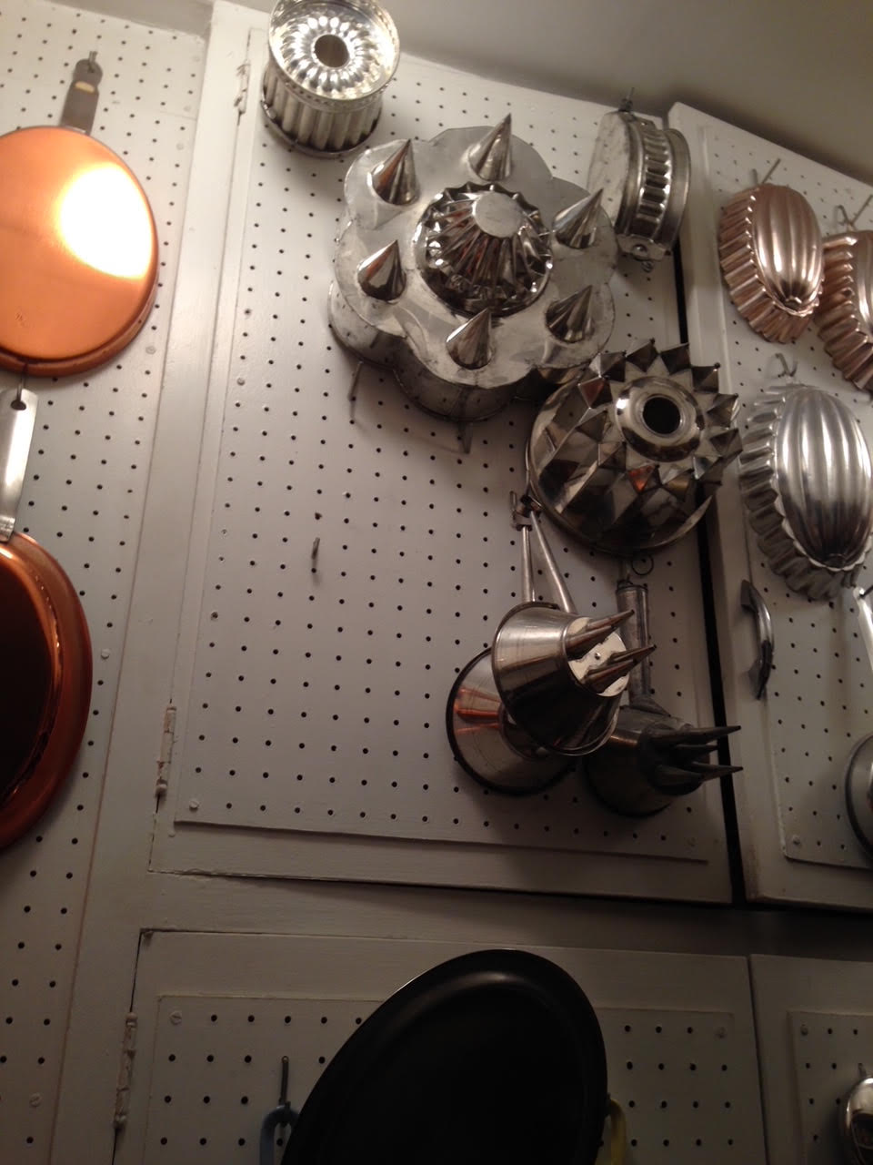
There are more pots and such inside the cabinet doors…
Now, we leave the pantry and return to the kitchen.

Slide 24
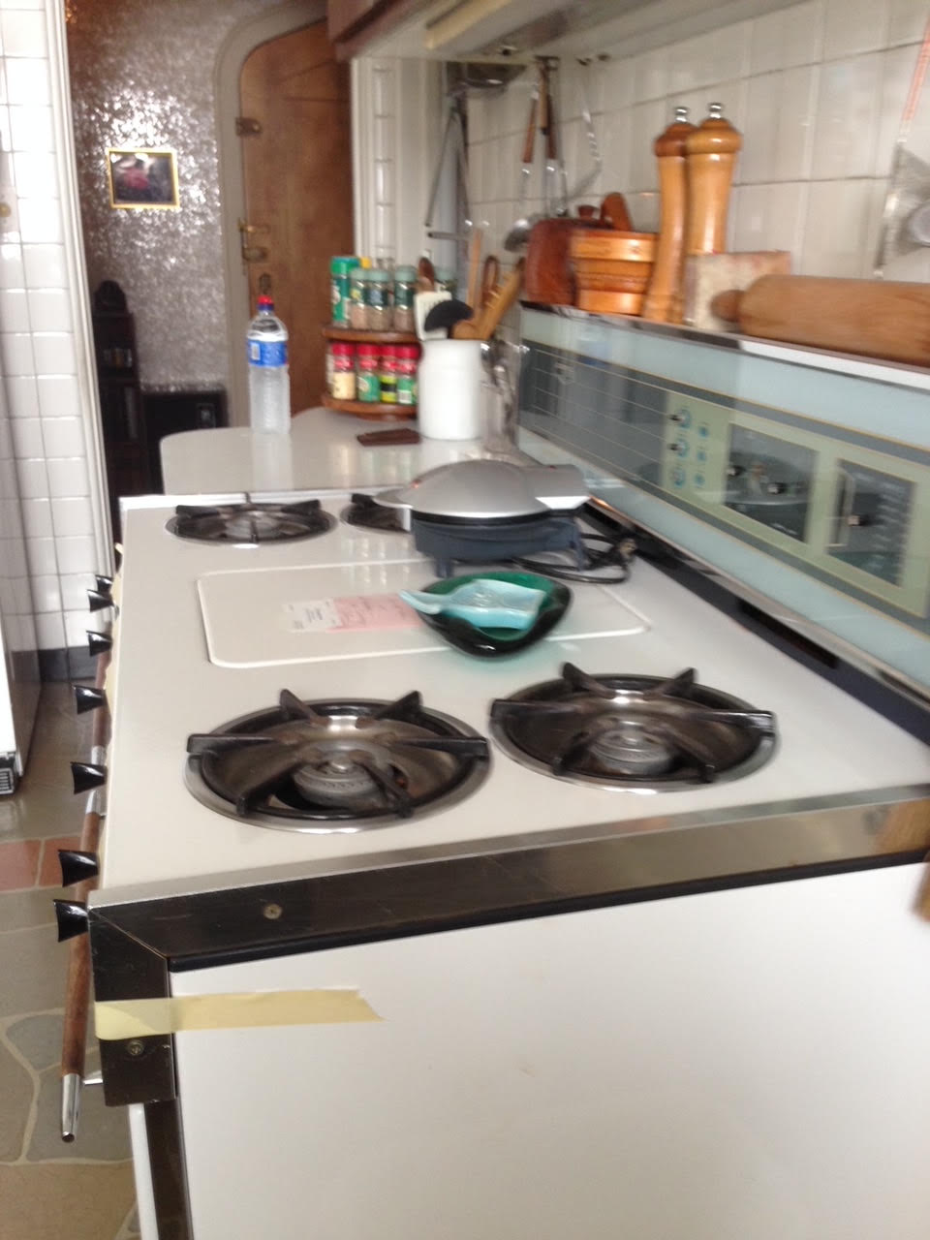
5750 S. Kenwood
Out of the pantry, and into the kitchen. View of the wall with the stove on it. Note the corner of the refrigerator on the left. And, note the view out into the Foyer and the front door. The stove is a Viking; Alma bought it for her test kitchen in 5759 Kenwood, across the street, and moved it to this apartment when the Lachs moved to the elevator co-op building at 5750. She loved this stove.

Slide 25
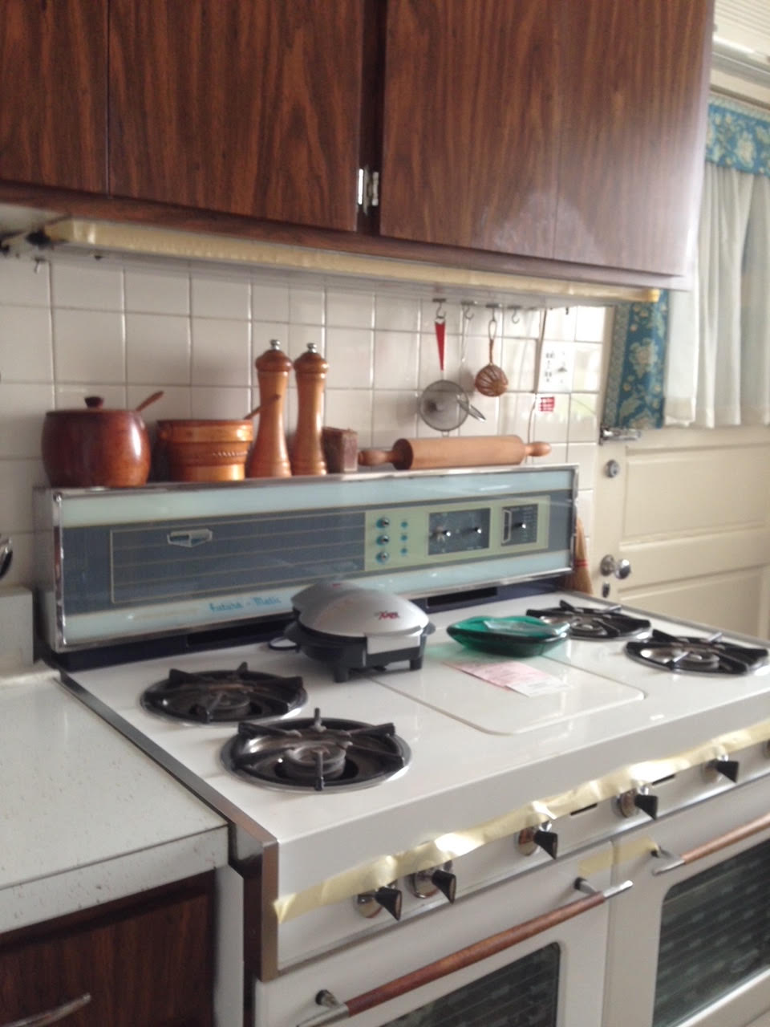
5750 S. Kenwood
Stove. Note the backdoor to the right of the stove. There is a porch out there. She had extra cabinets (locked) for extra items for the kitchen on that porch.
Most of the items on the shelf above the stove were donated to the University of Chicago Library.

Slide 26
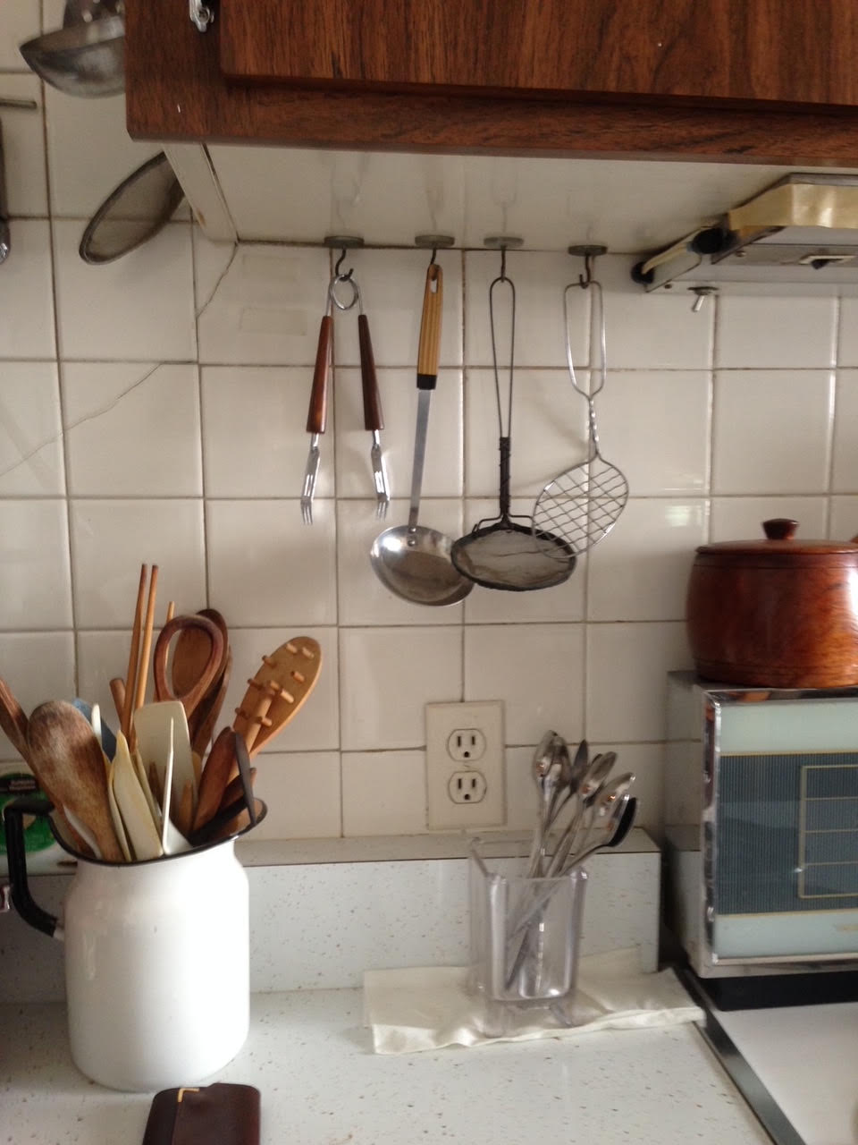
5750 S. Kenwood
Small counter to the left of the stove. Items donated to University of Chicago Library.

Slide 27
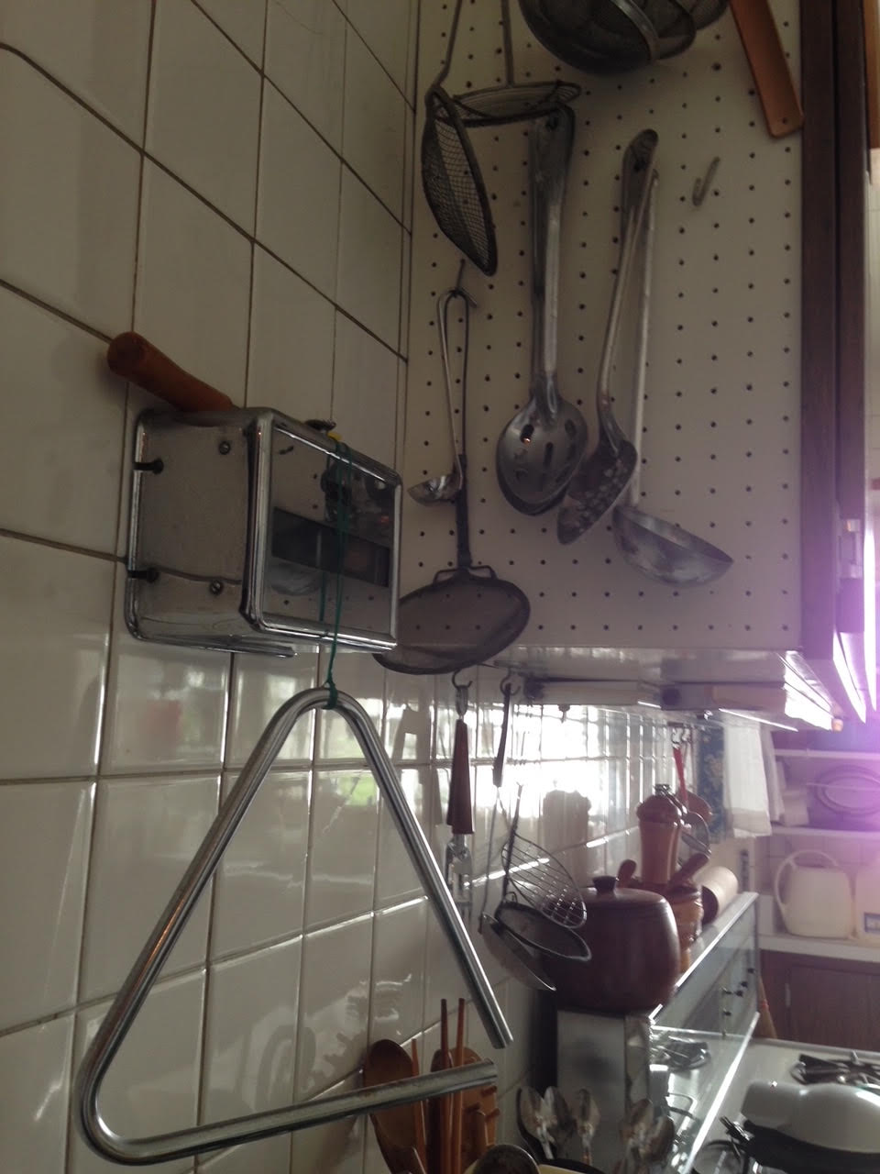
5750 S. Kenwood
Continuation to the left of the stove. Alma used the triangle to call Donald to dinner (he often sat in the back of the apartment and could not otherwise hear her call him). The triangle was also donated to the University of Chicago Library.

Slide 28
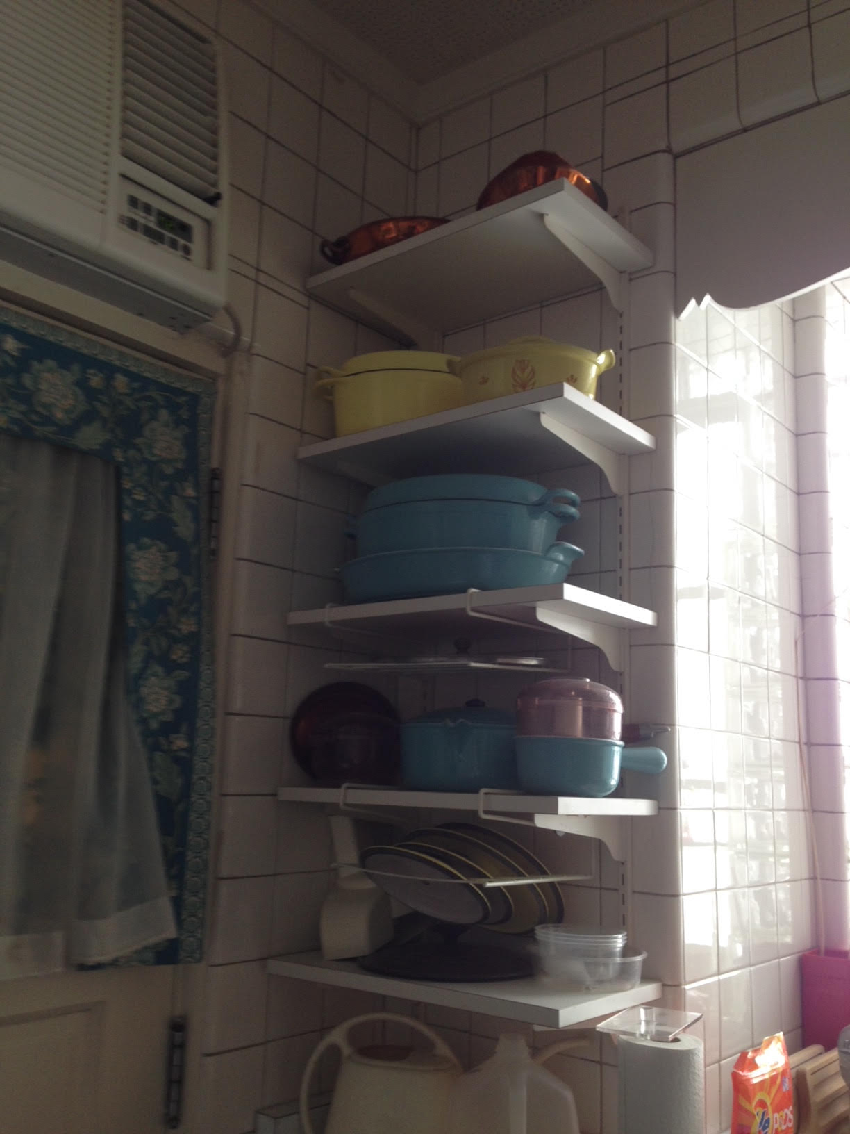
5750 S. Kenwood
Shelving to the right of the stove, on the other side of the back door from the stove, and just to the left of the sink. Copper pot with lid on top shelf given to friend Ted Foss. Enameled cookware to grandson.

Slide 29
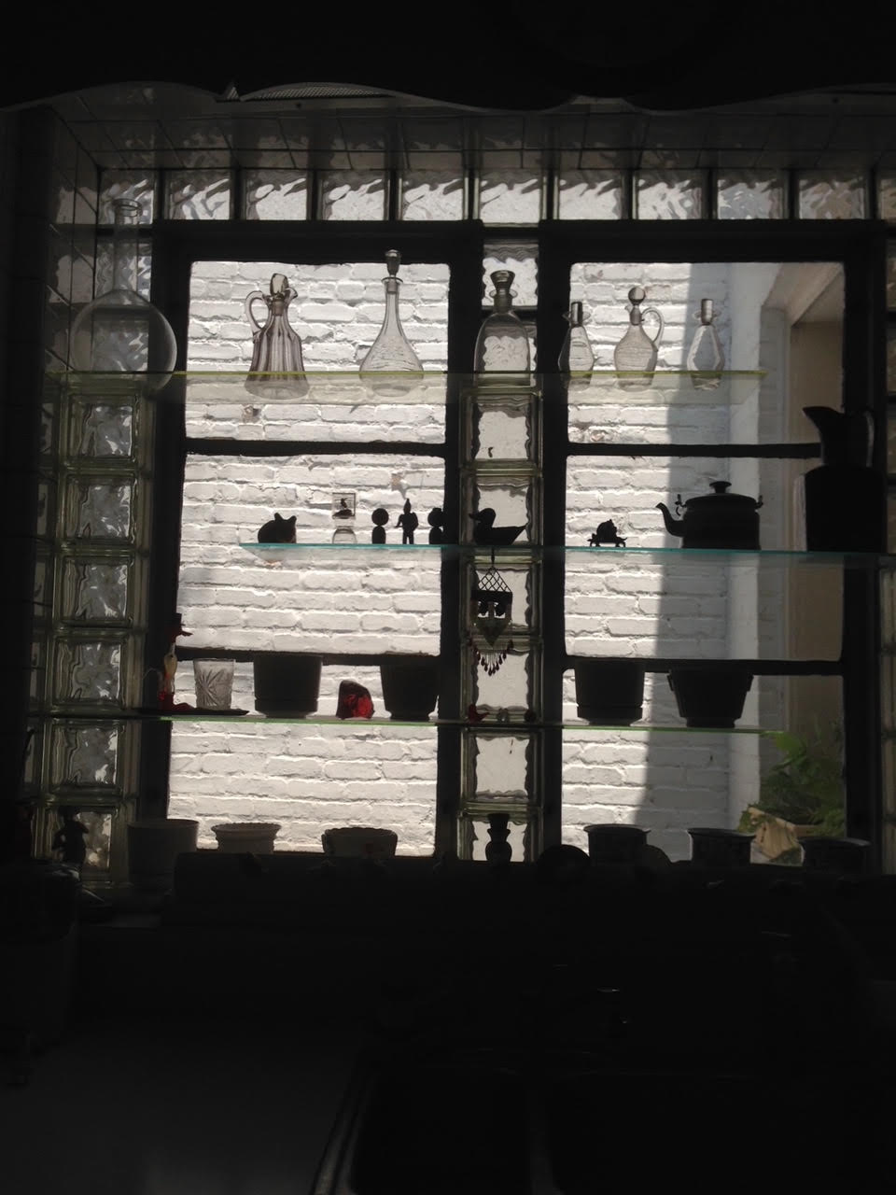
5750 S. Kenwood
Light reflected off neighboring building obscures the sink, directly below the windows. Alma grew African violets, and other plants in the pots on shelves she built herself from glass block and glass. These plants were more than merely decorative; they served as her little farm from which she gathered flowers to candy and use in food.

Slide 30
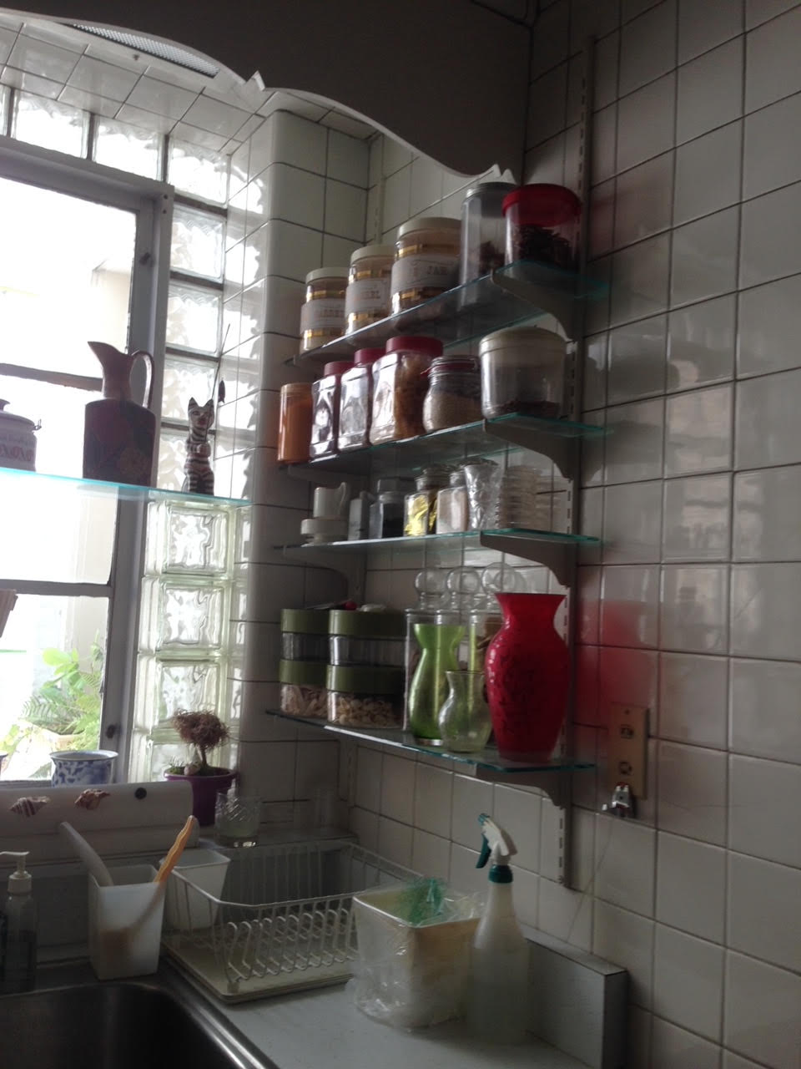
5750 S. Kenwood
Shelving to the right of the sink.

Slide 31
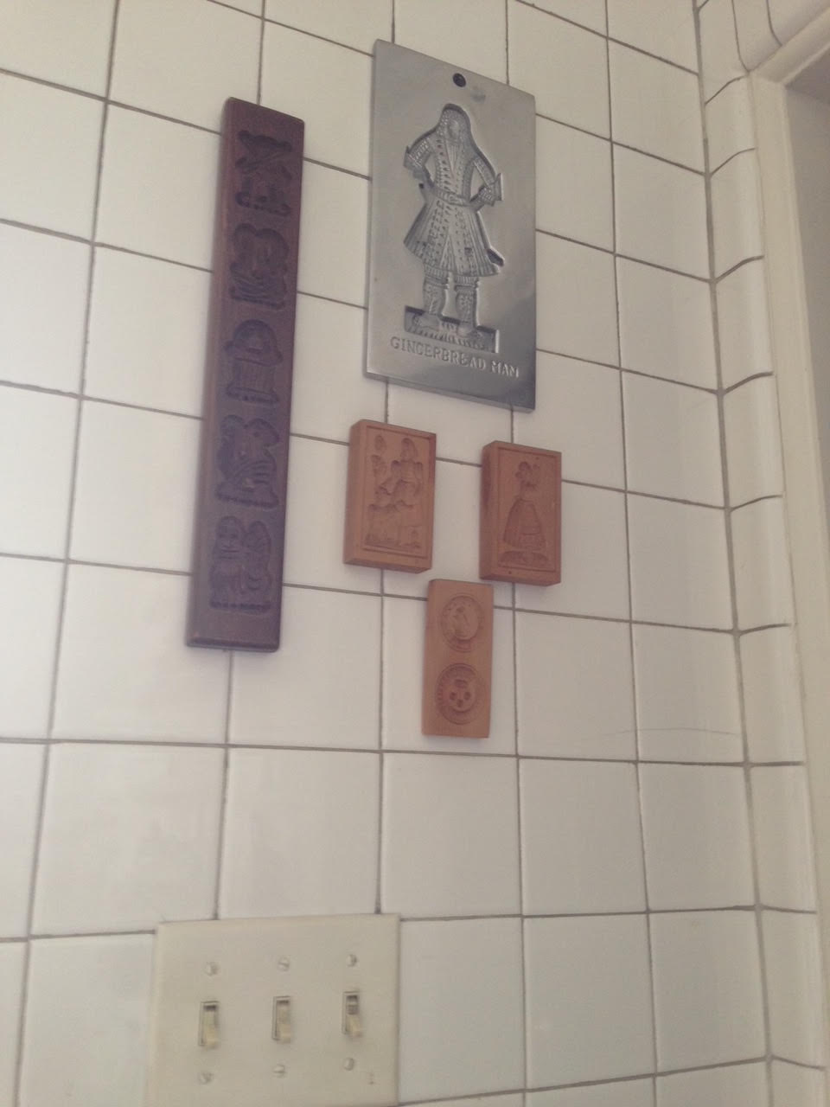
5750 S. Kenwood
Shelving farther to the right of the sink.
Molds given to the University of Chicago Library.
Notice the door frame to the right. That is the door where we began the tour.

Slide 32
5750 S. Kenwood
Take another look at this slide. This photo was taken after some items had been moved.
Alma’s study, through the door, still has some books on the shelves.
Now, we walk through that door, in the next two slides.

Slide 33
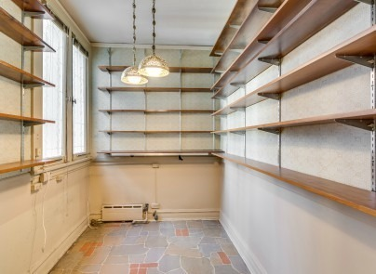
5750 S. Kenwood
Alma’s study, empty. It was filled with cookbooks and documents from floor to ceiling (including shelving over the doorway). All were donated to the University of Chicago Library along with documents and books stored elsewhere throughout the apartment. In all, the university removed about 350 boxes of books and papers to form their Special Collections of her work.

Slide 34
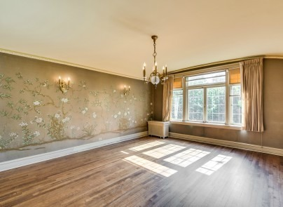
5750 S. Kenwood
The dining room, where Alma and Donald hosted so many fabulous, memorable parties, now empty.

Slide 35
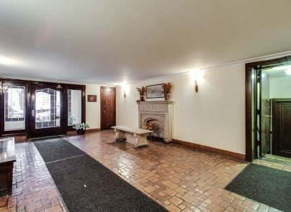
5750 S. Kenwood
So long….

Slide 36
