Slide 1
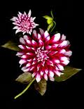
Alma Lach Celebration of Life
A Century of Culinary Progress
June 10, 2014
In the Library of the Quadrangle Club,
University of Chicago
Alma Elizabeth Satorius Lach
June 8, 1914 to October 21, 2013
With thanks, from her family, to Alma’s many friends, neighbors, and colleagues from Chicago.

Slide 2
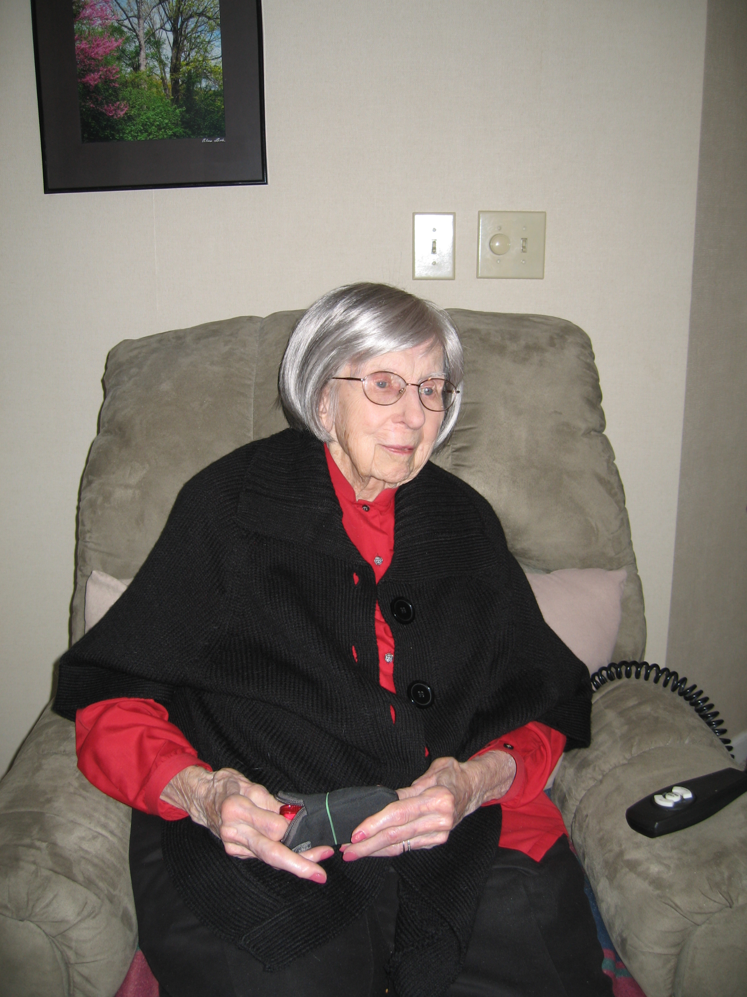
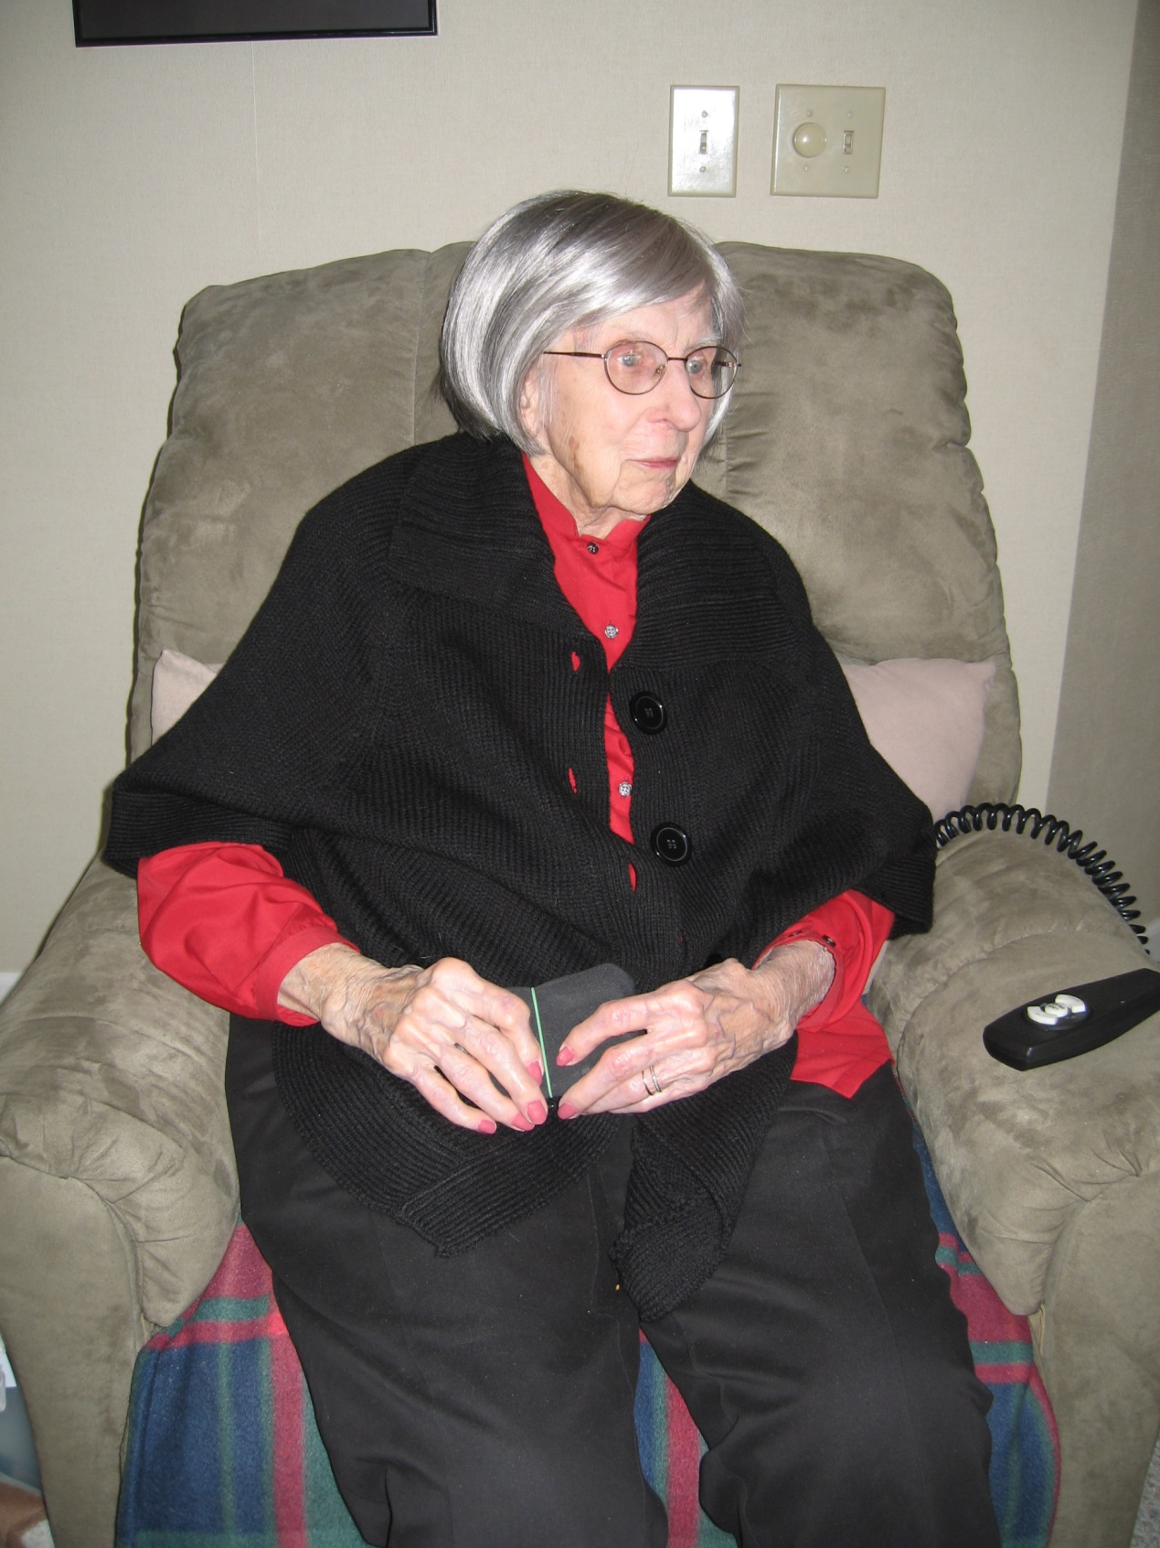

Slide 3
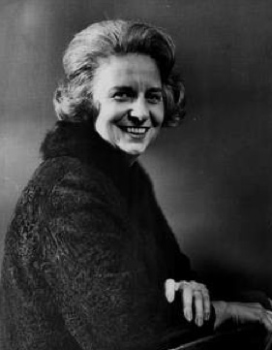
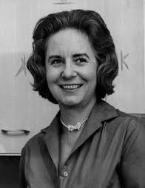

Slide 4
Alma’s Culinary Philosophy
The art of cooking rests upon one's ability to taste, to reproduce taste, and to create taste. To achieve distinction the cook must taste everything, study cookbooks of all kinds, and experiment constantly in the kitchen. I stress in my writing and teaching the logic of food preparation, for the cook who possesses logic, knows how to create dishes rather than being content merely to duplicate the recipes of others.

Slide 5
Flower of Life
Seven petals plus two leaves, one each for each full decade of life. The stem, almost complete, represents the almost complete last decade: June 8, 2014 would have been Alma’s 100th birthday.

Slide 6
Family
Parents, Clara E. Boeker and John H. Satorius, Petersburg, Illinois
Sister, Mary Satorius Eheart, 1912 – 2001.
Donald Frederick Lach (1917 – 2000), husband, married March 18, 1939
Daughter, Sandra Judith Lach, born April 18, 1943
Son-in-Law, William Charles Arlinghaus, wedding September 3, 1966.
Grandson, William Edward Arlinghaus, born June 24, 1967
Great-grandson, David Edward Voorhees Arlinghaus, born June 7, 1991.
Great-great-grandson, Edwin Arlinghaus, born March 6, 2014.

Slide 7
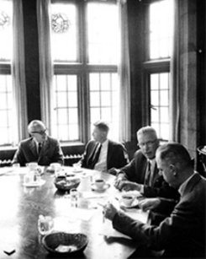
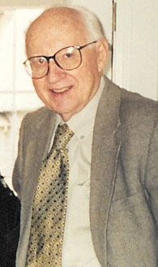
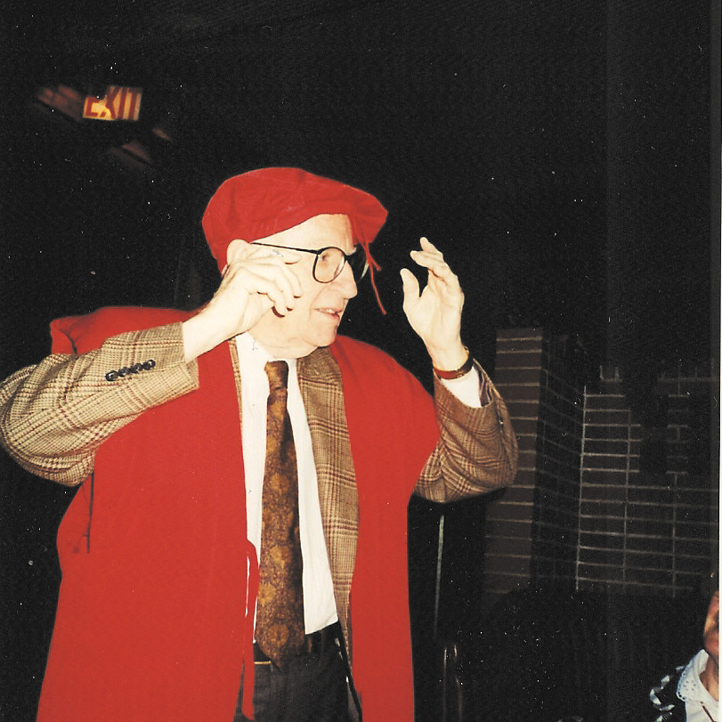

Slide 8
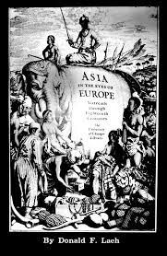
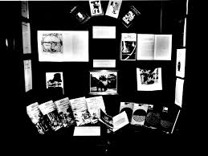
Asia in the Eyes of Europe Sixteenth through Eighteenth Centuries
Donald F. Lach (with selected photography by Alma S. Lach). Held in the Department of Special Collections, the University of Chicago Library, January 23 – May 1, 1991.

Slide 9
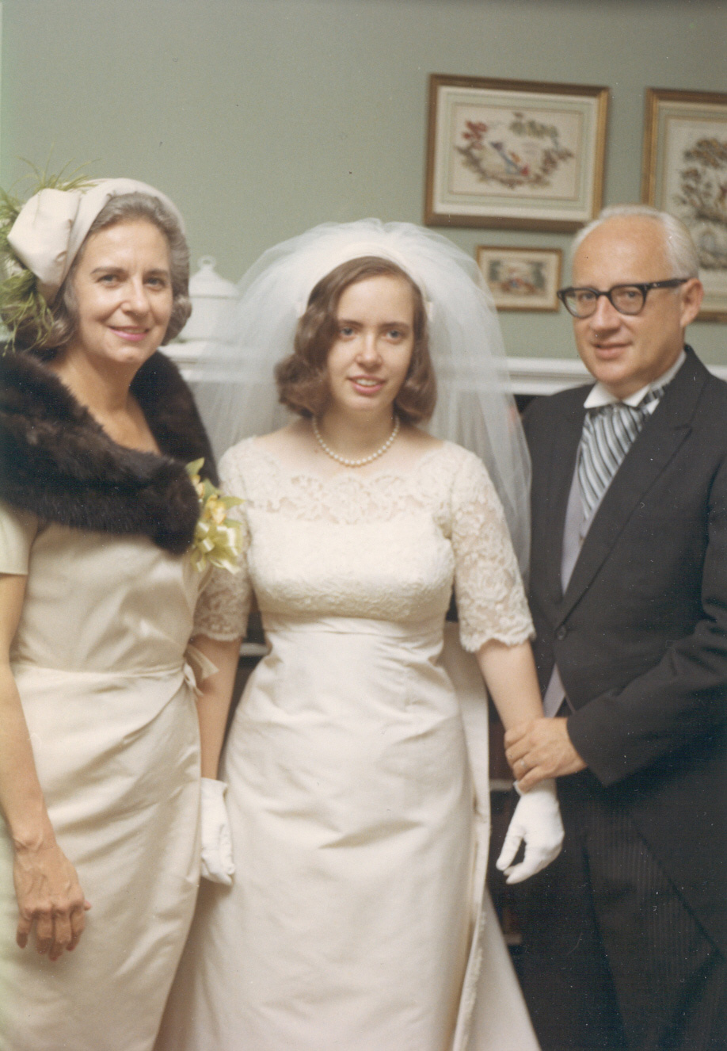
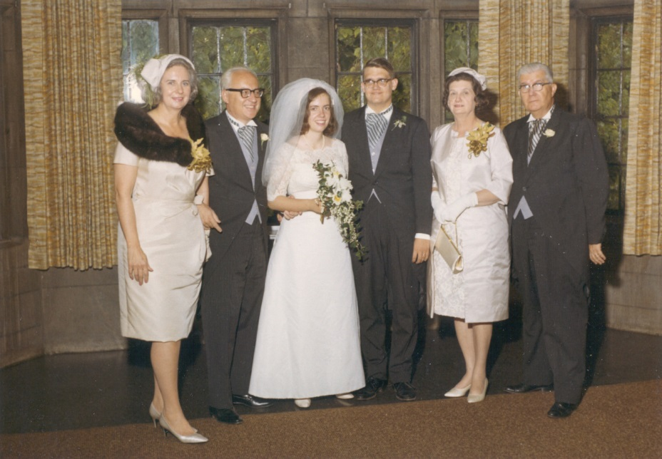
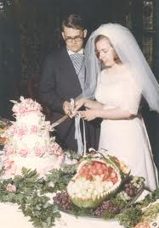
Wedding, Sandy and Bill, September 3, 1966

Slide 10
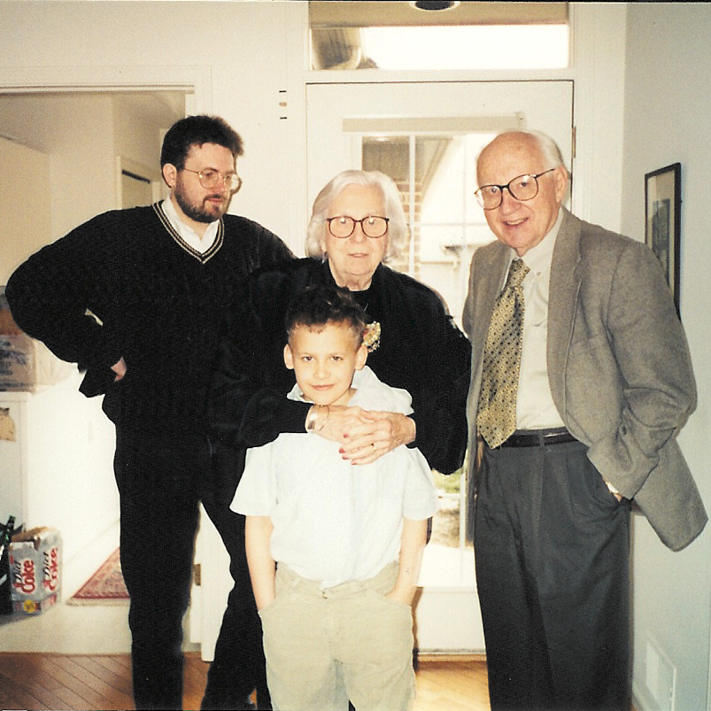
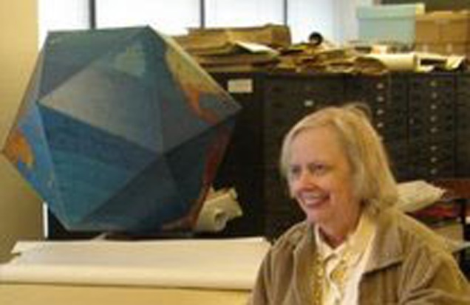
A Visit to Ann Arbor
Bill E. Arlinghaus, grandson on far left; David Arlinghaus, great-grandson in front of Alma.
Circa 1999.
Below, Sandy in the Map Library of The University of Michigan.

Slide 11
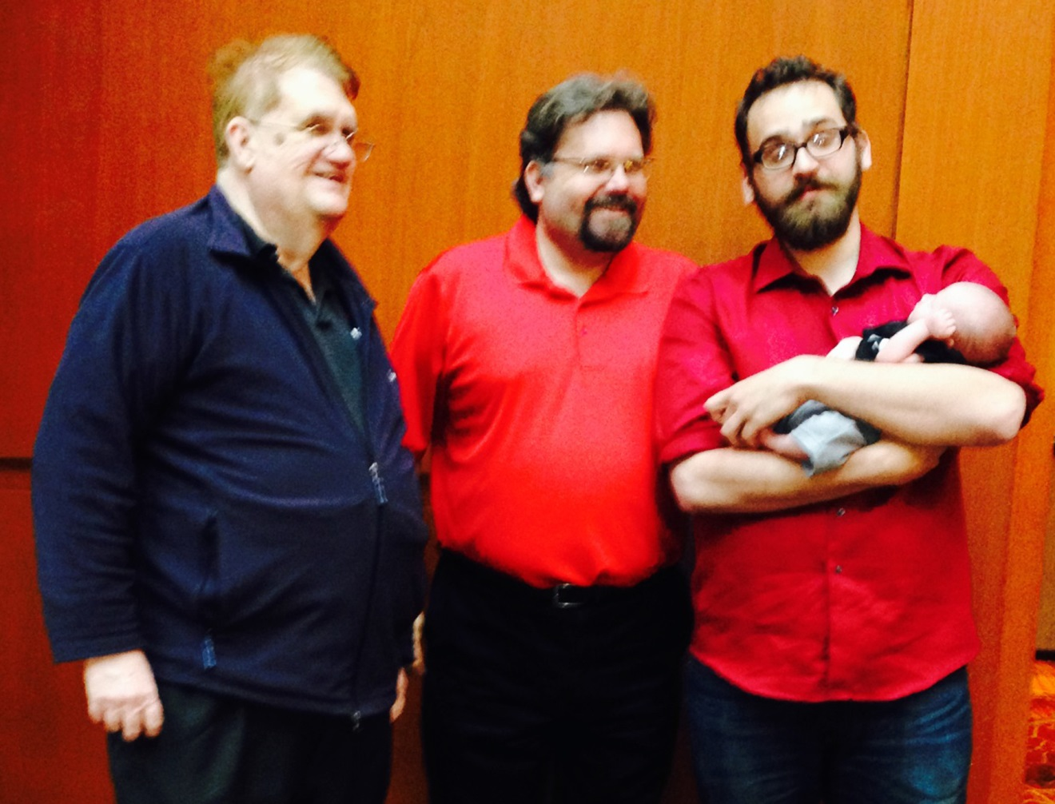
Four Generations! 2014. The sun sets on one and rises on another…
Left to right:
Bill C. Arlinghaus (son-in-law), Bill E. Arlinghaus (grandson), David E. V. Arlinghaus (Great-grandson), and Baby Edwin Arlinghaus (Great-great-grandson).

Slide 12
Education
One-room schoolhouse, downstate Illinois; taught by Miss Masters, daughter of poet Edgar Lee Masters.
Petersburg Harris High School
University of Chicago, where she got to know Miss Halliday of Evelyn G. Halliday and Isabel T. Noble, How’s and Why’s of Cooking, 1933 (rev.), Chicago: University of Chicago Press.
Participated with her sister Mary in human nutrition experiments in Robie House.
Millinery School, Paris France, 1949. Some of her hats selected for fashion models from Parisian fashion houses
Cordon Bleu, Paris France, 1949-50; 1952-53; 1956. Grand Diplome, 1956, signed by Madame Brassart.

Slide 13
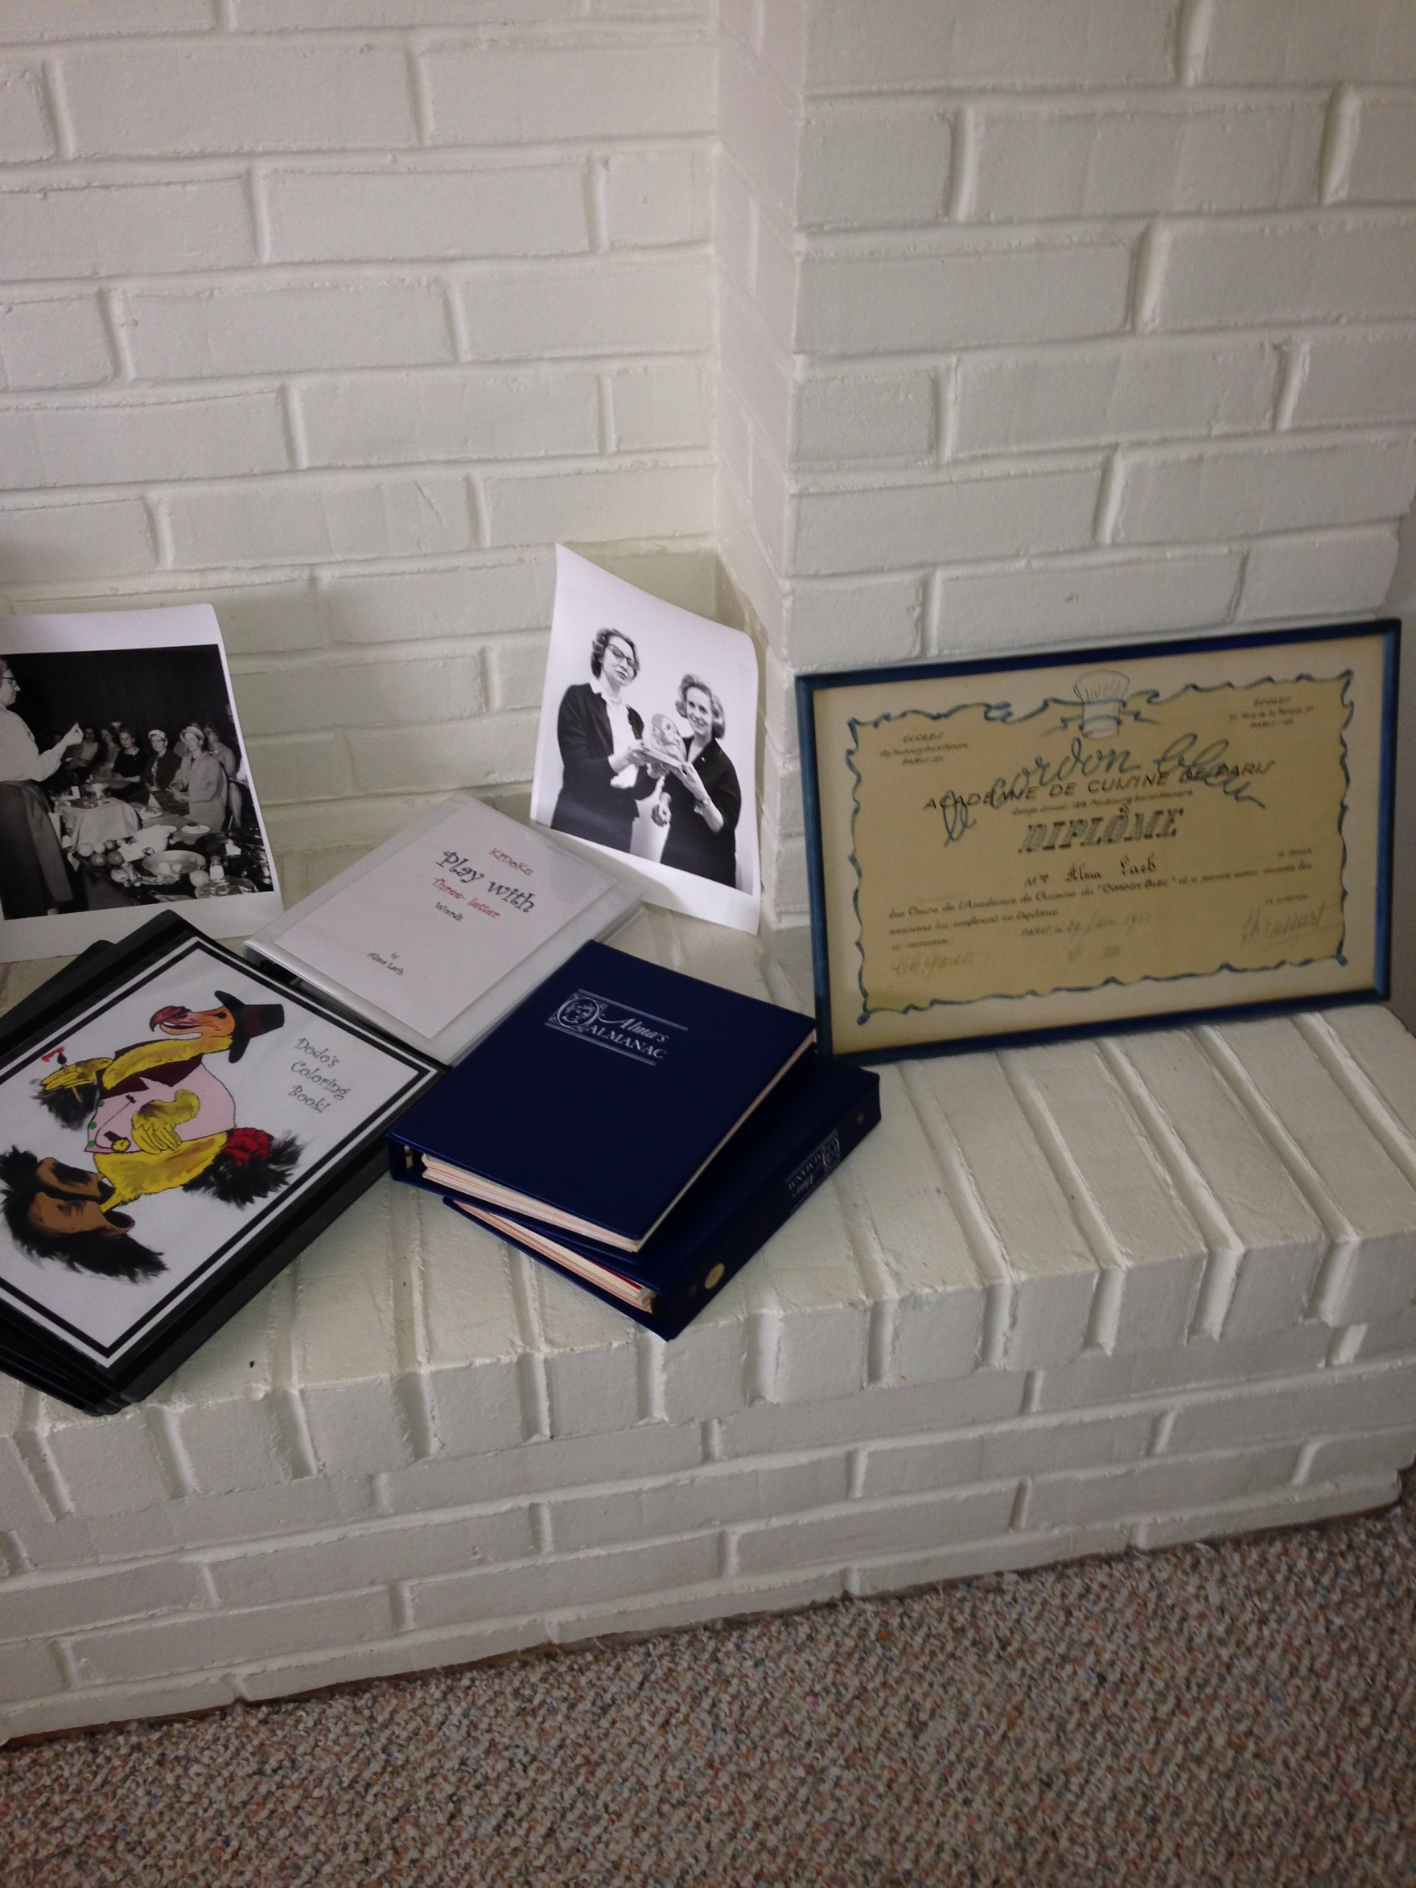

Slide 14
Teaching
University of Chicago Laboratory Schools, Invited Participation:
Miss Olga Adams, Kindergarten
Unified Arts Program, Upper School
Lecturer, University of Chicago Downtown College, 1963
Lecturer, University of Maryland Gourmet Institute, 1963
Lecturer, Modesto (CA) College, 1978
Lecturer, University of Chicago, 1981
Alliance Francaise
Gas Company

Slide 15
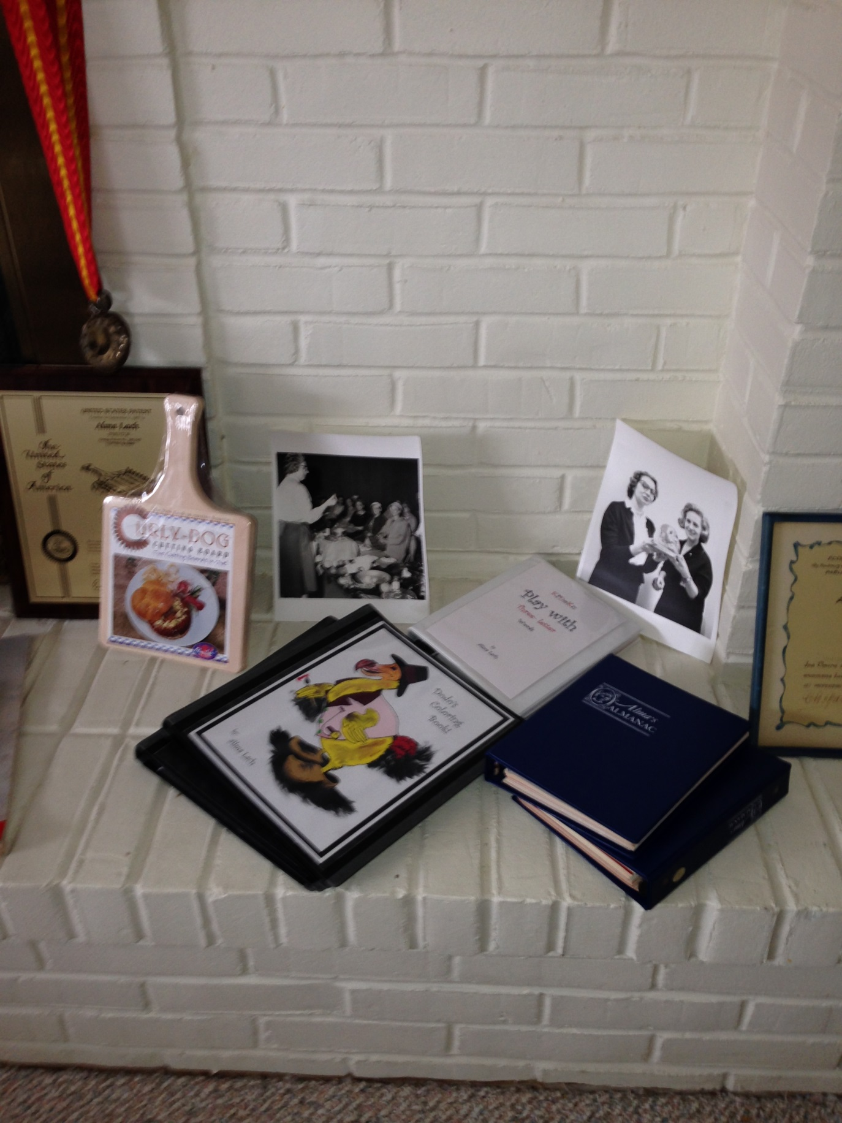

Slide 16
Alma’s Assistants: Diane Morgan and Others
Over the years, Alma had a number of ‘Assistants’ who aided her in teaching. They helped in numerous ways, and as they helped, they learned! Marianne Thorsen was probably the first in this line; Diane Morgan, Winner of the 2013 James Beard Cookbook Award for Vegetable Focused and Vegetarian Winner of the 2013 IACP Award for Single Subject Cookbook, came later.

Slide 17
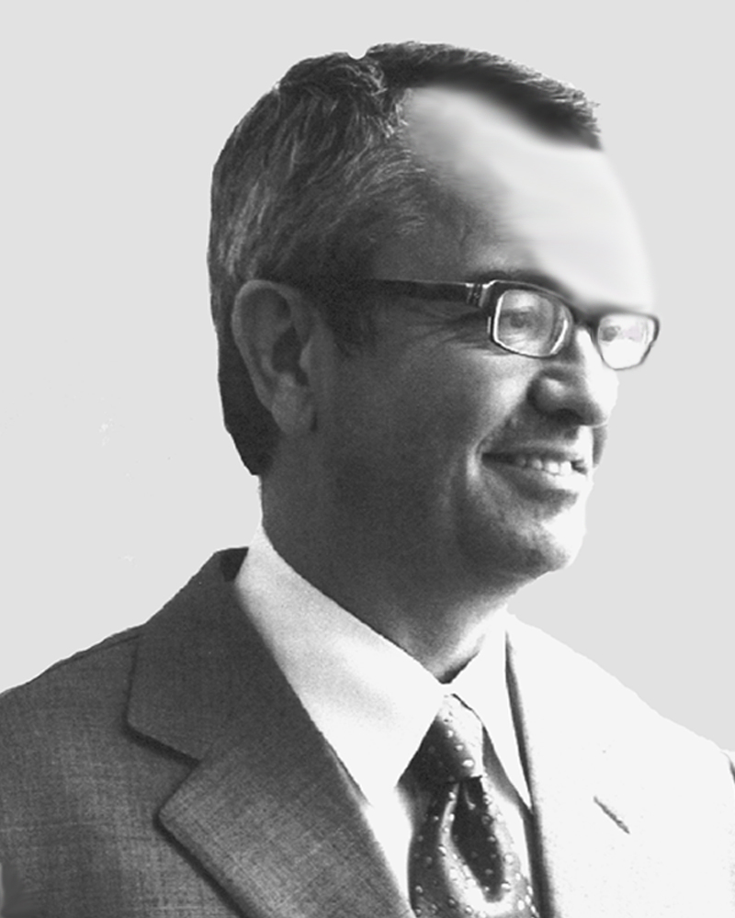
Family Salute to Alma’s and Donald’s Colleague: Ted Foss--and to their many other friends and colleagues.
Ted played many helpful roles for both Alma and Donald! Alma’s family extends hearty good wishes to both Ted Foss and Kent Dymak as well as to the many other long, and enduring friendships of both Alma and Donald. The network of good friends offered many deep and enriching rewards over the course of Alma’s and Donald’s long and illustrious lives.

Slide 18
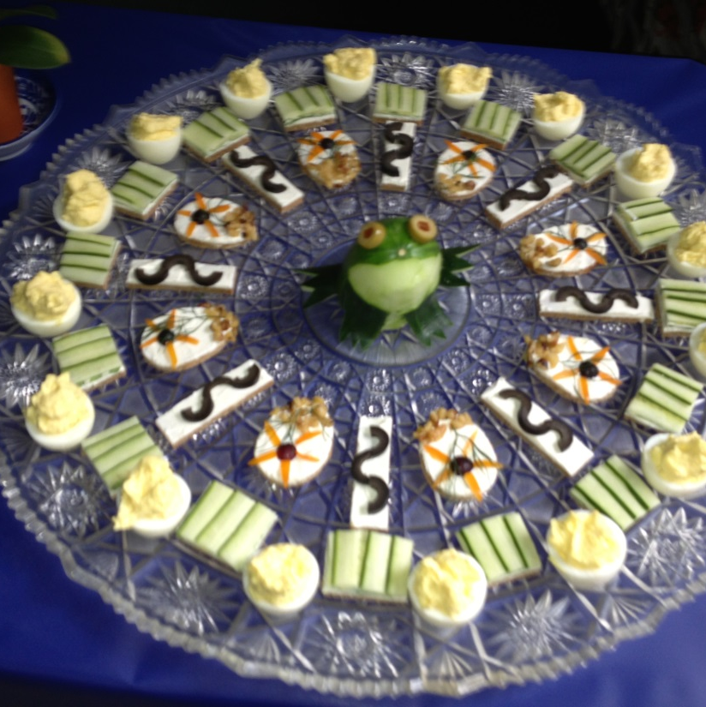
Sandy learned, too!
Alma’s enjoyment of beautiful food goes down the generations. For many years, Sandy has enjoyed creating tea sandwich platters for guests to her home. Shown here is a ‘swamp platter’—a central frog (that Alma taught Sandy to make) surrounded by flowers, snakes, frog steaks, and finally at the edge, the swamp animals and plants bathed in egg sunlight.

Slide 19
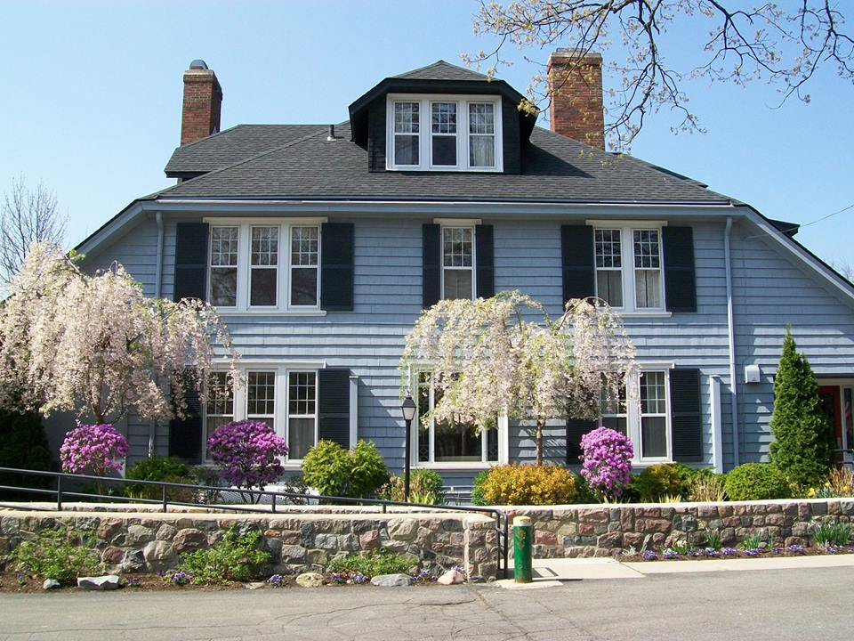
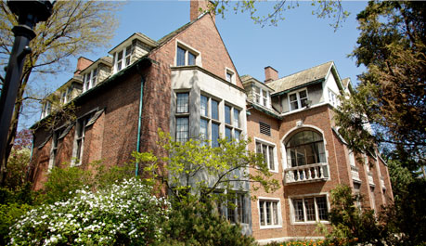
Memberships, Organizations, and Clubs
Food Editors Association of America, Chairman, 1959.
Les Dames d’Escoffier, 1982-2013.
Culinary Historians of Chicago, 1993.
Wine and Food Society, London
The Tavern Club
The Quadrangle Club
Ann Arbor City Club

Slide 20
Travels
Extensive travels throughout the US
Lived for several years in Western Europe, based in Paris. Six transatlantic crossings by ship: French Line, De Grasse, Ile de France (twice), Liberté (twice); and, Cunard-White Star, Queen Mary.
Traveled on numerous occasions throughout Western Europe, including conducting a cruise in the Bay of Biscay.
Year in India, based in New Delhi
Trip to the Philippines
Travel in Southeast Asia
Travels to mainland China; studied vegetable carving in Hong Kong.

Slide 21
Publications, Patents, and Inventions
A Child’s First Cookbook, 1950, NY: Hart Publishing.
The Campbell Kids at Home and the Campbell Kids Have a Party, 1953, Chicago: Rand McNally Elf Books
Feature Writer, Children’s Activities Magazine, 1954-55.
Let’s Cook, 1956.
Columnist, Chicago Sun-Times, 1957-1965.
Candlelight Cookbook, 1959. Out of print booklet.
Contributor to World Book Yearbook, 1961-1975.
Contributor to Grolier Society Yearbook, 1962.
Columnist, Modern Packaging, 1967-68
Columnist, Travel and Camera, 1969.
Columnist, Venture, 1970.

Slide 22
Publications, Patents, and Inventions
Cooking à la Cordon Bleu, 1970, NY: Harper and Row.
Alma’s Almanac, 1972.
The How’s and Why’s of French Cooking, 1974, Chicago: University of Chicago Press. (Later reprint, 1998, Castle Books.)
Columnist, Chicago Magazine, 1978.
Columnist, Bon Appetit, 1980.
Columnist, Tribune Syndicate, 1982.
Curly Dog Cutting Board ™ 1995.
The Dodo: His Story and Coloring Book
Alma’s Walker Tray ™
Kidoku: Sudoku Puzzles for Children

Slide 23
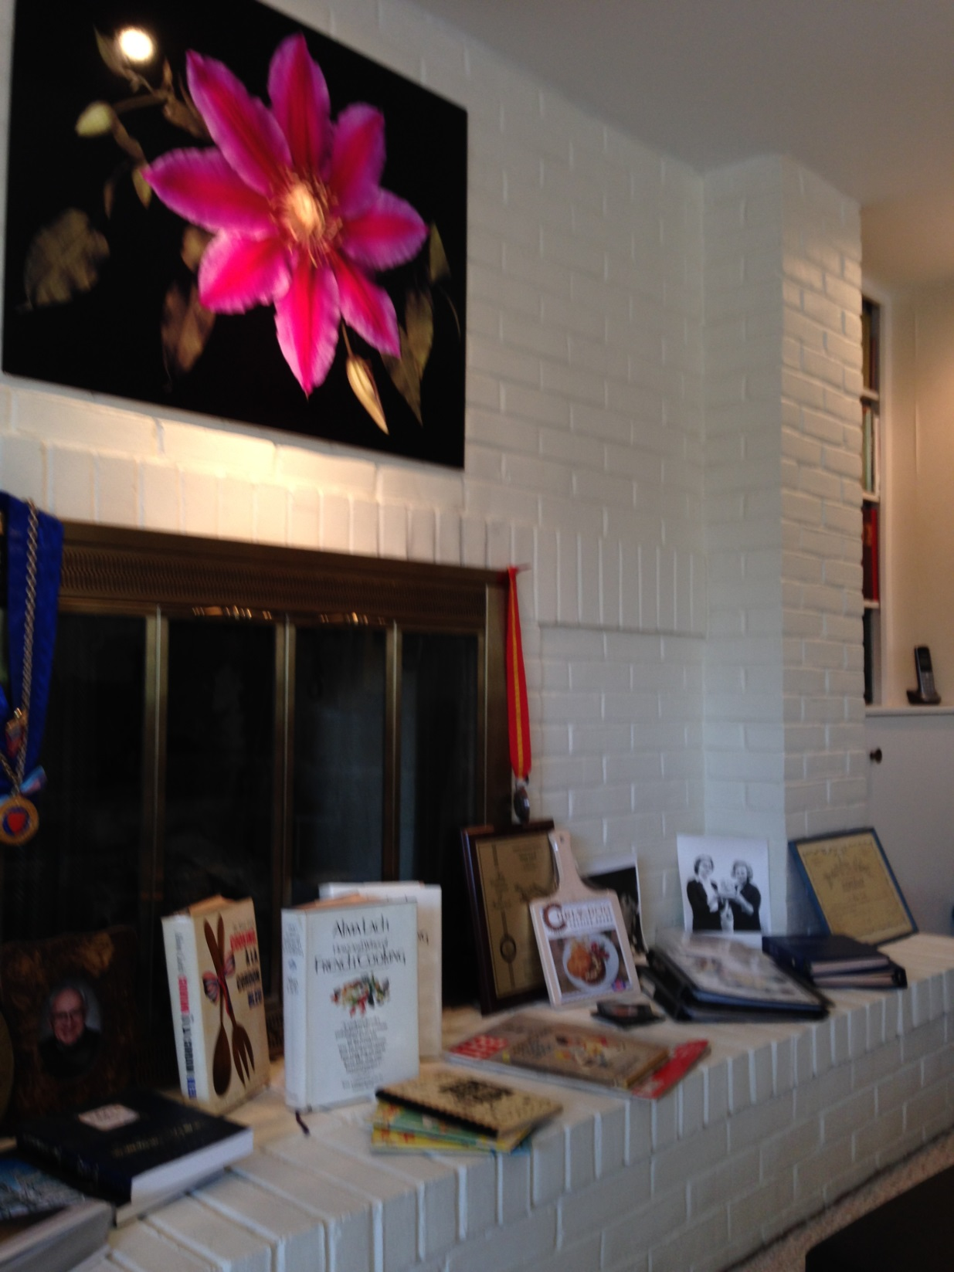

Slide 24

1959, Hart Publishing

Slide 25
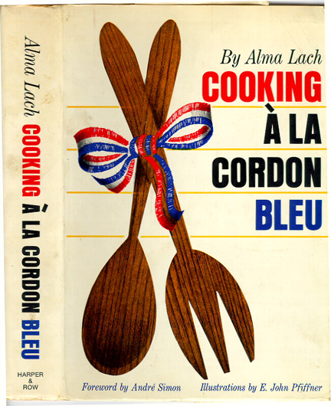
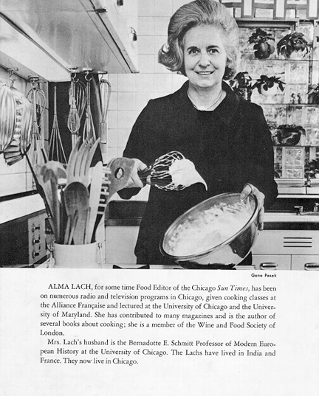
1970, Harper and Row

Slide 26
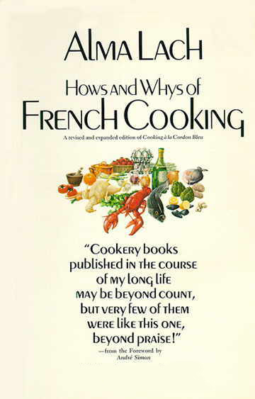
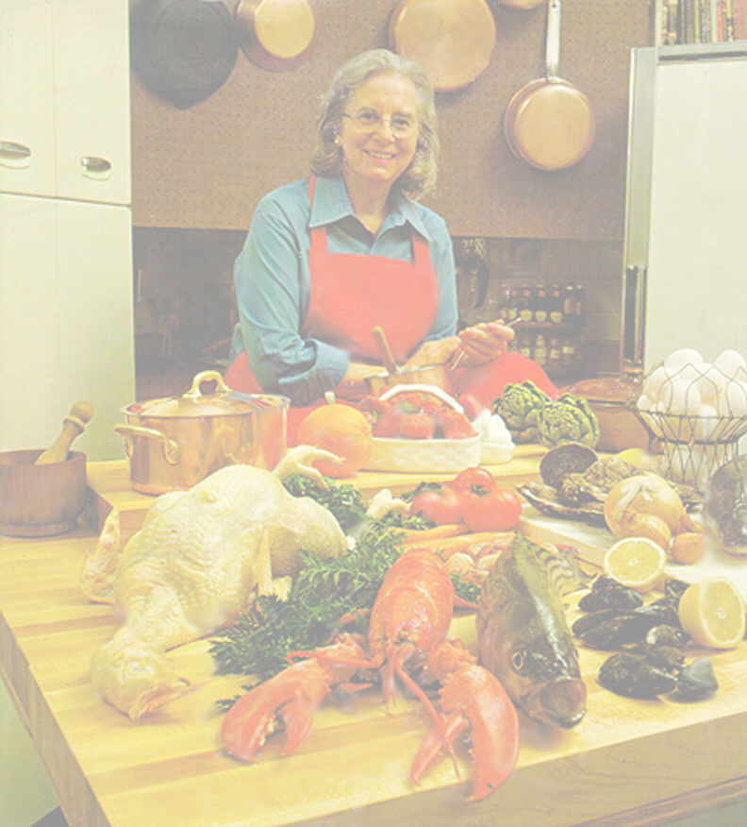
1974: University of Chicago Press

Slide 27
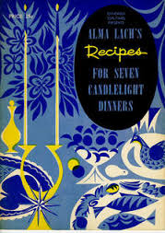
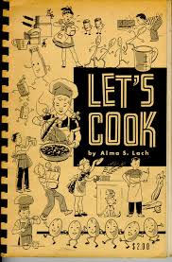
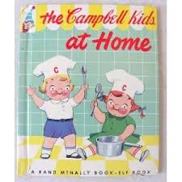


Slide 28
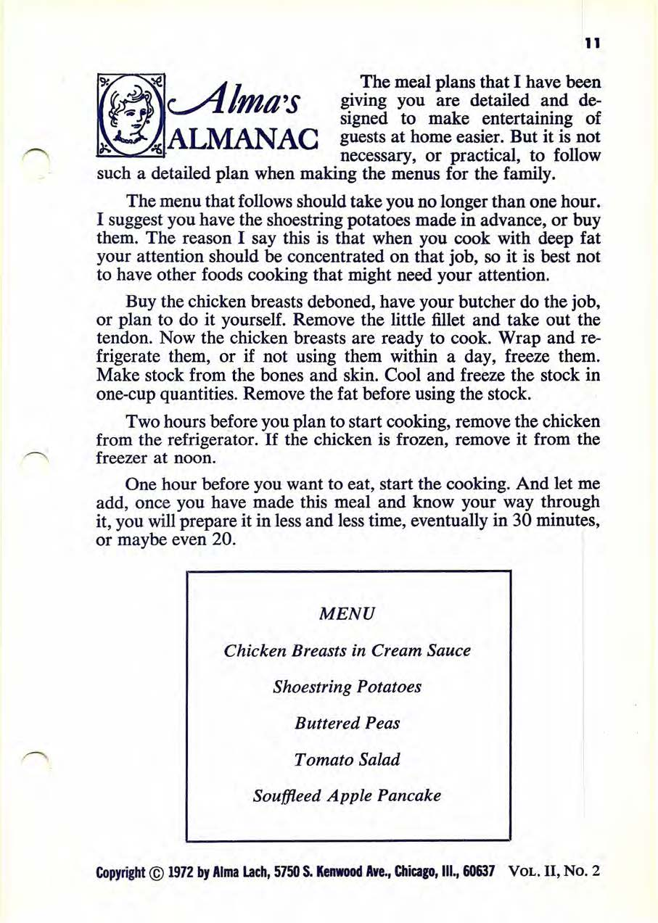
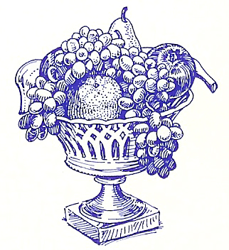

Slide 29
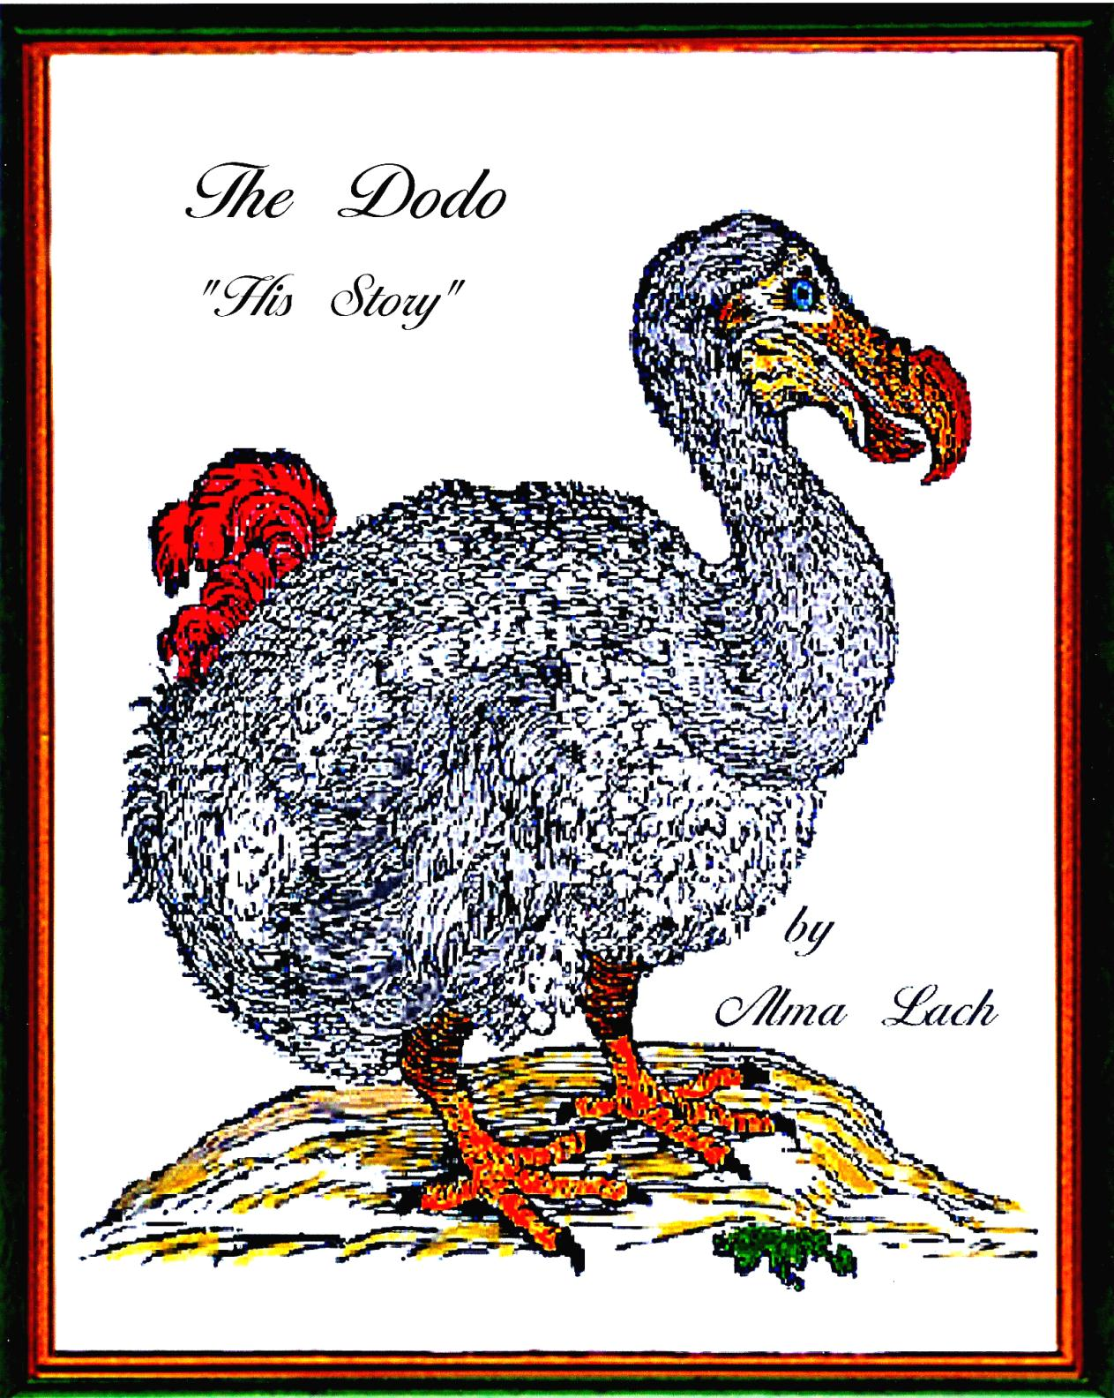
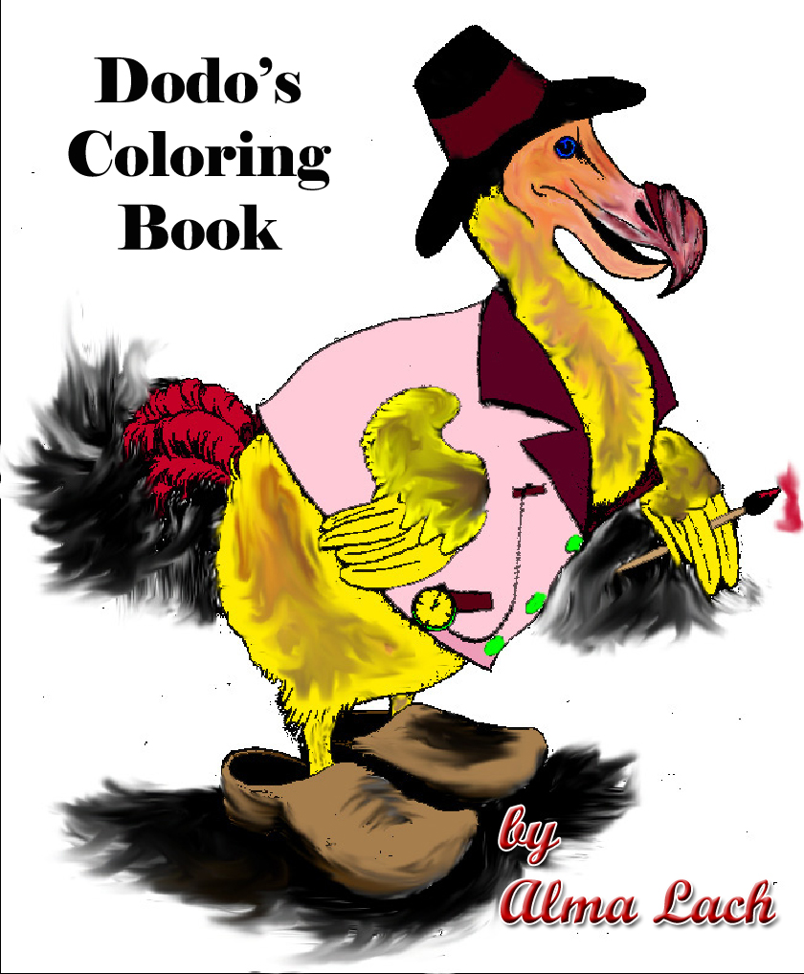

Slide 30
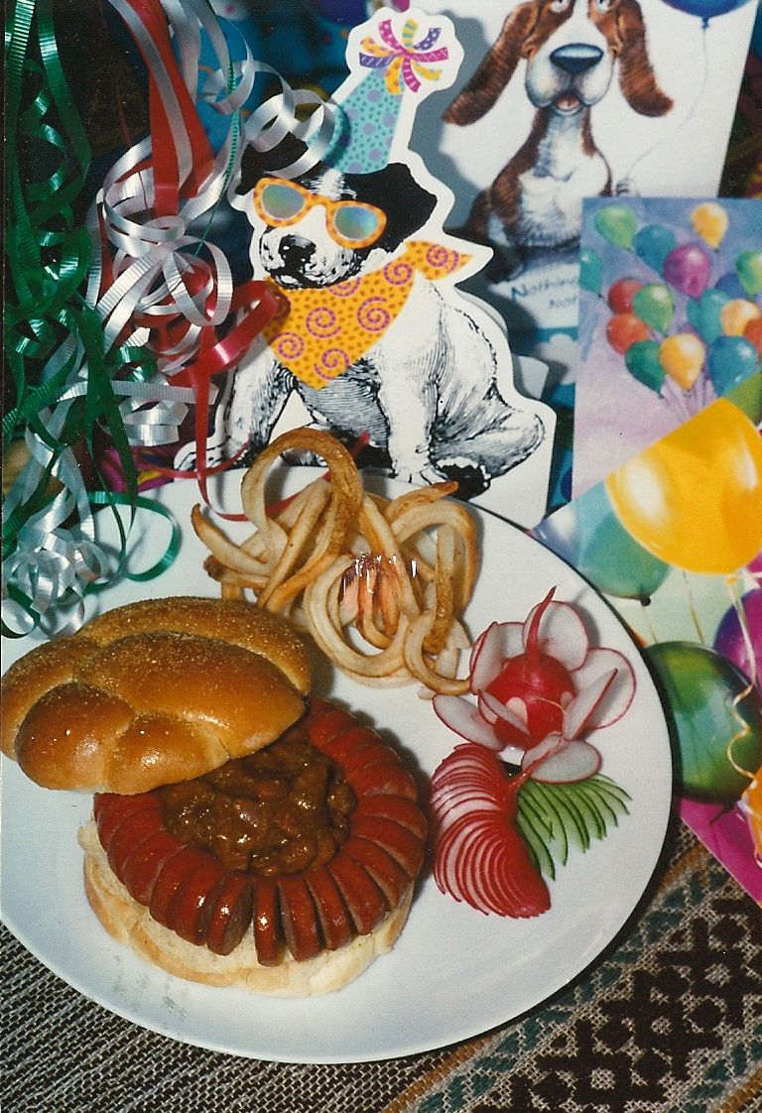
Curled hot dog
Made with a Curly Dog Cutting Board ™
These items are now served as a signature dish in the Brickhaus in Meridian, MS (owned and operated by Alma’s grandson, Bill).

Slide 31
Work Experience
Part of experimental nutrition group in Robie House
Typist in Kate Turabian’s office
Food Editor, Chicago Daily Sun-Times, 1957-65. Food Photography, Chicago Sun-Times
Director, Alma Lach Cooking School, 1963.
Food Consultant, Food Business Magazine, 1964-66.
President, Alma Lach Kitchens Inc., 1966-2013.
Food Consultant, Chicago’s New Pump Room, Lettuce Entertain You, 1967-68. Worked with Rich Melman.
Food Consultant, Bitter End Resort, British Virgin Islands, 1967-68.
Food Consultant, Midway Airlines, 1967-68.
Food Consultant, Flying Food Fare, Inc., 1967-68.
Food Consultant, Berghoff Restaurant, 1967-68.
Food Consultant, Hans’ Bavarian Lodge, 1967-68.
Food Consultant, Unocal ‘76, 1967-68.
Food Consultant, University Club, Chicago.
Resident Master, Shoreland Hall (University of Chicago), 1978-81.
President, Alma Lach, Inc.

Slide 32
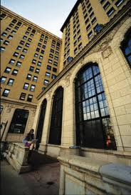
Shoreland Hall; Resident Masters

Slide 33
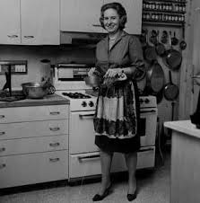
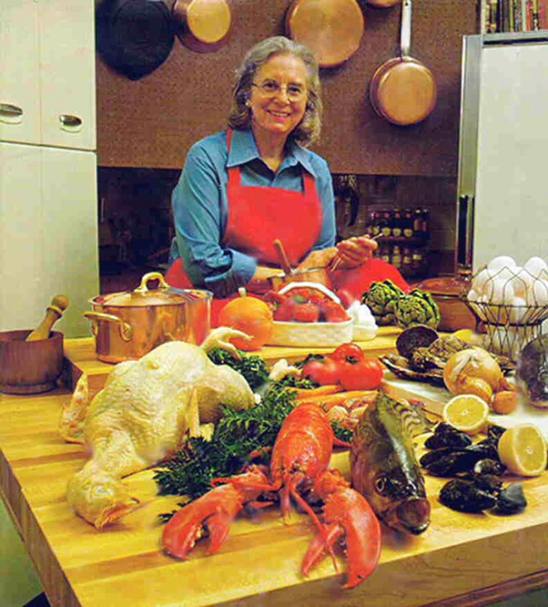
Sun-Times Test Kitchen: 5759 Kenwood Ave.

Slide 34
Media Exposure
Life Magazine, about children’s cooking, 1950.
Let’s Cook, children’s cooking show televised from the Museum of Science and Industry, 1955.
Hostess, weekly food program on CBS, 1962-66.
Over-Easy with Hugh Downs, PBS, 1977-78. Alma was featured regularly on this show
The Beacon, Feature Story, Ann Arbor City Club, 2012.
Obituaries:
Chicago Sun-Times, Maureen O’Donnell
Les Dames d’Escoffier, Joan Reardon
Michael Gebert, the Bleader
The State Journal-Register, Springfield IL

Slide 35
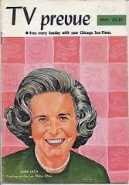
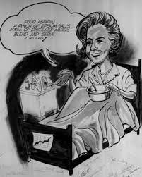
Caricatures: Sun-Times and a cartoon

Slide 36
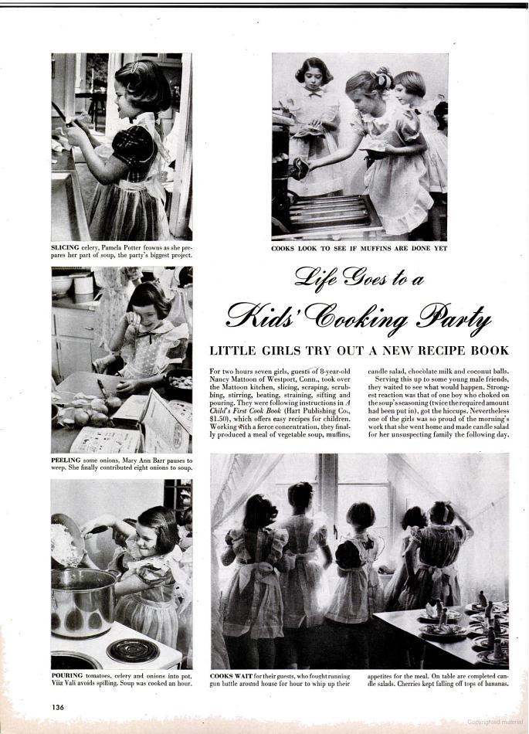
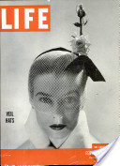

Slide 37
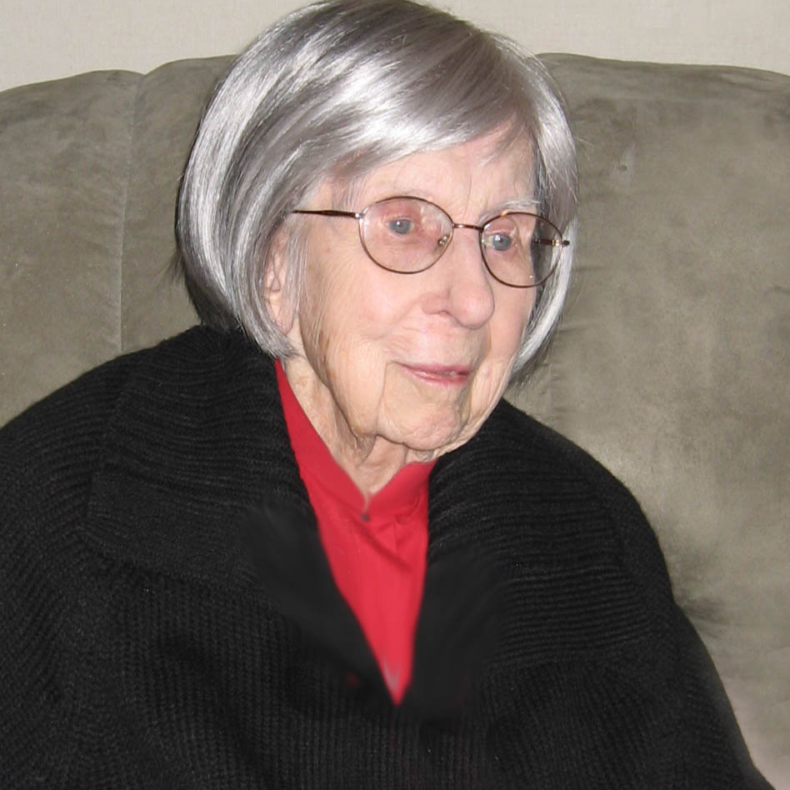
Ann Arbor City Club
Photo taken in 2012 for The Beacon.

Slide 38
Awards and Honors
4H Awards, downstate Illinois
Illinois State Typing Champion
Pillsbury Award, 1958.
Grocery Manufacturers of America Trophy award, 1959.
Grocery Manufacturers of America Certificate of Honor, 1961.
Chevalier du Tastevin, 1962
Legion d’Honneur, France
Commanderie de l’Ordre des Anysetiers du Roy, 1963.
Confrairie de la Chaine des Rotisseurs, 1964.
Biography included in Who’s Whos (Marquis): America, World, etc.
Computer Art selected for exhibition display at The Tavern Club: Pixellist Art, 1999 and later.
Dame of Distinction, Les Dames d’Escoffier, June 25, 2007.
Computer Art selected for exhibition display at the Ann Arbor Public Library
Computer Art included in permanent display at The University of Michigan Cardiovascular Center

Slide 39
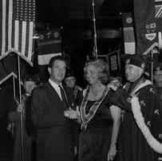
Les Anysetiers du Roi
Award presented by Jean Beliard, French Consul General in Chicago.

Slide 40
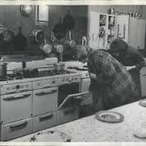
Peeking in the oven.
Perhaps in the test kitchen of Pillsbury? When she won the Food Editor’s Bakeoff, the prize was a golden ranch mink stole.

Slide 41
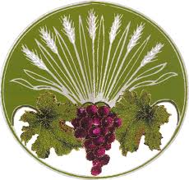
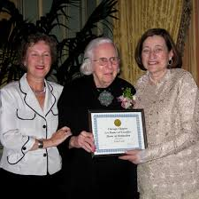
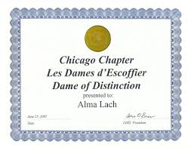
Les Dames d’Escoffier
Left to right, 2007:
Toria Emas, Alma, Barbara Glunz
Alma helped to found the Chicago Chapter of this international culinary organization. She was working on founding an Ann Arbor Chapter, based at the City Club, with Sandy, Donna Tope, Ricky Agranoff, and Pat Pooley!

Slide 42
Two scanned floral images installed in the ‘consult room’ of The University of Michigan Cardiovascular Center. This room is one where patients come who are anticipating counseling in regard to a possible heart transplant. Alma’s preventive cardiologist, Dr. Kim Eagle (not shown here; a pacemaker technician is shown here) suggested that something as beautiful as her art would work well in a room in which difficult conversation was taking place.

Slide 43
Computer Art
As she grew older, arthritis took a toll on joints in her limbs. The computer enabled her to continue with her broad artistic interests without requiring too much physical stress.
It was truly amazing to watch how she combined her photographic, food, and general artistic interests in the world of the new technology. She never shied away from learning the newest and most up to date thing!
Computer competence: Most recent computer, HP All-in-one with wireless keyboard and mouse. Adobe PhotoShop. Microsoft Excel and Word. HP flatbed scanners of various sizes. Digital cameras by various makers. Smartphone, most recent, iPhone. She tracked her stocks on her iPhone. She used the Internet for various purposes.
E-mail, alma@almalach.com; website: http://www.almalach.com/

Slide 45
Gourds become birds

Slide 46
Rabbit becomes globe

Slide 47
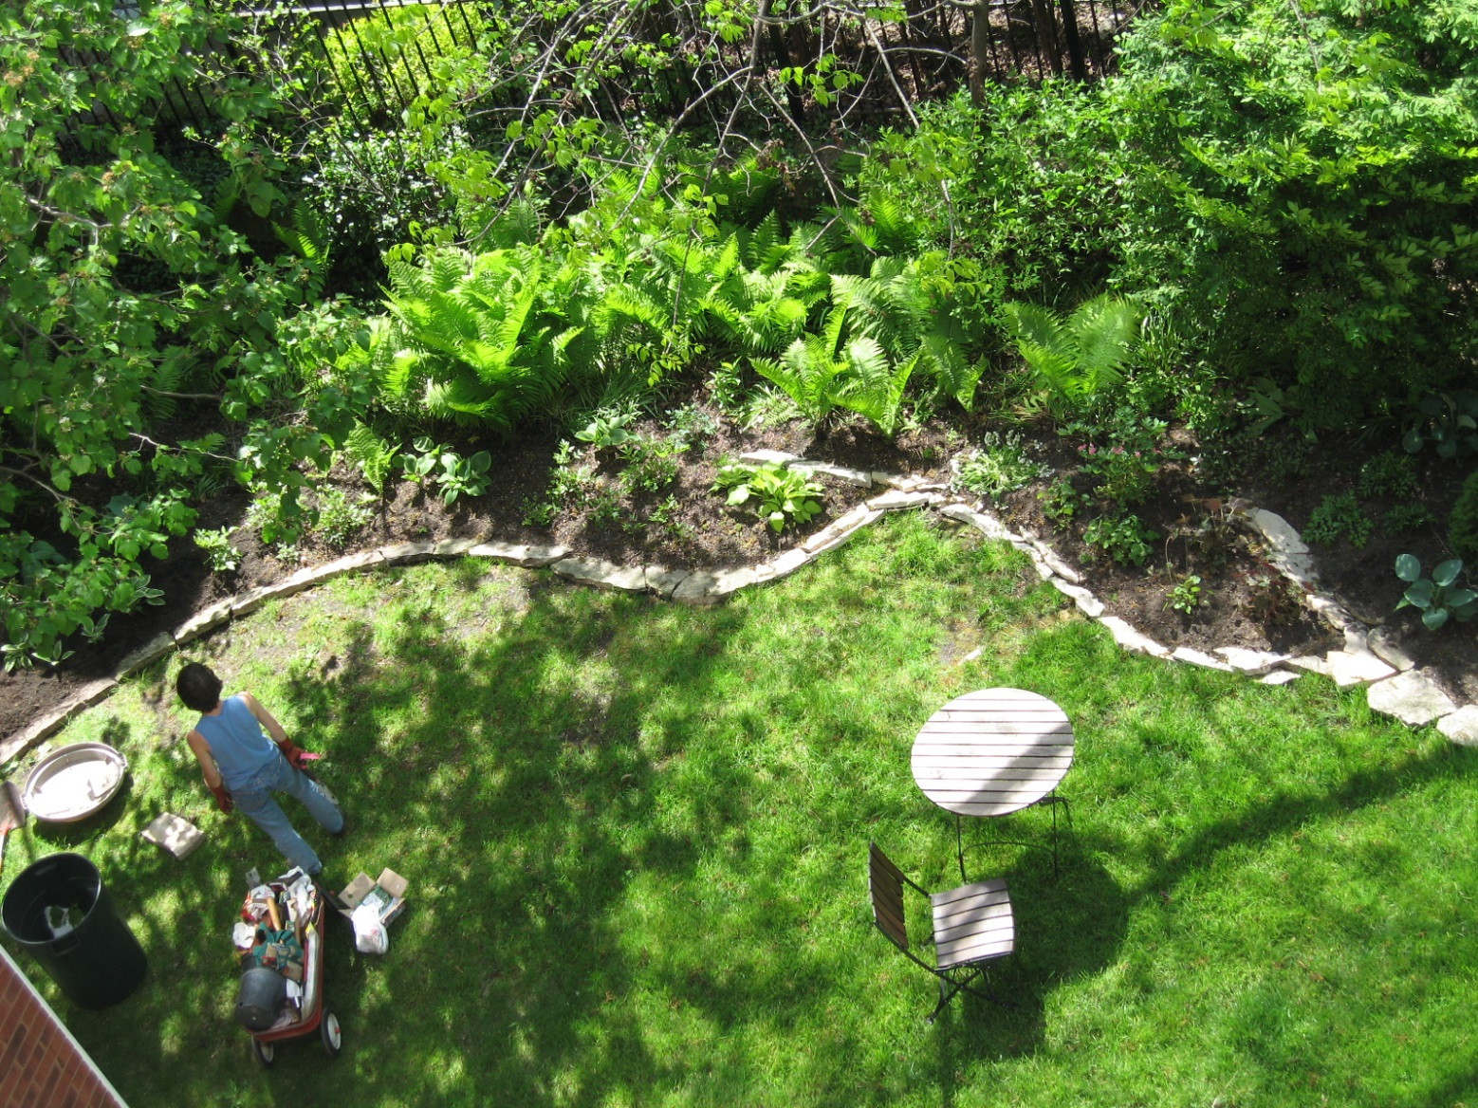
View from her Apartment: Chicago

Slide 48
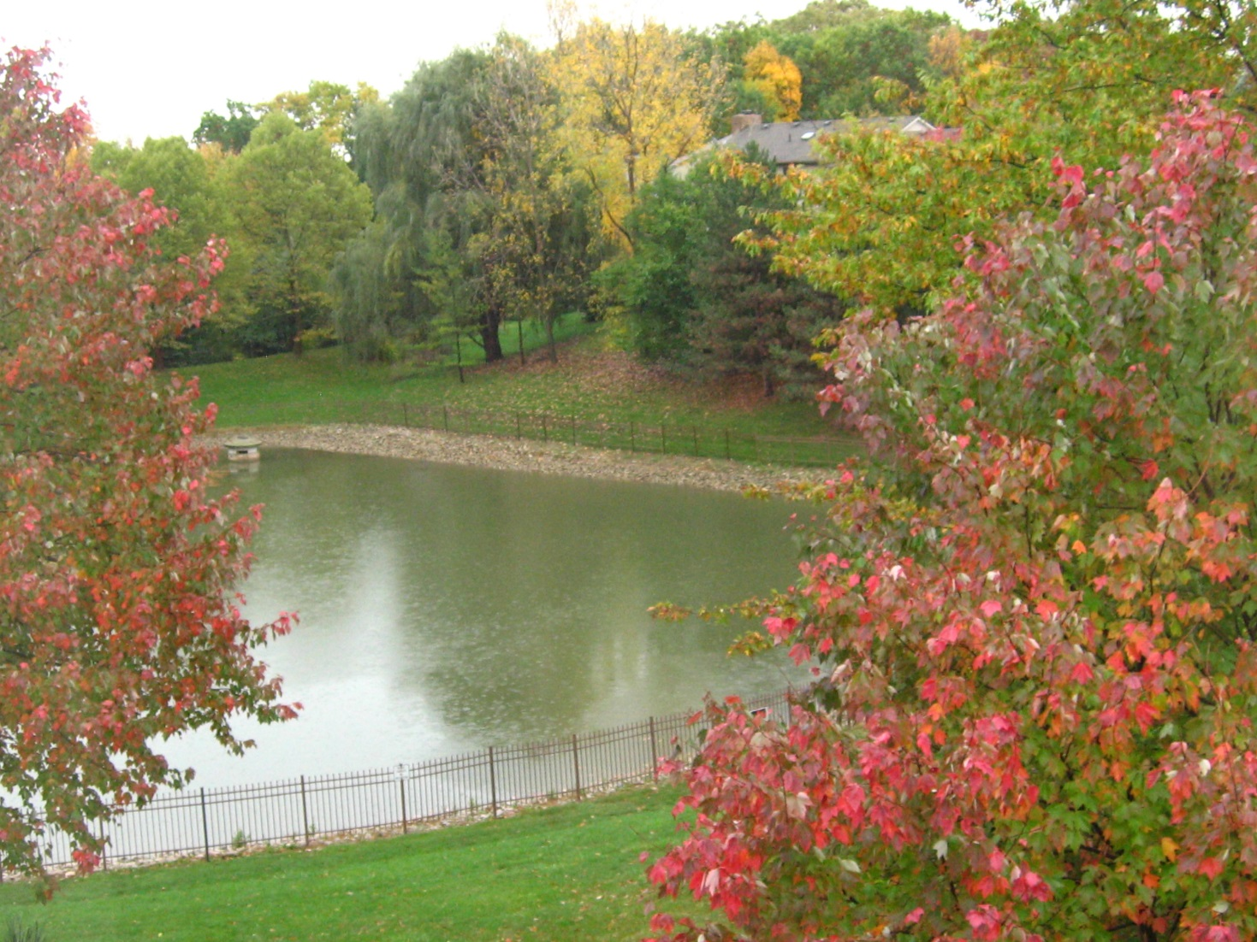
View from her Apartment: Ann Arbor

Slide 49




Selected scanned flowers

Slide 50

Scanned shrimp on the half shell
Think about what the scanner must have looked like after this image was created!

Slide 51

Sand Dollar
Alma and Donald spent memorable times on Captiva Island as guests of Herman and Jan Berghoff. Here is a memory of those fine times on the beautiful beaches.

Slide 52

Stuffed animals were fun
Binker Bear, top right, came from Les Galeries Lafayette in Paris in 1949. He is seen here wearing the special outfit given to Sandy as class mascot of the class of 1949, when the Lach family lived in Elmira, NY, for Donald’s first teaching job at Elmira College.
Bear and duckling in lower right are natives of Ann Arbor, Michigan, where they currently reside.

Slide 53

Balloon Friends
Alma loved to go to an Ann Arbor restaurant to see Gordo the Magician who made special balloon animals for her. In fact, at the Ann Arbor Celebration of her Life, Gordo came and made balloon animals for all the guests who wanted them!

Slide 54

Alma made beautiful cards, and cards, and more cards!
She made thousands of cards of her beautiful art. She gave them to friends, family, neighbors, office and medical staff, doctors, restaurant wait staff, and viturally anyone she met. In fact, in the University of Michigan medical community, many knew her simply as “The Card Lady.” She is shown in this photo next to her exhibit in the University of Michigan Cardiovascular Center Gift Shop to which she donated boxes of cards for them to use as a fundraiser.

Slide 55

Website
http://www.almalach.com

Slide 56
Mom’s Mum

Slide 57
Imaginative backgrounds
Dahlia against carved brass table.

Slide 58
Imaginative Foreground
Lalique Madonna behind fish tank

Slide 59

Poplar trees
Photoshopped with a flip to make a bilaterally symmetric image.

Slide 60

Tulip tree flower
Alma’s father placed one on the grave of Ann Rutledge in downstate Illinois. Alma gathered seeds from that tree and planted two in front of 5750 Kenwood where the trees had long lives. Later, in Ann Arbor, her condo association planted one (from different seed stock) outside the window of her apartment there.
Tradition continues…

