Slide 1
CSF Intern Programme: Honorary Interns Sandra L. Arlinghaus, Programme Director Paid Interns Kris S. Oswalt, Programme Director
16th Anniversary

Slide 2
Mission: Honorary Interns
CSF honorary interns are offered the opportunity to interact with the rest of the CSF extended family. No requirements are made of the interns. Interns are free to craft the opportunity to suit their interests and needs. As they “graduate” from CSF, we hope they leave the Foundation with highly positive memories of the people they met, and that perhaps one day in the future, they will wish to return, as Research Associates in conjunction with an otherwise successful career, as partners from one Foundation to another, or as Trustees of CSF.

Slide 3
CSF Honorary and Paid Interns: 1995 to Present
(in reversed chronological order)

Slide 4
*Stacy Potthoff , Chicago, Illinois *John Toner, Brooklyn, NY *Haydee Izaguirre , Ann Arbor, Michigan *Candie Cassabalian Formson, Nice, France Jennifer Horton, Master’s Student, S.N.R.E. and U.T.E.P.; U.M. Emily Chi, Master’s Student, S.N.R.E. and U.T.E.P.; U.M. Kerry Ard, Ph.D. student, S.N.R.E. and Sociology, U.M. Allain Rasolofoson, M.P.H. Loma Linda Medical Center; Ph.D. student, S.N.R.E.; M.A. Math./C.S., E.M.U. Luci Y. Kim, Ph.D. Candidate, S.N.R.E. Seung-Hoon Han, Ph.D. T.C.A.U.P. Peter Vincent, M.S., S.N.R.E.; M.U.P. Makoto Noguchi, M.U.P. Hyeyun Lee, M.U.P. Eun-Young Kim, Ph.D. Candidate U.T.E.P. Ming-Hui Hsieh, M. A. English, M.S.U., and M.A. Ed. U.M. Richard Wallace, Ph.D. Candidate, U.T.E.P. Marc Schlossberg, Ph.D. U.T.E.P. Robin Saha, Ph.D. S.N.R.E. Seema Iyer, Ph.D., U.T.E.P. Tamana Nishiguchi, M.S. S.N.R.E. Rosalyn Scaff, M.U.P. Richard Aishton, Ph.D. S.N.R.E. Astrid Hillers, M.S. in Engineering and S.N.R.E. Dan Jacobs, M.A. Ed. S.N.R.E. = School of Natural Resources and Environment; University of Michigan (U.M.) U.T.E.P. = Urban, Technological, and Environmental Planning; University of Michigan (U.M.) T.C.A.U.P. = Taubman College of Architecture and Urban Planning; University of Michigan (U.M.) M.U.P. = Master’s of Urban Planning (U.M.) * = Paid Intern

Slide 5
Honorary Interns

Slide 6
Jennifer Horton
Jen is working on her Master’s Thesis in Environmental Justice in SNRE (Committee: Paul Mohai, Dan Brown, Sandy Arlinghaus) and U.T.E.P.
Research Questions
What are the adverse environmental effects of confined animal feeding operations (CAFOs) in North Carolina flood plains?
Why are most of the CAFOs in North Carolina sited in the flood plains?
Are communities adversely affected by these sitings within flood plains?
Environmental justice: are CAFOs being sited in marginalized communities?
Methods
Use GIS and remote sensing data to analyze the environmental burden of siting CAFOs in flood plains
Use GIS to overlay current census tracts, flood plain data, and CAFOs (taking GIS course in the Fall to help me work on this project)

Slide 7
Emily Chi
Emily is working on her Master’s Thesis in Environmental Justice in SNRE (Committee: Paul Mohai, Sandy Arlinghaus). Marc Schlossberg, former CSF Intern, was helpful in setting up contacts for GIS data.
Her draft proposal, which involves an analysis of environmental justice issues in relation to park access (data for City of Portland, Oregon) contains the following headings:
Park distribution and demographics
Air quality in parks
Demographic characteristics across parks with varying air quality
Asthma and air pollution
Asthma rates in park access areas
Asthma rates across parks with varying air quality
Asthma rates in polluted areas: parks vs. nonparks

Slide 8
Kerry Ard
Kerry is working actively on her dissertation. She resides in Ann Arbor and can freely interact with CSF Headquarters as she wishes.
The first slide that follows shows an excerpt of a press release about some of her work.
The second slide that follows shows a connection to that work.

Slide 11
Allain Rasolofoson
Allain had been an earlier student in NRE545 in 1996. He wrote on “Deforestation in Madagascar.”
Later, he approached first Bill Drake and subsequently Sandy Arlinghaus to express interest in participating at CSF; thus, he became an Intern.
To date, he has been unable to attend annual meetings, but he has expressed interest in participation at other times, perhaps as a collaborator of some sort.
Current affiliation: Allain Rasolofoson joined the Global Initiatives Project (University of Michigan) as a Research Associate since December 2006. He has a B.S.E. in Chemical Engineering, a Master in Public Health, and a M.A. in Mathematics & Computer Science. His international experience includes Madagascar and Ivory Coast (West Africa). For the last 5 years, he has been extensively working with database development and data analysis.
Link to a publication: Central Regional Database for Great Lakes Regional Aquatic GAP--Dora R. Passino-Reader¹, Scott R. Nelson¹, Jana S. Stewart², Allain J. Rasolofoson³, Judith C. Thomas², and Limei Zhang¹

Slide 12
Luci Y. Kim
Intern Luci exhibits much imagination in her carefully crafted maps.
She continues to work on her Environmental Justice dissertation in the School of Natural Resources and Environment, University of Michigan (Paul Mohai, Chair; other committee members include Sandy Arlinghaus).
Link to material she created in UP507 in 2003: A Look at the People and Pollution, Republic of Korea

Slide 13
Seung-Hoon Han
Seung-Hoon was meticulous in his approach to mapping. He found new capability an intriguing challenge and would work into the night mastering it and finding outstanding uses for it.
Served on his dissertation committee (as did John Nystuen). He is in Architecture with emphasis on collaborative, distributed computing. Selected references:
Seung-Hoon Han (2006) A Study on the Distributed Collaborative Architectural Design System . Journal of Asian Architecture and Building Engineering, Vol. 5, No. 1 pp.67-74
Han, Seung-Hoon. “ARCH:DMUVR – A Working Prototype of a Distributed Collaborative Design System.” International Journal of Architectural Computing, Vol 3, Issue 2, June 2005 (United Kingdom: Multi-Science). pp. 203-226.
Spatial Analysis of Subway Zones in Boston, Massachusetts , UP507, Winter 2001. Based on material created as a graduate student in Architecture, The University of Michigan. The author's undergraduate degree is from Harvard College. Work done in UP507: link
Seung-Hoon has been in touch periodically, asking for letters of reference for positions in Korea.

Slide 14
Peter Vincent
Peter was a student in NRE430, Spatial Analysis, Theory and Practice, in the Fall of 1999.
He became interested in Triangulated Irregular Networks and related them to his interests in Great Lakes bathymetry (he also served as an intern at the Great Lakes Environmental Research Laboratory in Ann Arbor). We learned together how to create these maps that were absolutely amazing at the time. One of them follows on the next page. Sometimes we would have to let the computer run for more than a day to create one image; sometimes it would crash and we’d have to start over. These maps pushed the leading edge of the technology available to us at the time.
Link to his TINs; they take a long time to load.
His work later helped to inspire part of an article in Solstice, linking geography and music composition: link.
Peter stayed in touch for a few years following his graduation.

Slide 16
Urban Planning
The following set of interns were recruited from teaching (SA) of urban planning courses (GIS, in context)—the three that follow all took UP507 in 2002.

Slide 17
Makoto Noguchi
The Possibility of Extending Streetcar Line in Kagoshima City, Japan
Link in Solstice
Features of his project that made it related to CSF interests:
Animated maps
Hand-digitized original maps
Field evidence
Volume of flow map in the style of Napoleonic map

Slide 18
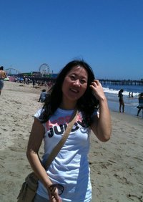
Hyeyun Lee
The Relationship between Bicycle Accidents and Lanes of Travel at Downtown Ann Arbor Intersections
Link in Solstice
Features of her project that made it related to CSF interests:
Interactive internet map
Animated map
Accumulated historical field evidence
Interview results (Prof. J. Nystuen, CAUP/UM)
Significance testing
Work with client, Matthew Naud, City of Ann Arbor, Environmental Coordinator.
Yun also had outstanding capability in the fine arts: drawing, painting, ceramics, and so forth.
Yun subsequently, based on this urban planning work, held an internship with the City of Ann Arbor, with Matt Naud.
She has kept in touch, off and on, over the years. Facebook link.

Slide 19
Eun-Young Kim
Bus Stops and Bus Users in the City of Detroit
Link in Solstice.
Features of her project that made it related to CSF interests:
Interactive internet map
Over 50,000 files--not all may be active all of the time
Clickable map
Aerial photos
Field photos
Field interview results.

Slide 20
Interns at 1120 Hill Street
The set of interns that follows had the good fortune to work in the light green house at 1120 Hill Street when CSF Headquarters were housed there. Each had a key and could come and go as he/she wished to take advantage of computers, softwares, and most of all, interaction with each other and with CSF human resources.

Slide 21
Ming-Hui Hsieh
Ming-Hui was incredibly enthusiastic about integrating technology in a wide variety of projects. She worked with me as we both learned new twists on using interesting (often free) software to make websites. As the Internet was developing, we worked along with it, trying to keep pace with this wonderful new capability. She had amazing patience with students, as well. Thus, she became, courtesy of Fred Goodman, a Teaching Assistant in a GIS course I taught in Urban Planning, where again her work was excellent.
Ming-Hui was quite creative with her CSF Internship. I remember that she once asked Bill Drake if she and her husband might try to improve the physical network of computer and phone lines at CSF. We said yes, because we knew them to be thorough and careful. There they were, into the night, climbing up on chairs to run phone wires over the tops of doors so that no one would trip on them. Of course, they did a great job.
Ming-Hui is the most recent of the interns to have been housed at 1120 Hill Street.
Ming-Hui is currently a Full-time lecturer, National Central University Language Center, Taiwan, where she teaches English. I keep in touch with her over the e-mail and have seen her on three occasions when she and her husband have returned to visit friends and colleagues in Ann Arbor.

Slide 22
Richard Wallace
Richard spent many hours in the CSF house at 1120 Hill Street.
As he worked on his own projects, he shared his wisdom with others who came in to the house, be they students coming to office hours or others.
Like others before him, Richard was extremely gregarious when on the premises. He was eager to share his enthusiasm for his own work and for the work of others.
Link to work appearing in NRE 545 Monograph, 1994.
1995 , Solstice article: Volume VI, Number 1 Richard Wallace: "Motor Vehicle Transport and Global Climate Change: Policy Scenarios."
Richard and his wife Kami Pothukuchi reside in Ann Arbor and periodically participate in CSF or other events (often in his role of serving IMaGe) involving some CSF folks. Richard is a Lecturer, Engineering Undergraduate Education. Kami is an Associate Professor in the Department of Geography and Urban Planning at Wayne State University.

Slide 23
Marc Schlossberg
I first met Marc upon his return to the US from serving as a Peace Corps Volunteer in Fiji.
Later, he became a student in some GIS courses I taught in SNRE (while he was also teaching GIS in urban planning).
He had great interest in mapping and carried that interest with him into his CSF internship.
Marc Schlossberg Associate Professor (Department of Planning, Public Policy, and Management, University of Oregon), Associate Director of Oregon Transportation Research and Education Consortium (OTREC). Research interests: The use of GIS personal digital assistants (PDA) for public participation, understanding walkability of the built environment, and safe routes to school for children.
Currently Marc is on a Fulbright in the UK, at the University of Sheffield.
I keep in regular touch with Marc; he also serves the Board of IMaGe.

Slide 24
Robin Saha
Robin spent many hours at 1120 Hill Street working on maps for his dissertation. Any time I went to the house, there was Robin. Any time we drove past it, including late at night, there was Robin. His work ethic was a model for all of us! He, as have so many others, took great advantage of the opportunity afforded him by CSF.
Robin is currently an Associate Professor of Environmental Studies at the University of Montana. Read the following link and reflect on his early experience at CSF.

Slide 25
Seema Iyer
Seema spent time learning a variety of mapping skills at CSF: from digitizing on the digitizing table, to digitizing on the screen, to overlaying layers of information using a variety of tools. She was interested in the logic and geometry of how mapping works.
Seema brought her husband Kaushik to CSF on occasion; Seema and I enjoyed talking about a wide variety of topics in addition to her project at hand.
She has kept in touch periodically over the years and has a successful career in planning (link).

Slide 26
Tamana Nishiguchi
Tamana, Luejit Tinpanga, and Hitomi Sasaki spent much time at 1120 Hill Street working on their NRE545 projects (1996). Tamana was always full of questions and appeared to want to know everything I knew (or anyone else knew) about anything or anyone in the world, immediately. Her curiosity was insatiable. Hitomi had a spectacular sense of interesting color combination. Luejit was enthusiastic about everything and always had a smile on her face. Often they were joined by their colleague, Hideo Kuramitsu, another hard worker. These four young Asians interacted with each other on their own terms and, with equal grace, with the many others who came in and wondered what they were doing. Often, this “triafeminate” got so involved in work that Hideo would need insert his strong voice to interrupt and say “Let’s go to lunch.” And, they did, only to return and work into the night.
Link to the works from that class.
A few years after graduation, Hitomi asked me for a letter of reference for a position in Asia.
We heard that Tamana, following graduation, went to work for the Asian Development Bank (which her father headed).

Slide 27
Rosalyn Scaff
Ros and I ate many brown-bag lunches together on the front porch of 1120 Hill Street where we talked about mapping the world, problems of the world, and anything else that came to mind.
Ros made an excellent clickable map of Ann Arbor neighborhoods. In fact, the City hired her as an intern to produce a full map of the same sort, and her original work served for many years as the basis for the online clickable neighborhoods map on the City of Ann Arbor website.
I hear from Ros on a regular basis, once or twice a year. She currently lives and works in the New York City area at the Center for Neighborhood Technology. She has (or had) extended family in Michigan (her father was Dean of Liberal Arts at Wayne State).

Slide 28
Richard Aishton
Richard spent much of his time in Russia; his family (wife and children) were based in Maine. Nonetheless, he found some time to spend in the house at 1120 Hill Street and was enthusiastic about learning to use CSF mapping software to capture electronically the maps of Russia that he had acquired on his various trips. He shared his enthusiasm with others who periodically came to the house.
Link to a 1995 paper Richard wrote while a student in NRE 545.
Richard is currently located in Brussels, Belgium, at the International Union for Conservation of Nature: link.

Slide 29
Astrid Hillers
Astrid participated as an auditor in NRE545 and also in NRE501/043. She often worked in the house at 1120 Hill from early morning into the evening hours. When she became an intern at UNDP, she kept up her contact with CSF.
She made, as part of her SNRE Master’s project (Drake and Arlinghaus, co-chairs), a wonderful clickable map of the world’s water resources using maps and data from the World Resources Institute.
After graduation from UM (in Engineering and SNRE) Astrid worked for the United Nations in New York and is now, and has been for a number of years, at the World Bank in Washington D.C. She is a Senior Water Resources Specialist and Senior Environment Specialist, Climate Change Unit, at World Bank . Read about her work there (in the link above) and reflect on the fact that she had experience early in her career at CSF.
Astrid has been by far the most active intern after graduation. She has returned regularly to Ann Arbor for CSF Annual meetings, and has often communicated ideas and data sources. She has talked, as well, of getting CSF folks together in Washington. Her pattern of contact is one that is a model for the CSF Intern Programme.

Slide 30
Dan Jacobs
Dan did much of his work in mapping the US Route 12 project in the CSF house at 1120 Hill Street. He helped students who came in, enthusiastically initiated interaction with others on a host of topics, and served generally as a bright and creative influence. I remember when he finished his mapping how pleased he was to receive a color printer of his own as a gift! It was a pleasure to give it to him. Copies of two of his maps, from the mid-1990s, appear on the next pages. Later, these appeared in an article.
Fall, 1996. Based on his outstanding performance as a CSF Intern, Dan served as a Teaching Assistant, courtesy of Fred Goodman, for Sandy in NRE501, Section 043, Spatial Analysis, Theory and Practice.
After graduation, Dan became a teacher. He is currently a teacher in the Upper School of The Roeper School.
Dan has kept in touch off and on. He has come to some of our annual meetings and associated parties.

Slide 31
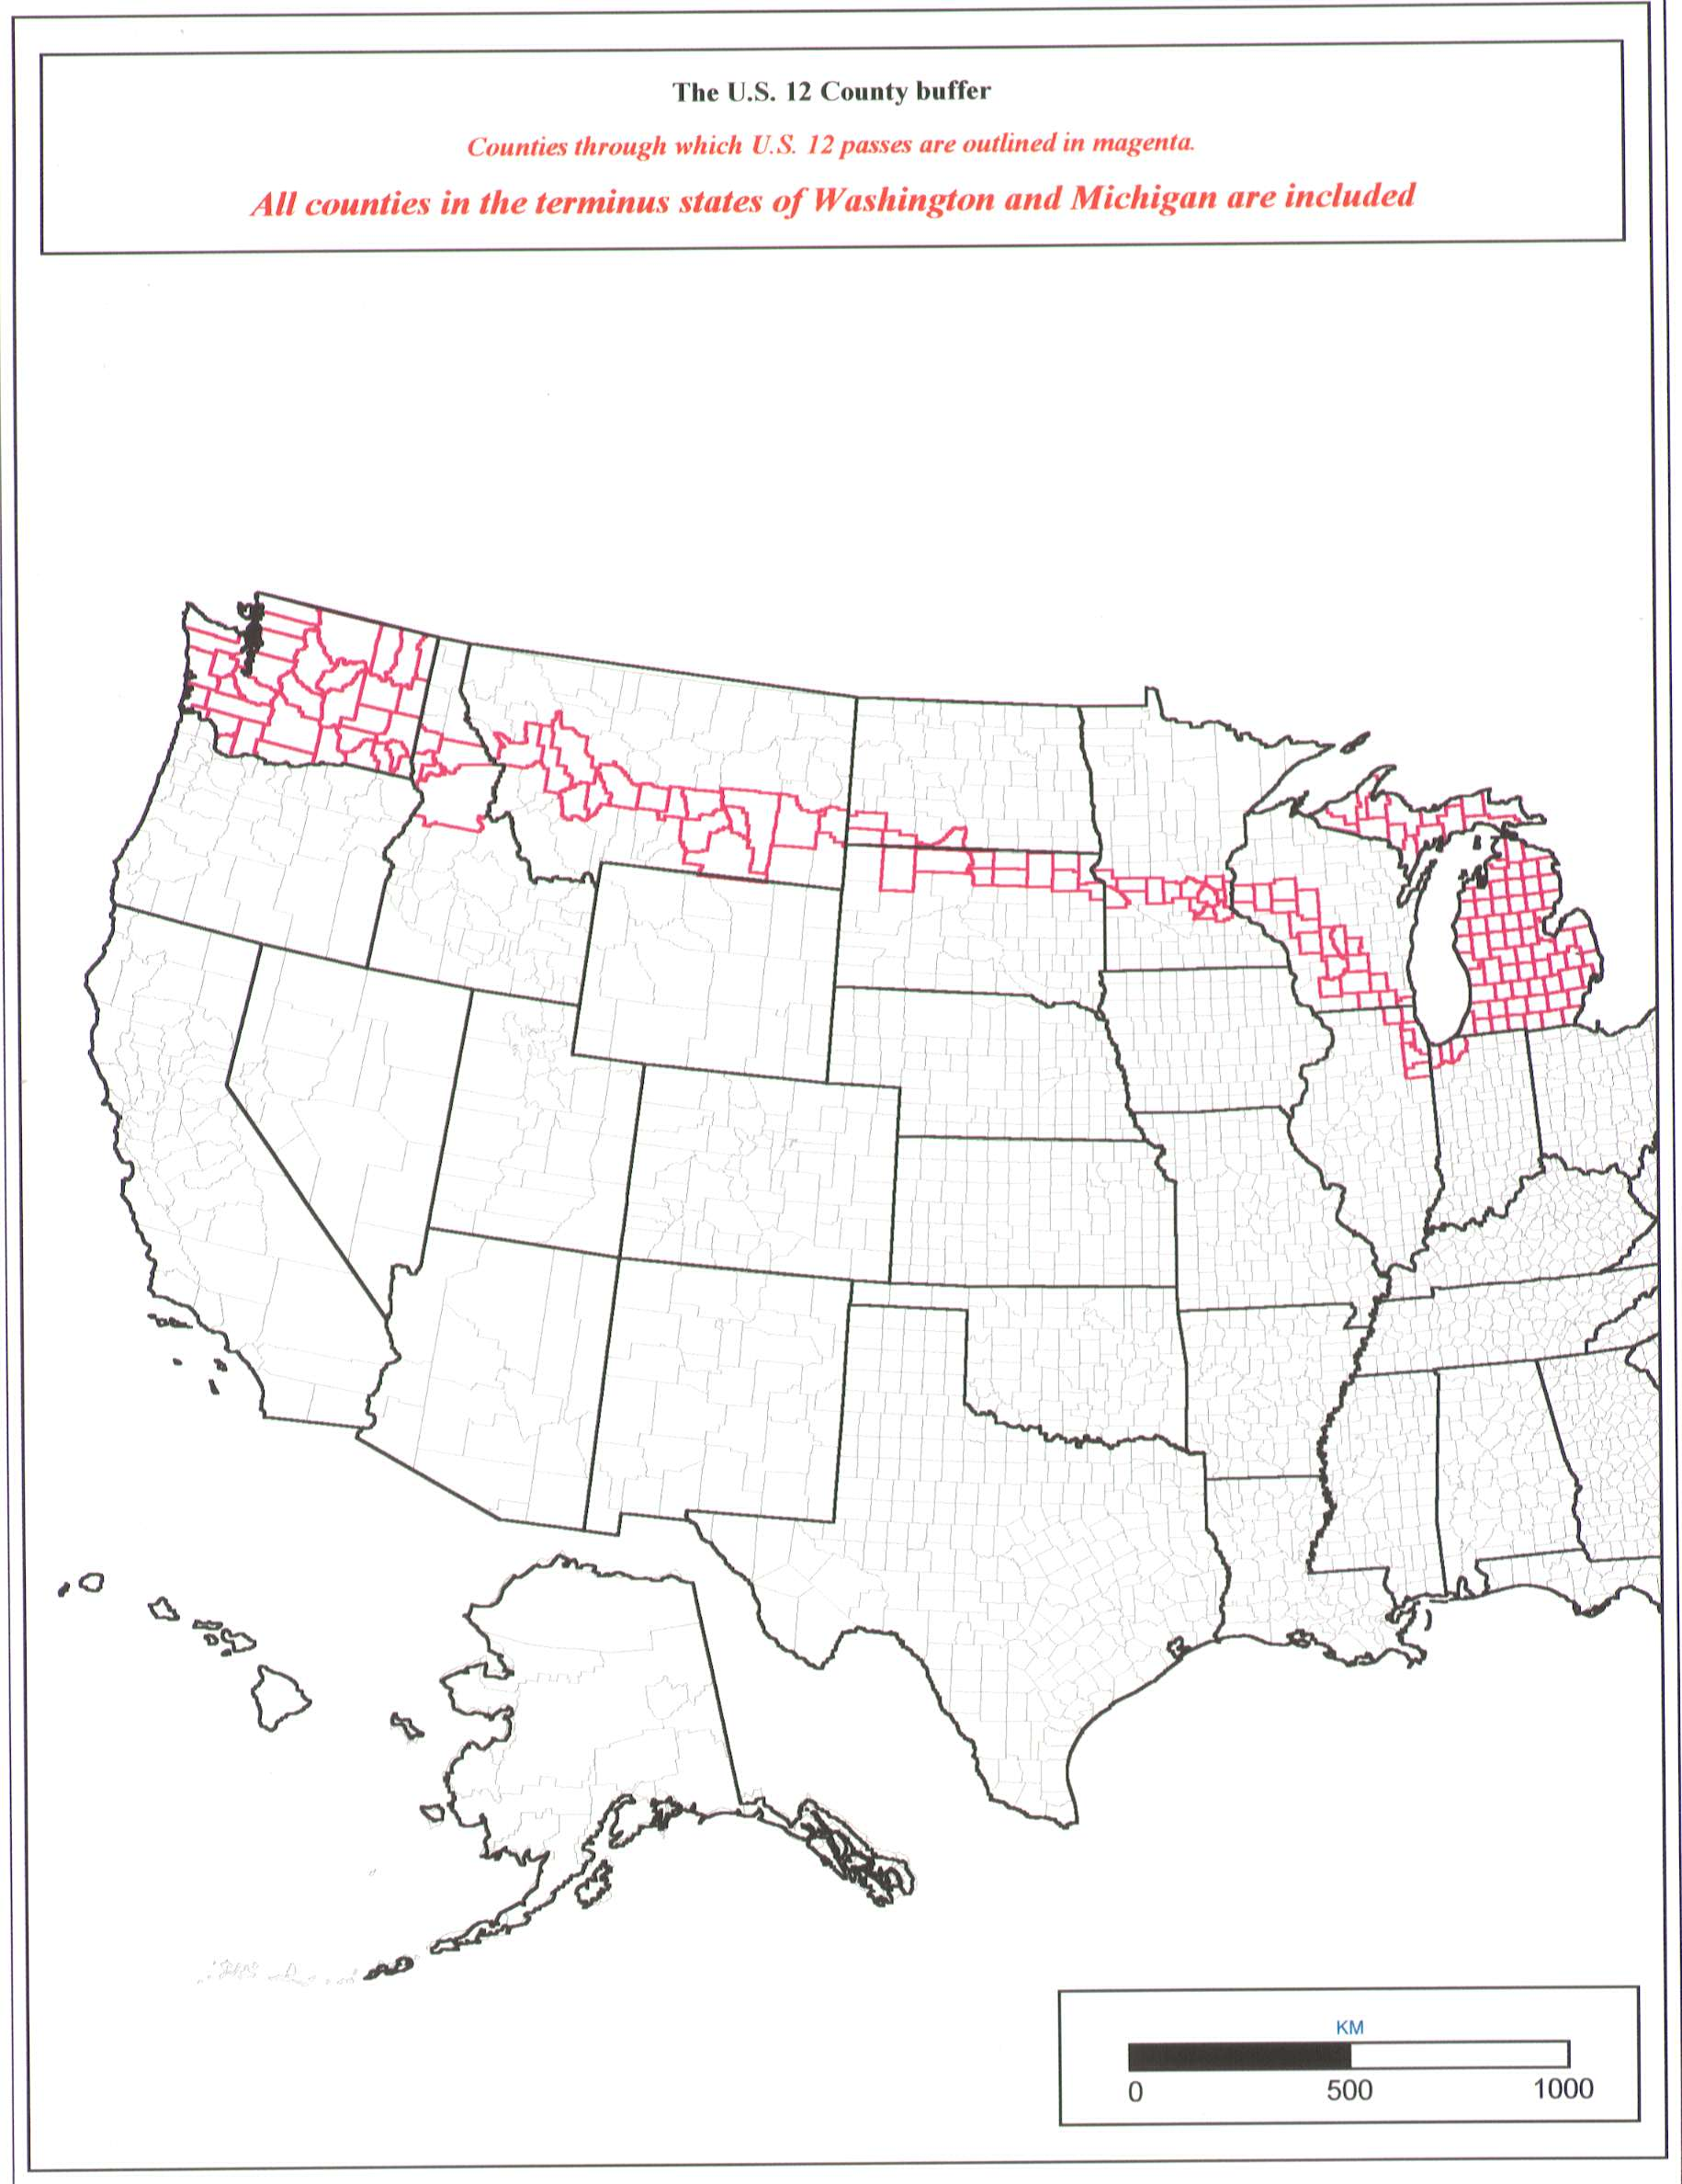

Slide 32
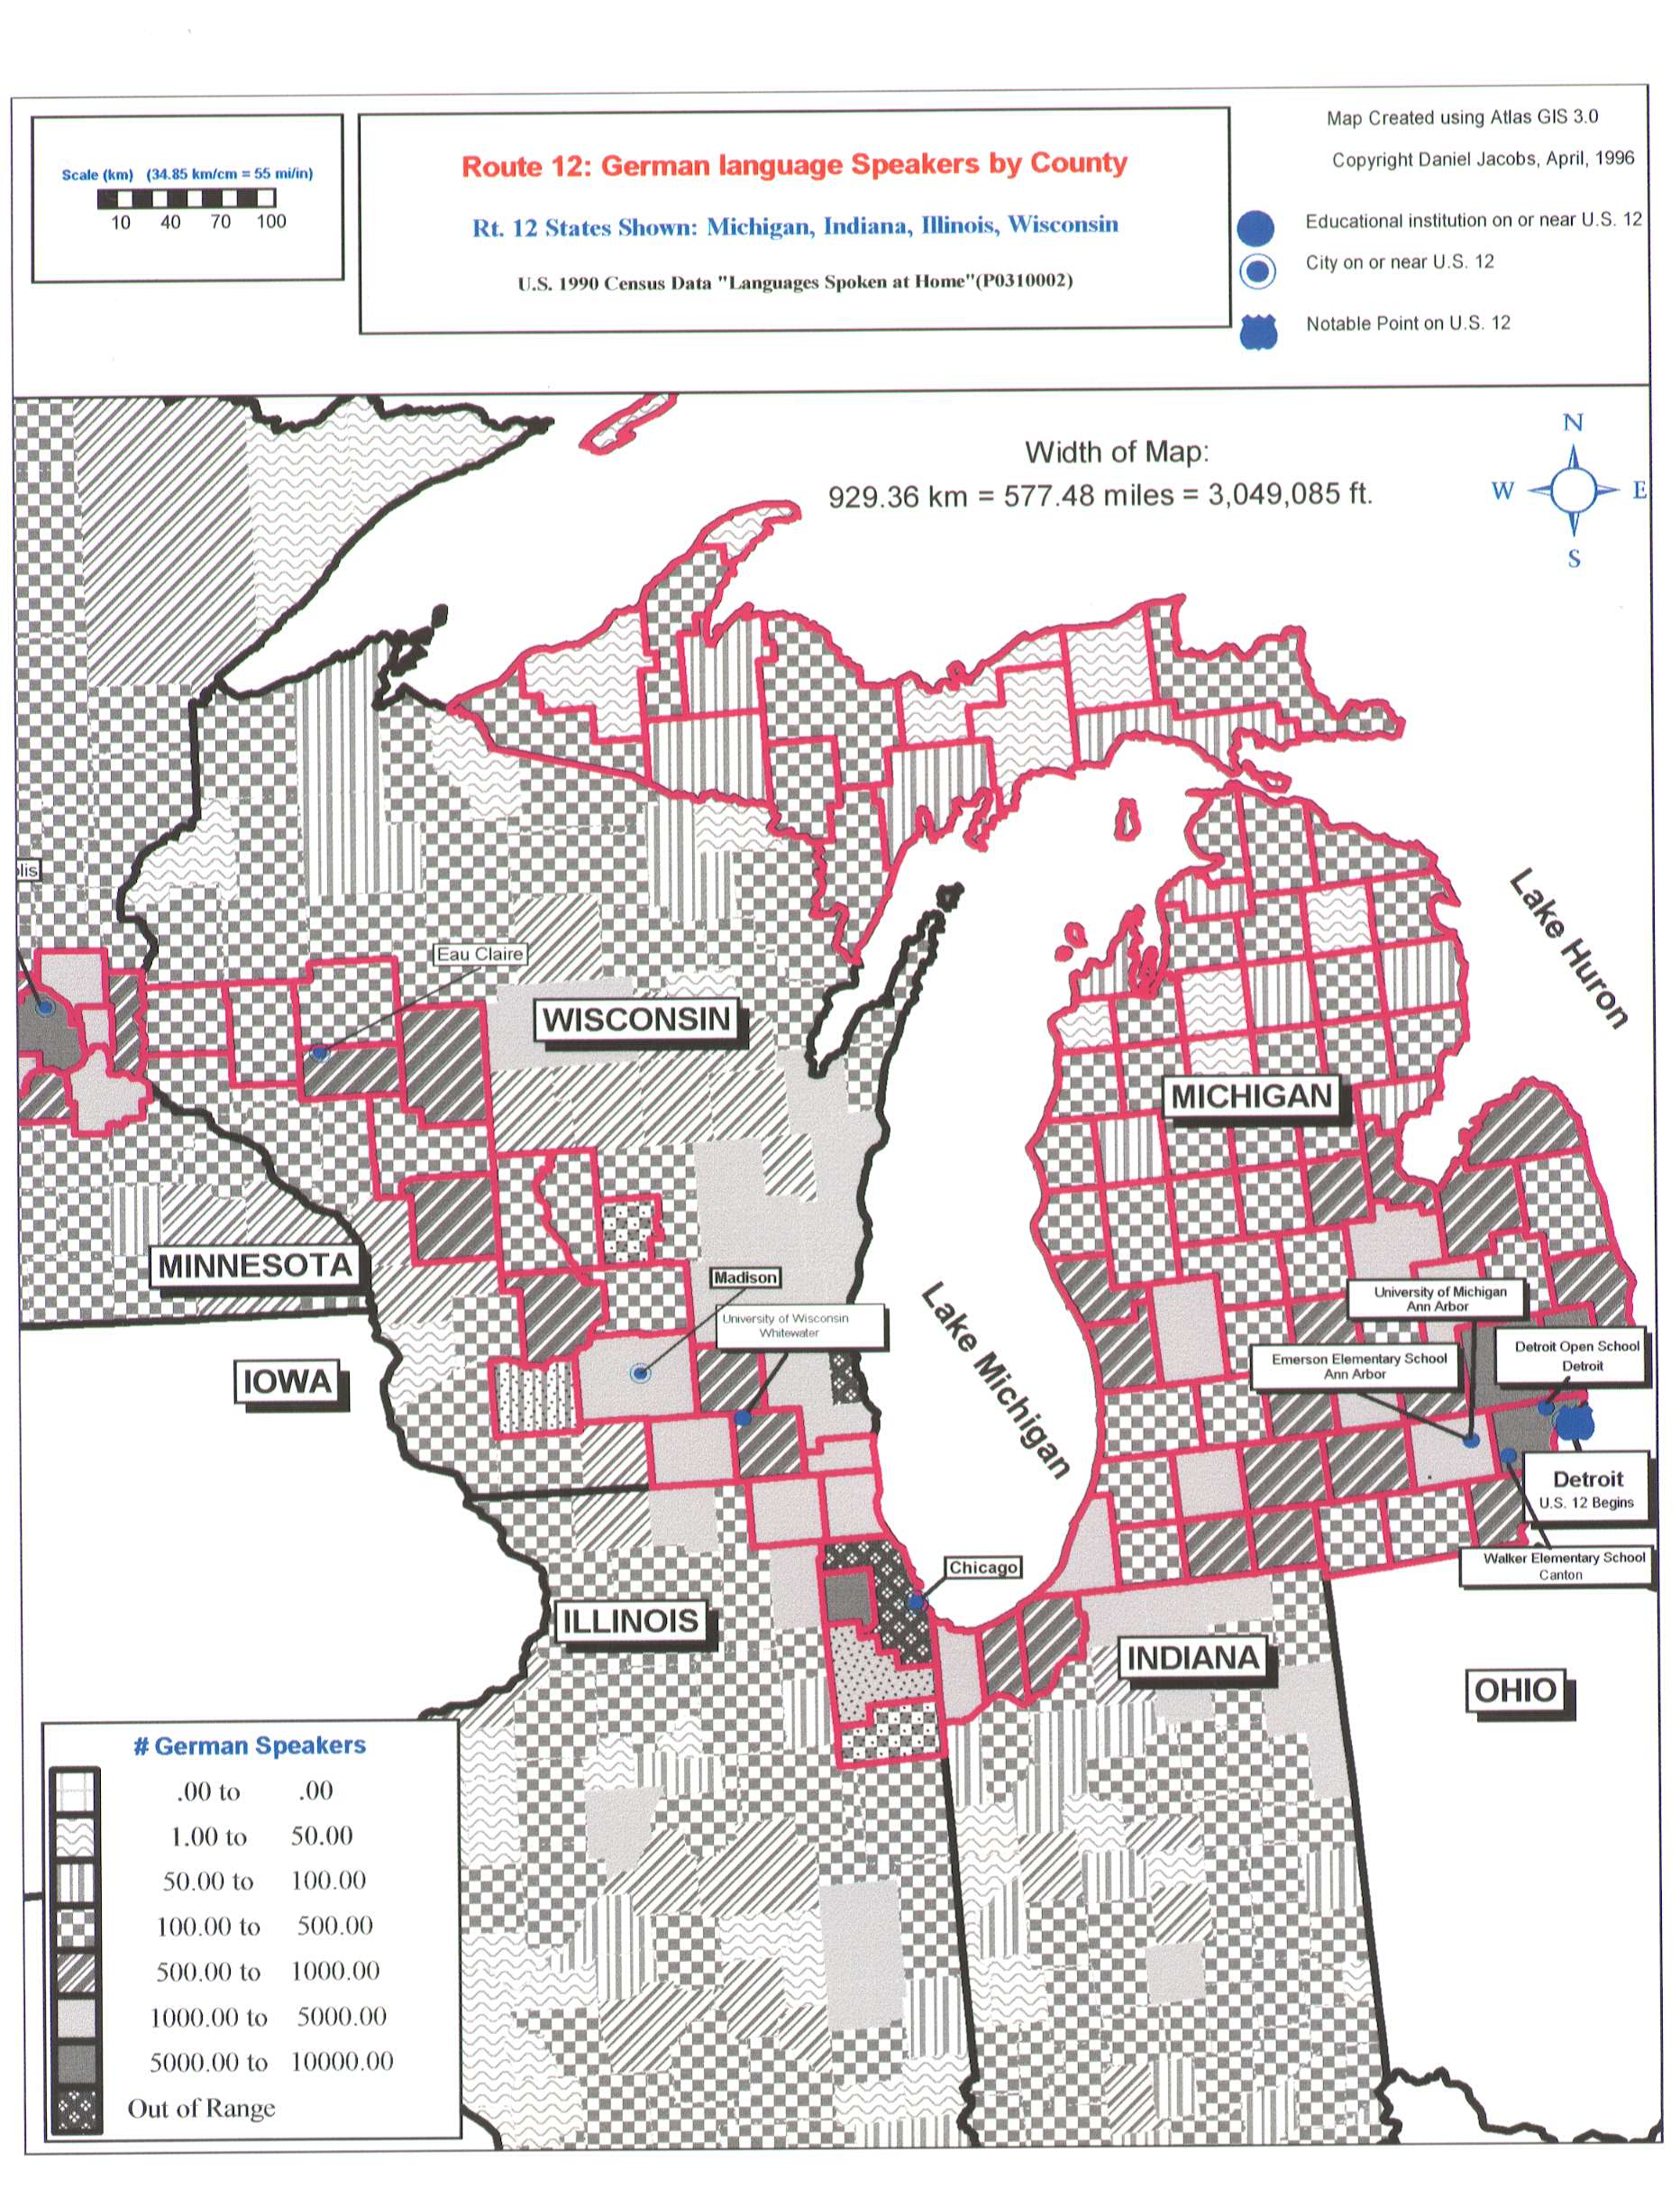

Slide 33
Others…
Many others used to “hang out” and function as interns themselves, although our records show that they were not formally interns.
1992, from NRE545—Eugene Fosnight, Katharine Hornbarger, Deepak Khatry, Catherine MacFarlane, Stephen Uche.
1993, from NRE545—Sanjay Baliga, Bruce Frayne, Kameshwari Pothukuchi, Rhonda Ryznar, Caroline Stem. Caroline kept in touch with Bill Drake for many years following her graduation. She was working in South America.
1994, from NRE545—Deborah Carr, Soonae Park

Slide 34
Others…continued
1995, from NRE545—Andrea Frank, Lily Lombard, Diane O’Connell, Erin Perry, Lynelle Preston, Gwo-Wei Torng. Lily practically lived at 1120 Hill; often she brought her husband, John Lombard. They took turns, one time, sitting in the house all bundled up in cold weather waiting to let the furnace repair man in (neither Bill nor I could be there). Lynelle was also an enthusiast; she brought her parents (from Vermont) in to meet us. She also brought her boyfriend, Chris Morrow, who subsequently worked with CSF at a later time.
1996, From NRE545—Hideo Kuramitsu, Clive Lipchin, Julie Smith. “Reprint” requests for Julie’s project, “Nine Nations, One Nile” have continued until recently. In particular, folks like her map, reprinted here on the next page. She, as did many others of this period, made good use of the Digital Chart of the World files that CSF owned and were not available at UM.

Slide 35
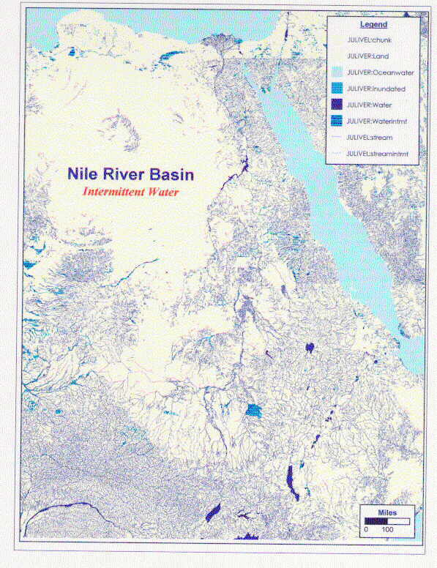
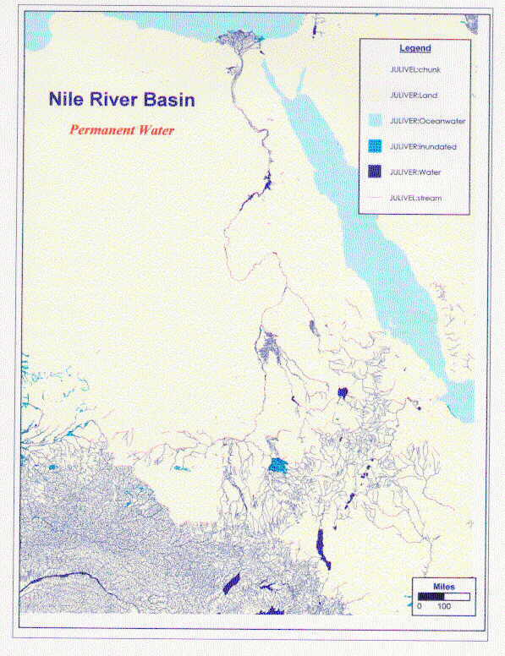

Slide 36
Others…continued
1997, from NRE545—Shannon England.
1998, from NRE545—Asli Gocmen, Taufik Hanafi, Jennifer Talbot, Moira Zellner. Jennifer spent many hours working on an elaborate PowerPoint. During that time, we talked about many topics, including her mother’s adventures, as an anthropologist (or other), in subSahelian Africa.

