Slide 1
Connections: Scholarly Multi-Tasking in a Mobile Virtual World, Part 3 October 22, 2011, 9th Annual CSF conference.
Sandra L. Arlinghaus, Adj. Prof. SNRE, Univ. of Michigan.
AKA “Archimedes” in the Google 3D Warehouse
William E. Arlinghaus, President, Greenscape Inc.

Slide 2
Projects in overlapping categories
Geography Projects
Mathematics Projects
Non-traditional Projects
The Perimeter Project
Mathematical Geography Projects

Slide 3
The Perimeter Project: 2011.
Protect Fragile Lands using Cemetery Practice
Pilot project: Chapel Hill Memorial Gardens, Grand Rapids. COMPLETE
Bundling of Archived Memorials Online with sale of cemetery plots, cremation service, etc.
Creation of Virtual Cemetery using Google Earth
Land acquisitions.
IN PROGRESS
Expansion of pilot project to other cemeteries—in progress.
Extension of idea to include golf course perimeter lands—viewing the golf course as a nation of 18 contiguous states.

Slide 4
The Perimeter Project: 2011.
Land Acquisitions. In Progress
Expansion of pilot project to other cemeteries—in progress.
Magnolia Cemetery, Meridian, Mississippi. Acquired, January 2011
Meridian Memorial Park, Meridian, Mississippi. Acquired, January 2011
Extension of idea to include golf course perimeter lands—viewing the golf course as a nation of 18 contiguous states.
Creation of QRcodes as memorials.
Golf Course Genealogy Garden:
Proposal

Slide 5
Mississippi Cemeteries
Meridian properties:
Acquisition strategy
Physical differences in maintenance in cemeteries in the Deep South.
Local management issues
Local political issues
Local cultural issues
Possible acquisition targets elsewhere.

Slide 6
Mississippi Cemeteries
Memorial webpages physically linked to sites or grave markers using QR Codes engraved on bronze plaques (as “Memory Medallions”) are in current use. Loved ones visit the cemetery and, with their SmartPhones, can link to obituaries while standing at the gravesite!
Precedent for this practice is long-standing in Japan (where space is at a premium) and more recently in Haifa, Israel.

Slide 7
QR Codes: SmartPhone as Scanner
QR Code #1
QR Code #2
Two different patterns link to the same site: Many-One transformation (not the reverse).

Slide 8
QR Codes: Link to a variety of formats
QR Code #1: Active webpage
QR Code #2: Archived image

Slide 9
QR Code on a Gravestone— look in the hatband!

Slide 10
Close-up of QRcode

Slide 12
Golf Course Genealogy Garden
Much land associated with a golf course is not used directly for golfing purposes. Areas in the woods, sections off the trails between holes, and so forth, will be referred to here as “Edges.” Golfers typically do not walk on these Edges. They are the Perimeter of the golf course.
Might we find another, complementary, use for Edges? A use that will:
Not alter, in the slightest,
The appearance of the existing golf course
The existing usage pattern of the current golf course
Offer opportunity for increased year-long funding, above and beyond direct golf course revenues, for the owners/managers of the golf course.

Slide 13
Golf Course Genealogy Garden
One possibility is to dedicate Edges (part or all of) to genealogy/memorialization, independent of burial or scattering location. Visualize QRcodes mounted, perhaps, on trees in memory of a loved one. Or imagine a “family tree” with some codes for loved ones already gone and with codes leading to active sites of another’s current life. One can build his/her own memorial in this garden while still alive and have it live on after death.
Such use is complementary to golf course use from a fiscal standpoint
Golf course revenues are seasonal; death-care revenues are year-long
Ash scattering on golf courses may already take place by individuals with no revenue for anyone and no memorialization for the cremains of loved ones. Professionally managed memorials offer:
Professionally managed, and trust-funded, memorialization opportunities using the Internet (so not invasive of physical golf course lands).
Planning practice consistent with contemporary principles involving “mixed use.”
Extra funding for the golf course owners, managers, and memorialization experts.
Extra funding with no detrimental consequences to neighbors or golfers. No change in appearance of the course or its usage.
There is long-standing precedent to this general idea: one use of totem poles is this sort of application (albeit using different technology contemporary in different times).

Slide 14
Golf Course Genealogy Garden
Indication of fiscal possibility: Significant possibility for revenue upgrade.
Local cultural issues in the case of Ann Arbor: history of park bench memorials difficulties.
Possibility of implementing this idea in a variety of locales…under consideration.

Slide 15
Physical Memorial and Virtual Cemetery: Integration of two different worlds using QR Codes.

Slide 16
The Perimeter Project 2011 Overlaps with Non-traditional Projects
Heart pacemakers enhance and extend both the quality and quantity of life for many folks around the world. What happens to these marvelous devices, though, in the final analysis? Most of us are familiar with organ donation and the miraculous opportunity it may provide. Now there is a program, in development, to recycle pacemakers and to do so in a humanitarian manner that brings opportunity to individuals who had no previous possibility. Pacemakers extend the perimeter of life.
One might expect that, as we age, we are more likely to need a pacemaker. By extension, one might guess that there are more pacemakers, per capita, in the American Contract Bridge League (ACBL) population of 165,000, average age of 69, than there are in a randomly selected group of 165,000 people, of average age less than 69. Different people choose different ways of caring for their earthly remains. Cemetery experts, however, assure us that pacemaker removal is a good idea prior to cremation (lest the crematorium explode). Pacemakers removed prior to cremation, or conventional burial, are generally simply trashed. How sad--most have "life" (battery and/or mechanical life) left in them that might be transferred elsewhere, to someone who could not otherwise afford it. An opportunity to save or improve someone else’s life is lost--what a shame.

Slide 17
Project My Heart/Your Heart is a program of The University of Michigan Cardiovascular Center. It is headed by Dr. Kim Eagle (Clinical Director of the Cardiovascular Center of The University of Michigan) who is working on it with Dr. Thomas Crawford and Dr. Timir Baman. It has a simple, but powerful, focus: recycle used pacemakers to individuals in developing nations or to others in need. Nations without strong health care programs cannot offer such wonderful life-extending devices to most of their residents. We can--as one individual to another. The U. of M. team is establishing procedure for sterilizing used pacemakers so they can be safely transplanted from a cadaver to a living individual. They are also developing training programs for medical personnel so that target developing nations become self-reliant in moving forward to improve cardiovascular health. According to the Project My Heart/Your Heart website, each year 1-2 million individuals worldwide die due to a lack of access to pacemakers. Meanwhile, almost 90% of individuals with pacemakers would donate their device to others in need if given the chance. What helps one person, and one nation, helps the world.
Publications of this material appears in publications of the American Contract Bridge League in an effort to recruit participants.
A Donor Card was created for the ACBL segment of the program.
A project to develop registry of pacemakers, as artificial organ donations, is underway in exploration with existing organ donation networks.
A project to develop a census of pacemakers is underway.

Slide 20
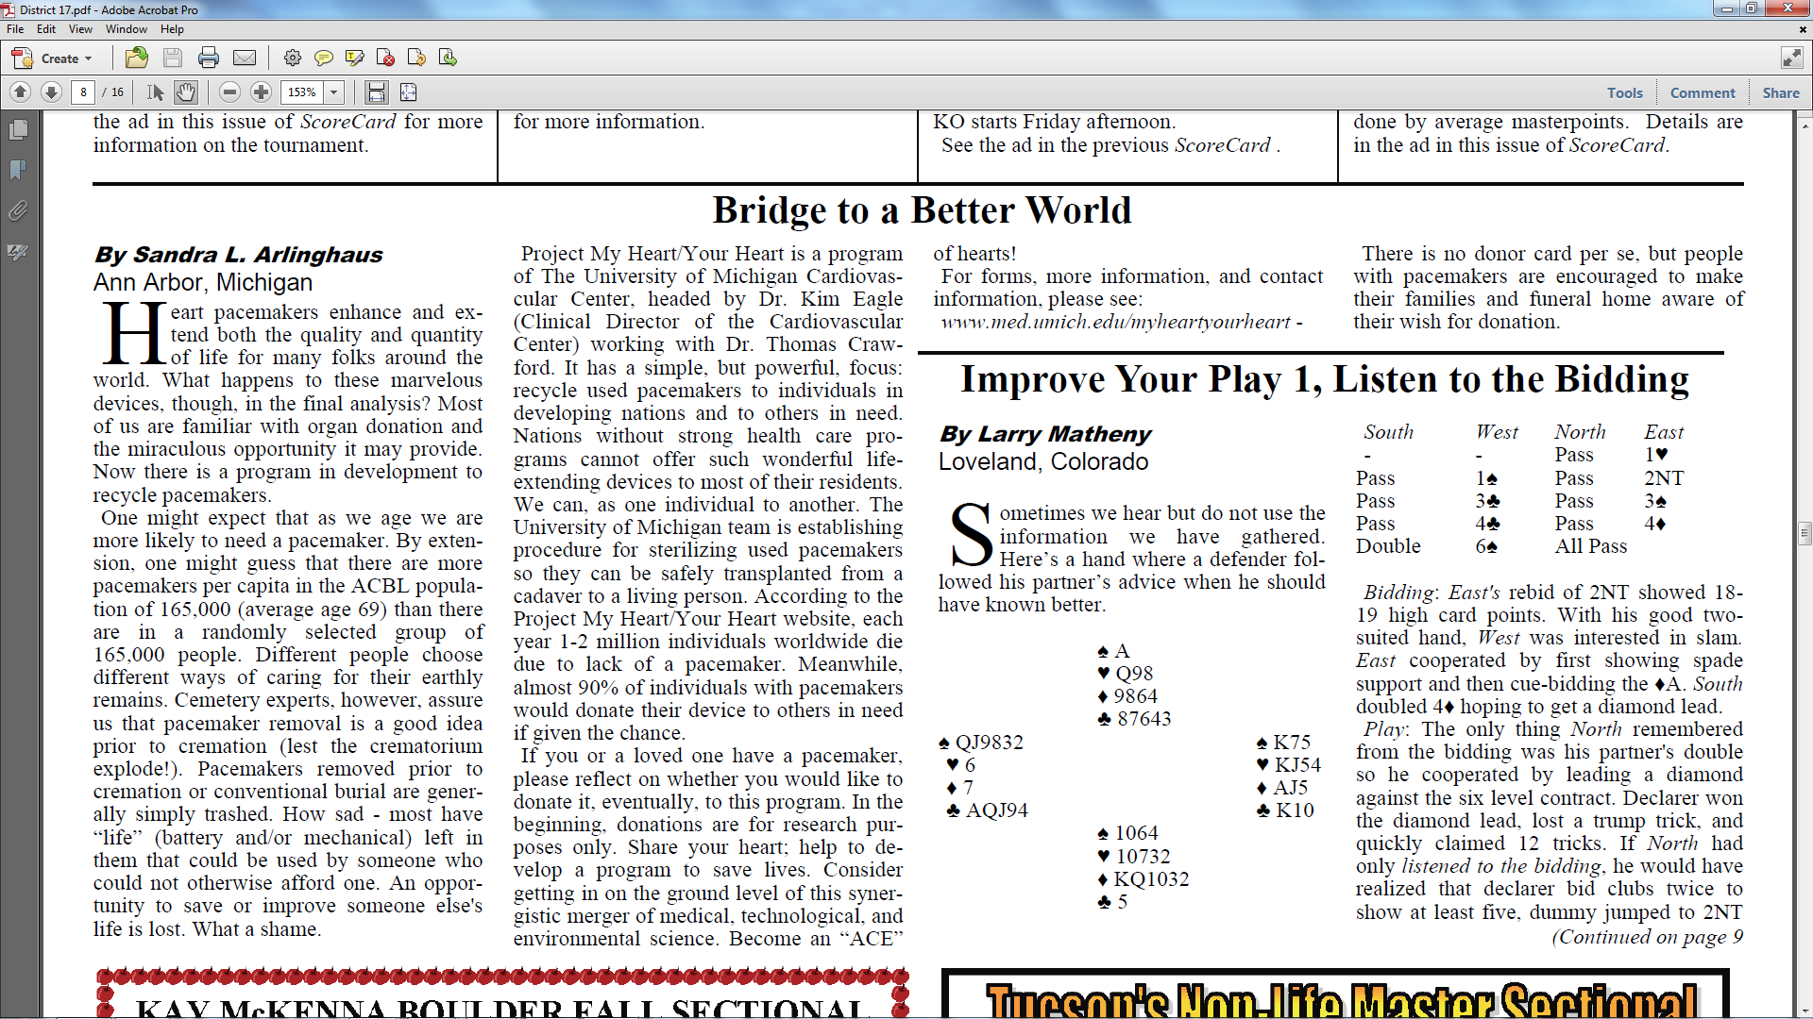
From Contract Bridge Forum, September 2011, p. 8.
Letter to the Editor to appear, ACBL Bulletin, Nov. 2011

Slide 21
Some sort of synergistic connection between this project, at the edge of the “Perimeter of human welfare” and CSF might evolve, initially in the US/ACBL project now, and in future global pacemaker census efforts.
Fields in a database might include items such as contact information of recipient; name of donor; age of pacemaker; registration number of pacemaker.
Others to be developed in conjunction with the medical community.
Online components seem desirable both for recruitment and for tracking.
Like other censuses, that number is changing; indeed, today’s recipient may become tomorrow’s donor.

Slide 22
Cloud Computing makes it easy!
QR Codes
Client Requests
Videos
Cloud Dropbox

Slide 23
Many Thanks to
The School of Natural Resources and Environment for room use;
Kris Oswalt of Community Systems Foundation (CSF) for advice.
Related Information
http://www.MyLovedOne.com
http://www.imagenet.org/
http://www-personal.umich.edu/~sarhaus/
Pacemaker Recycling: http://www.med.umich.edu/myheartyourheart/
Totem Pole: http://en.wikipedia.org/wiki/Totem_pole
Matthew Naud, Environmental Coordinator, City of Ann Arbor, for advice.
Gwen Nystuen, Commissioner, City of Ann Arbor Parks and Recreation Commission, for advice.
Contract Bridge Forum: http://www.contractbridgeforum.com/11/September/District17.htm
William C. Arlinghaus, Bonnie Bagley and Ken Monzingo, ACBL District Directors.
American Contract Bridge League: http://www.acbl.org/

