Slide 1
Alma Lach’s Kitchen: Transforming Taste
Summary of an Exhibition,
The University of Chicago,
Joseph Regenstein Library,
September 19, 2016 to January 6, 2017

Slide 3
Credits, plus…
Special Collection Information: Eileen Ielmini, Daniel Meyer. http://news.lib.uchicago.edu/blog/2016/10/25/alma-and-donald-lachs-legacies-continue-in-special-collections/
Photographer: Marc Monaghan, Chicago. http://www.marcmonaghan.com/home--singles/
Full photographic set: Contact Sandra Lach Arlinghaus, sarhaus@umich.edu , http://www-personal.umich.edu/~sarhaus/

Slide 4
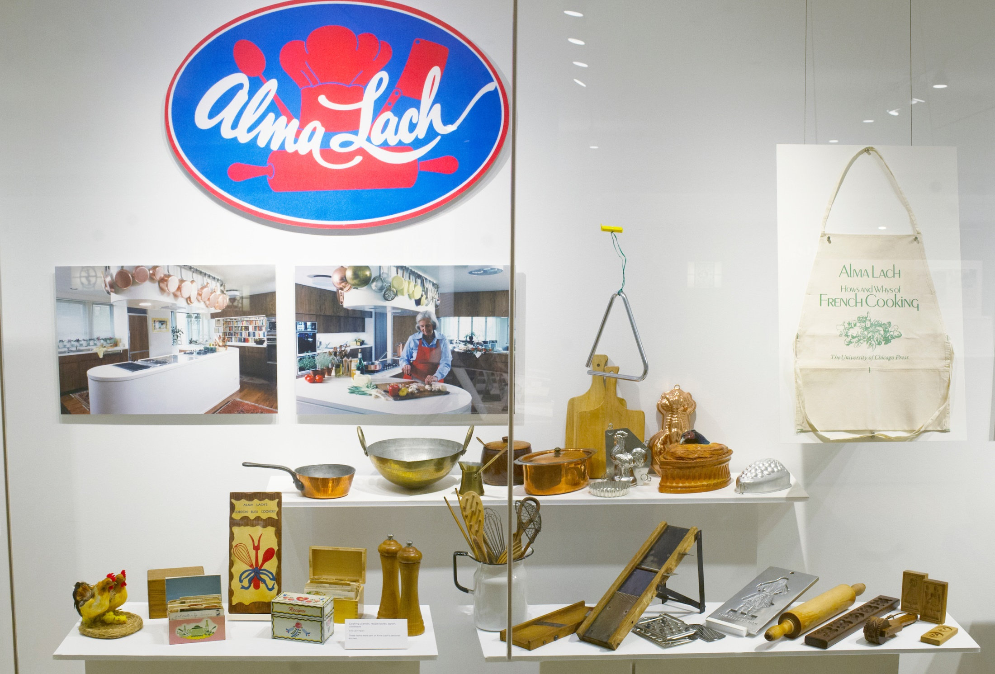

Slide 5
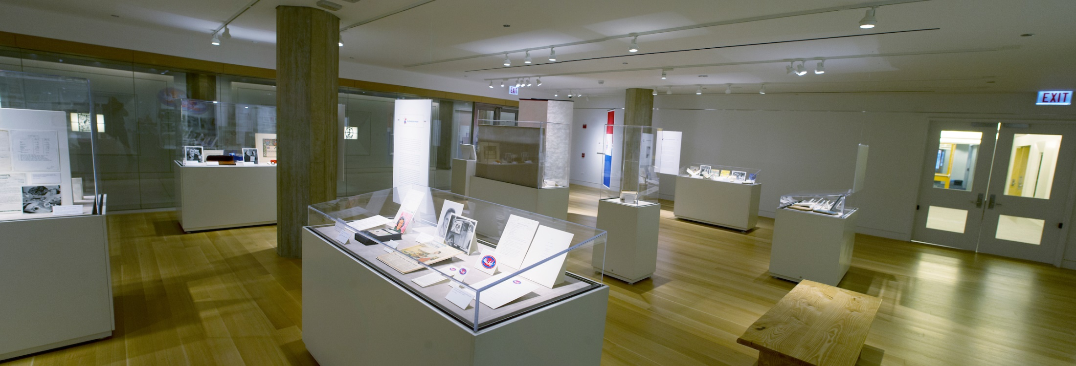

Slide 7
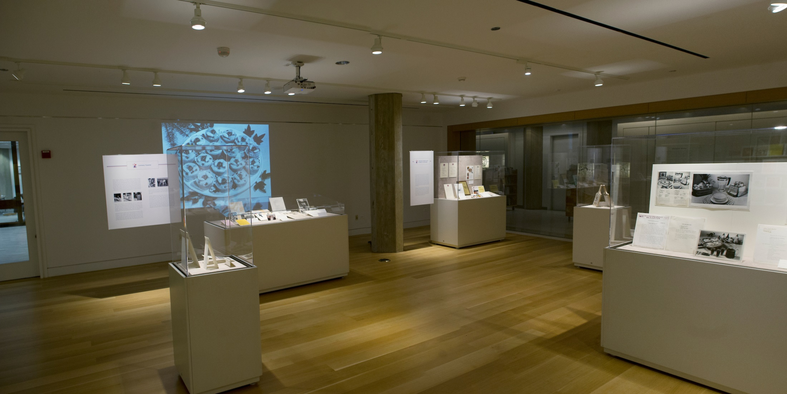

Slide 8
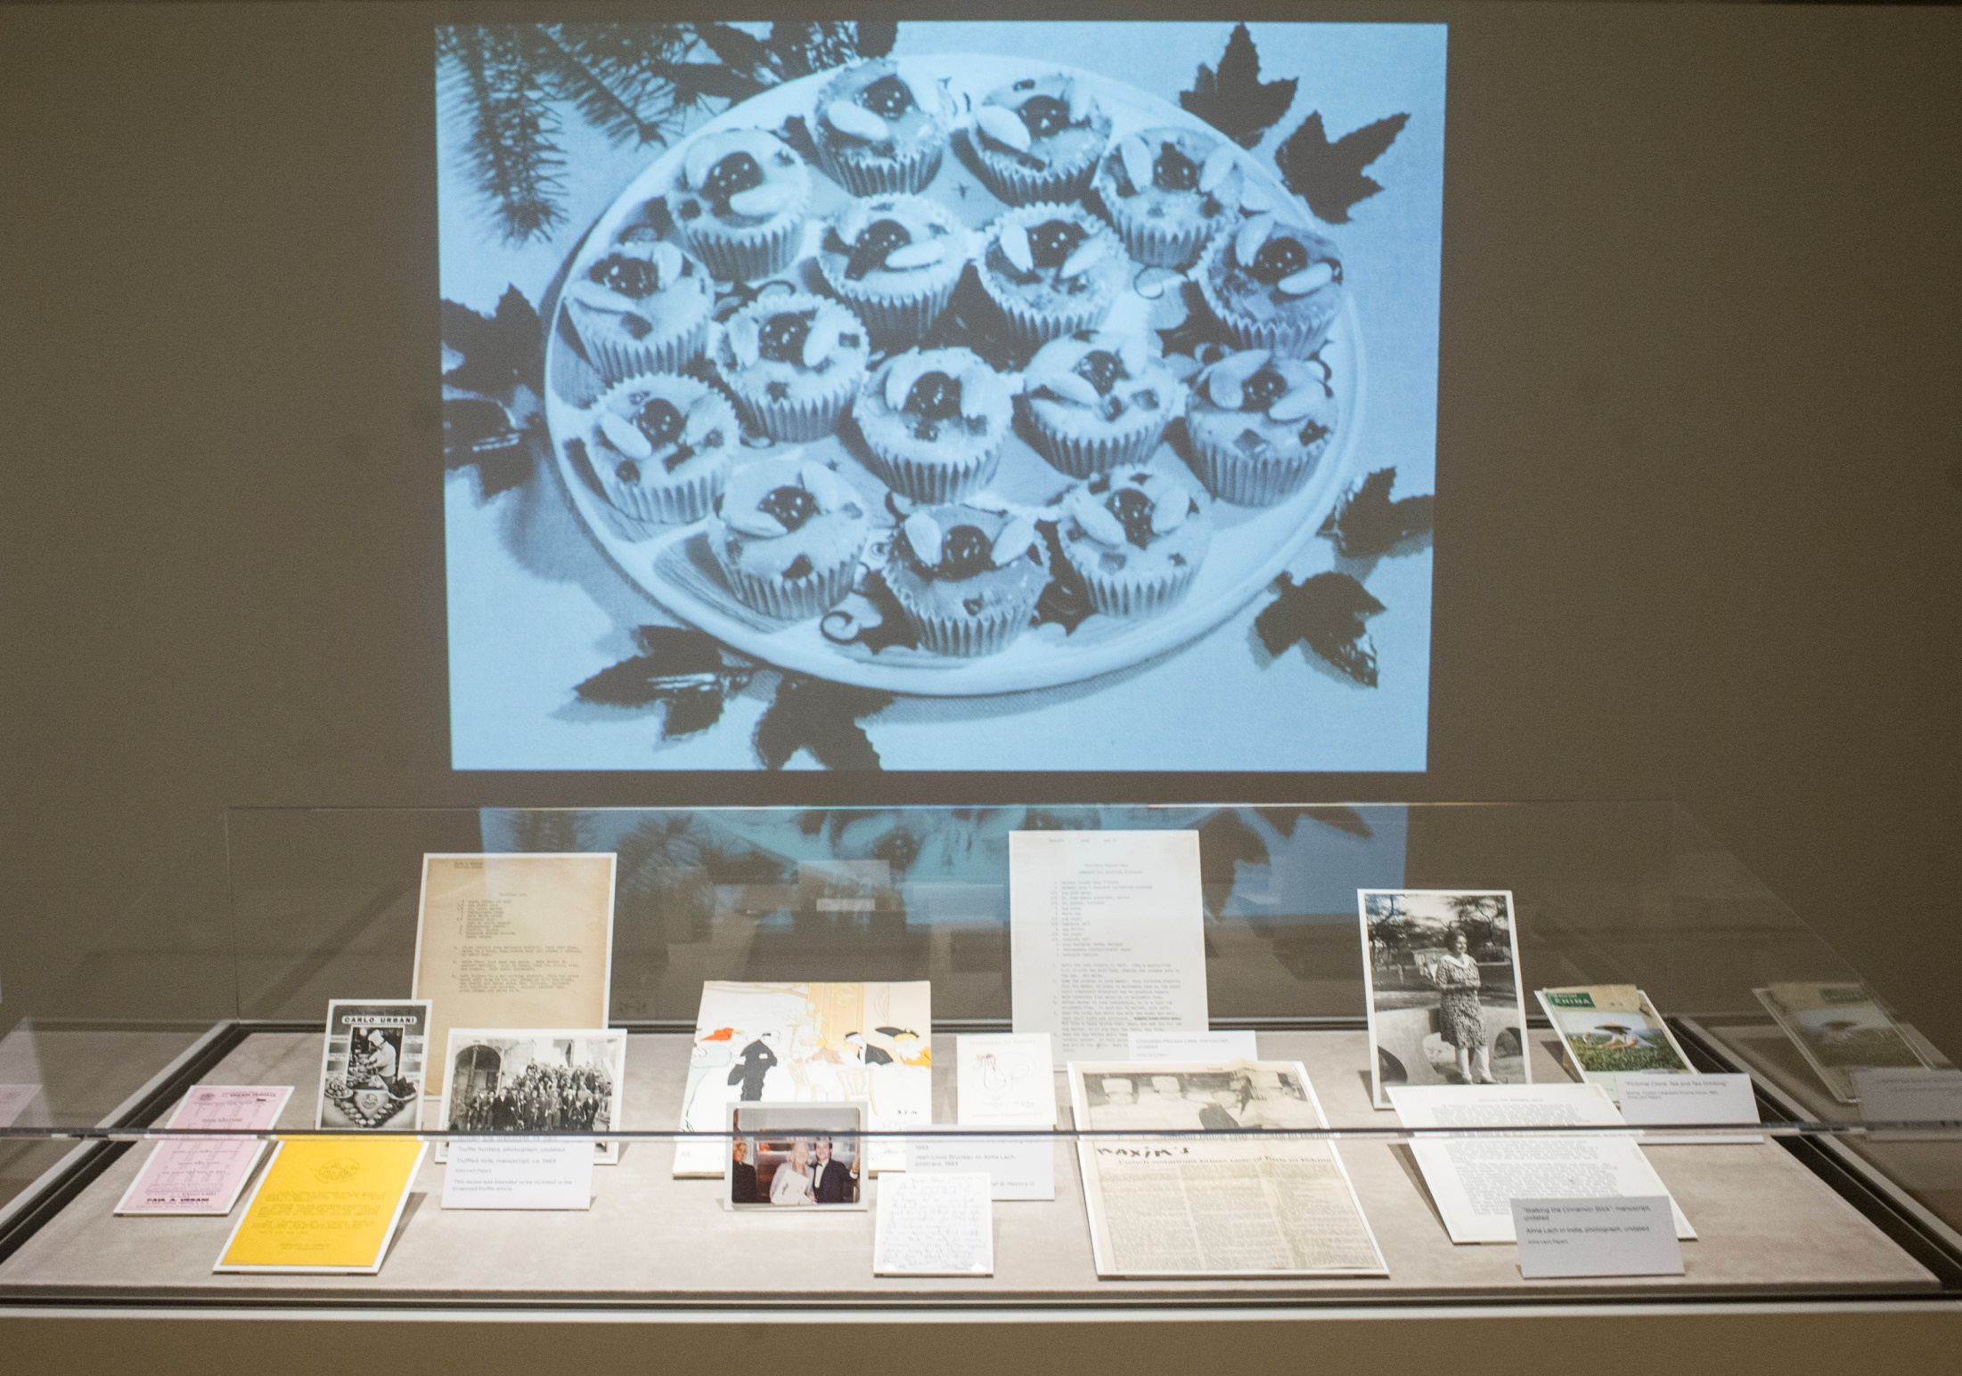

Slide 9
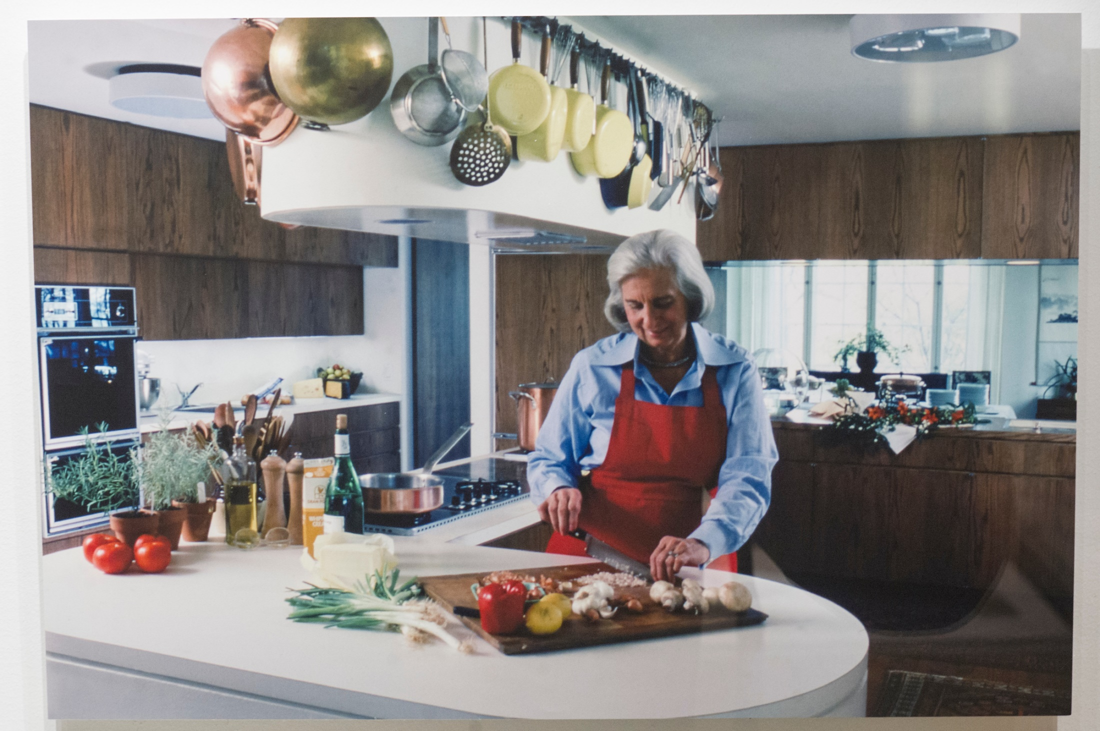

Slide 10
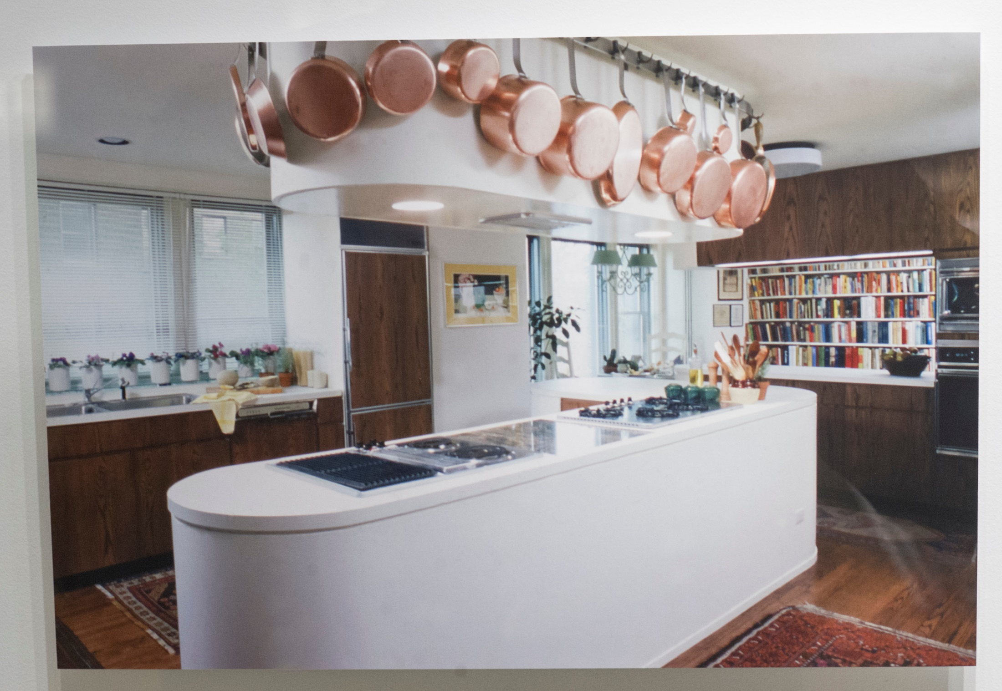

Slide 11
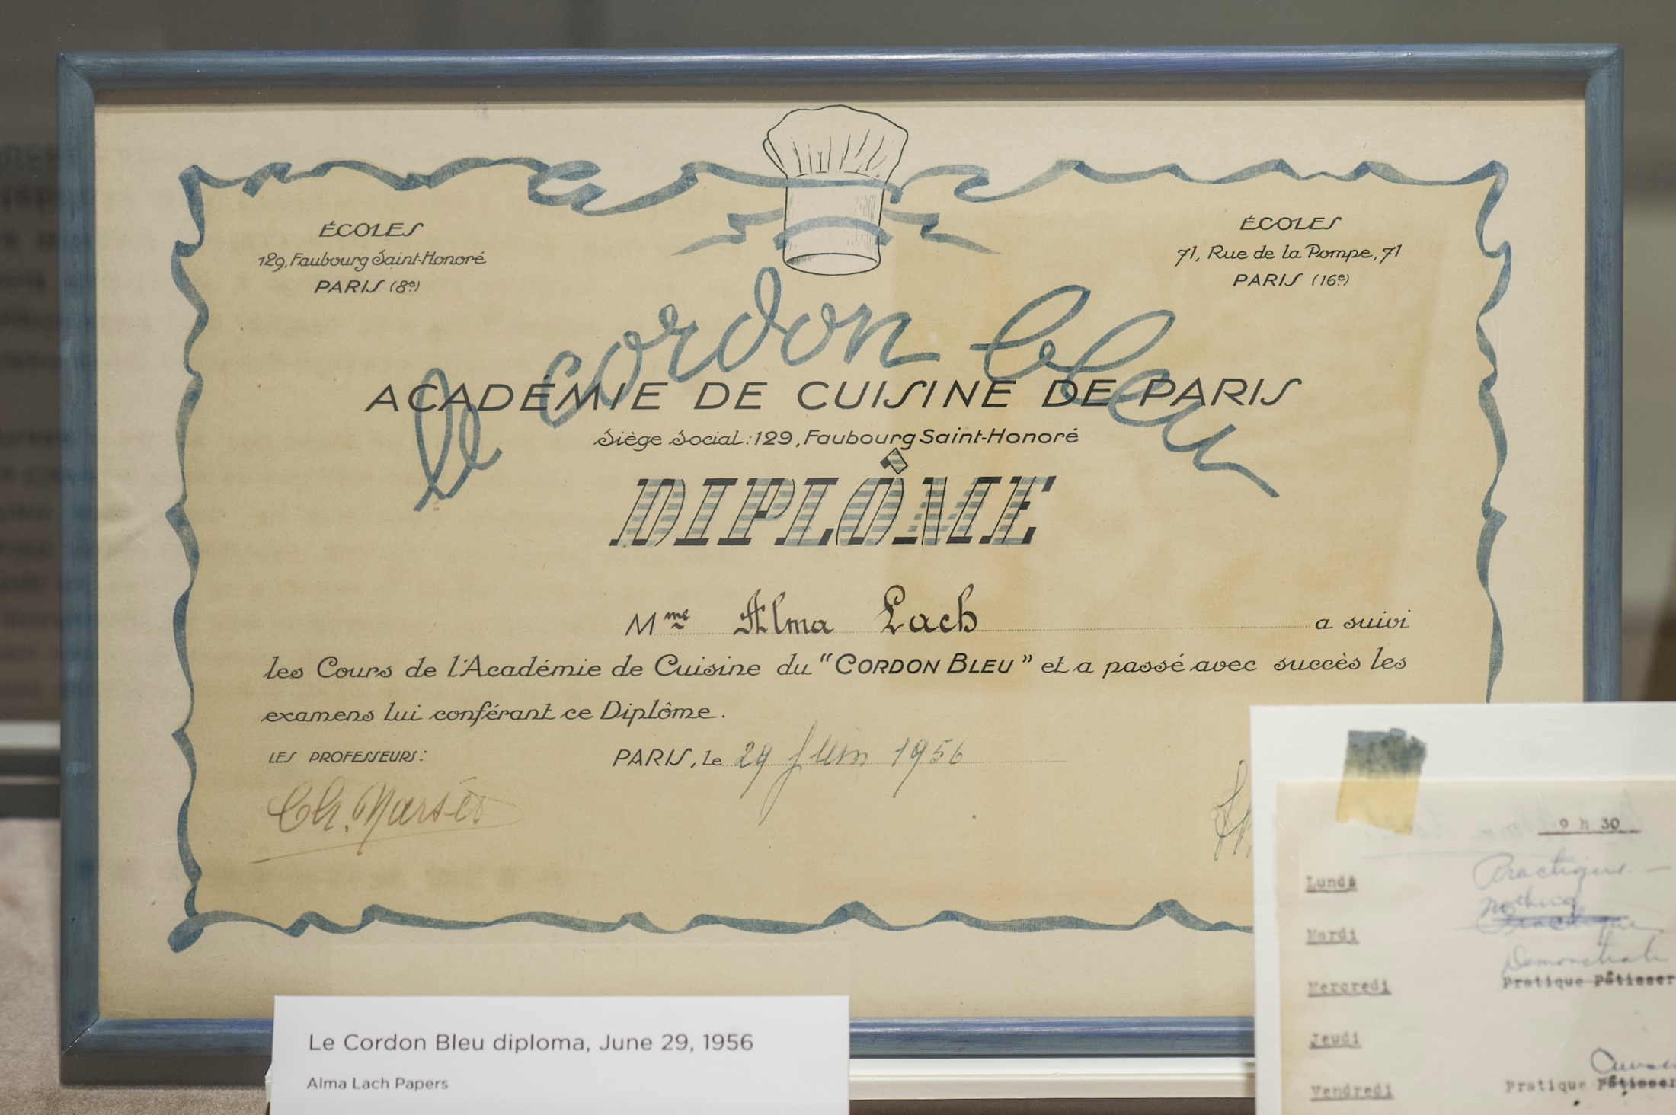

Slide 12
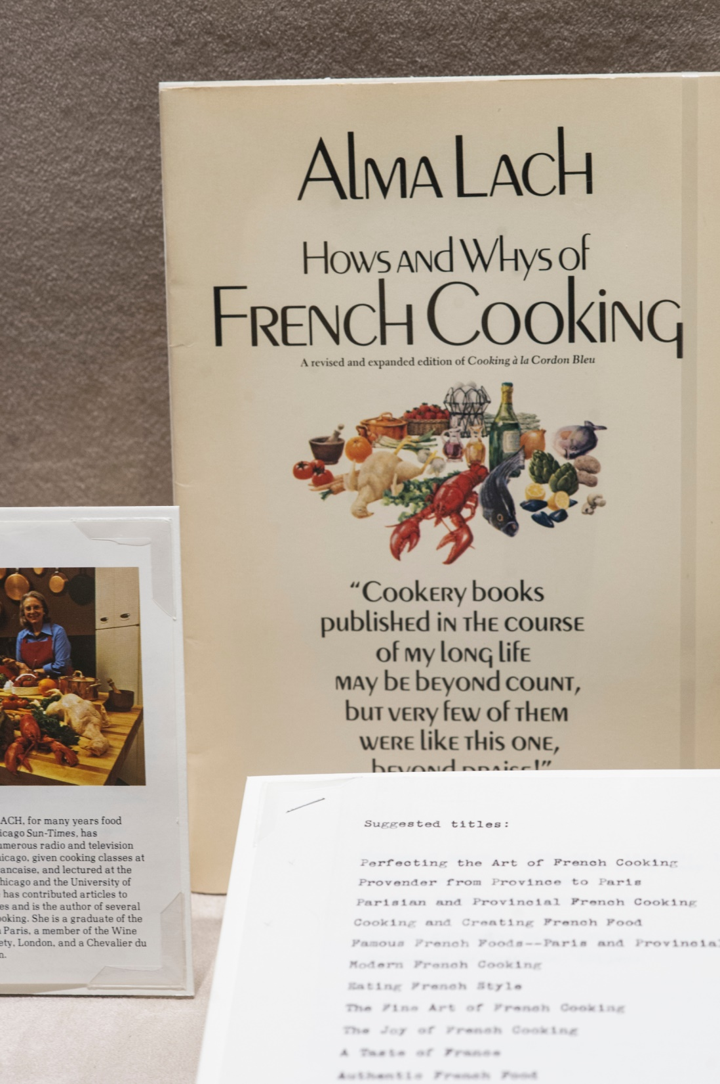

Slide 13
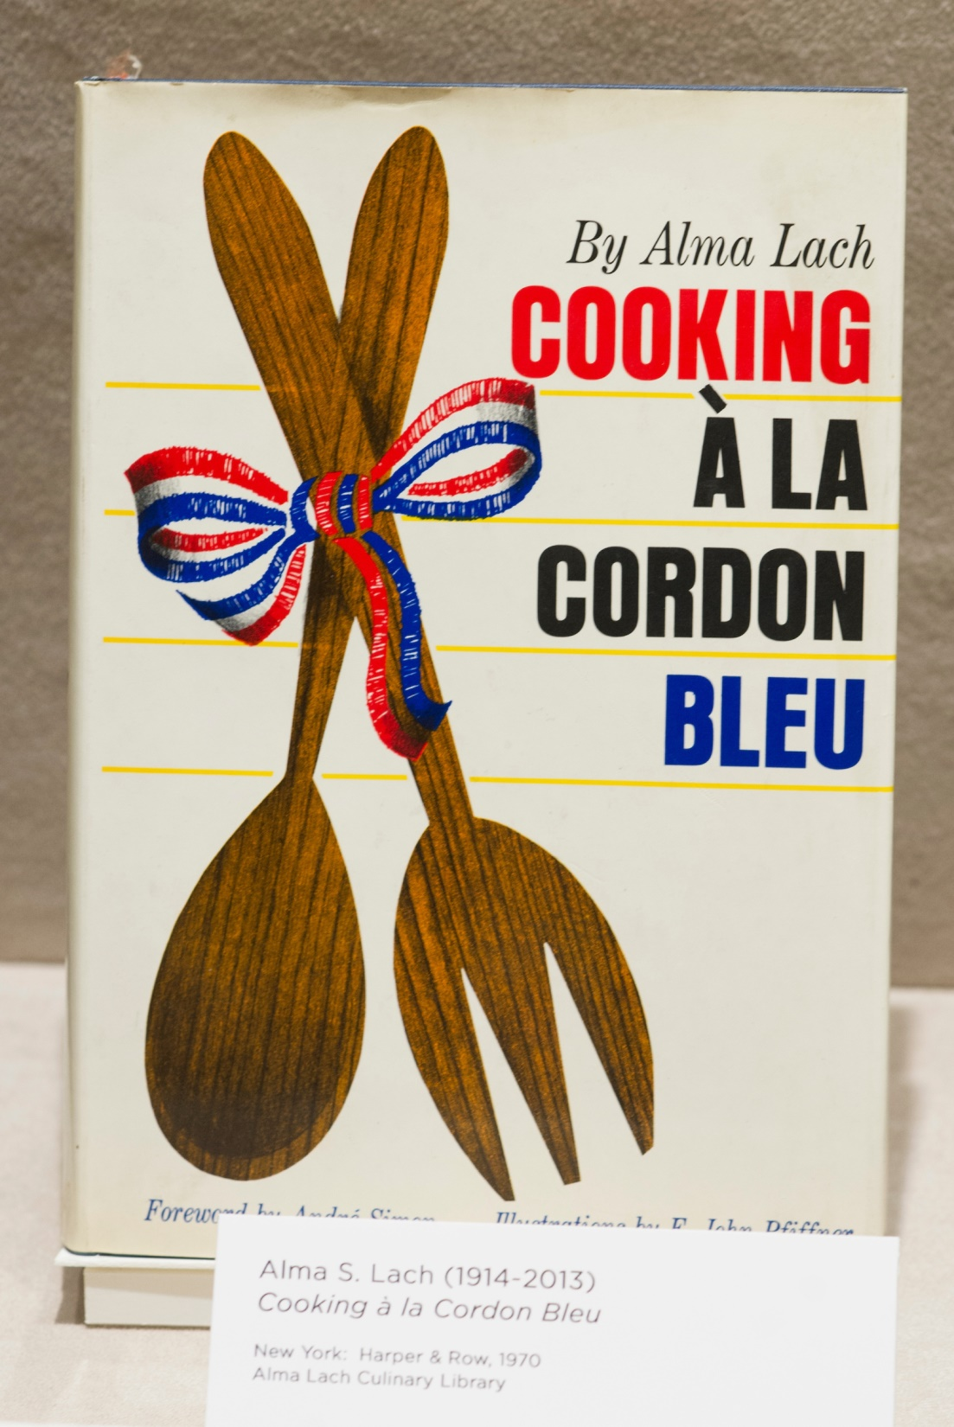

Slide 14
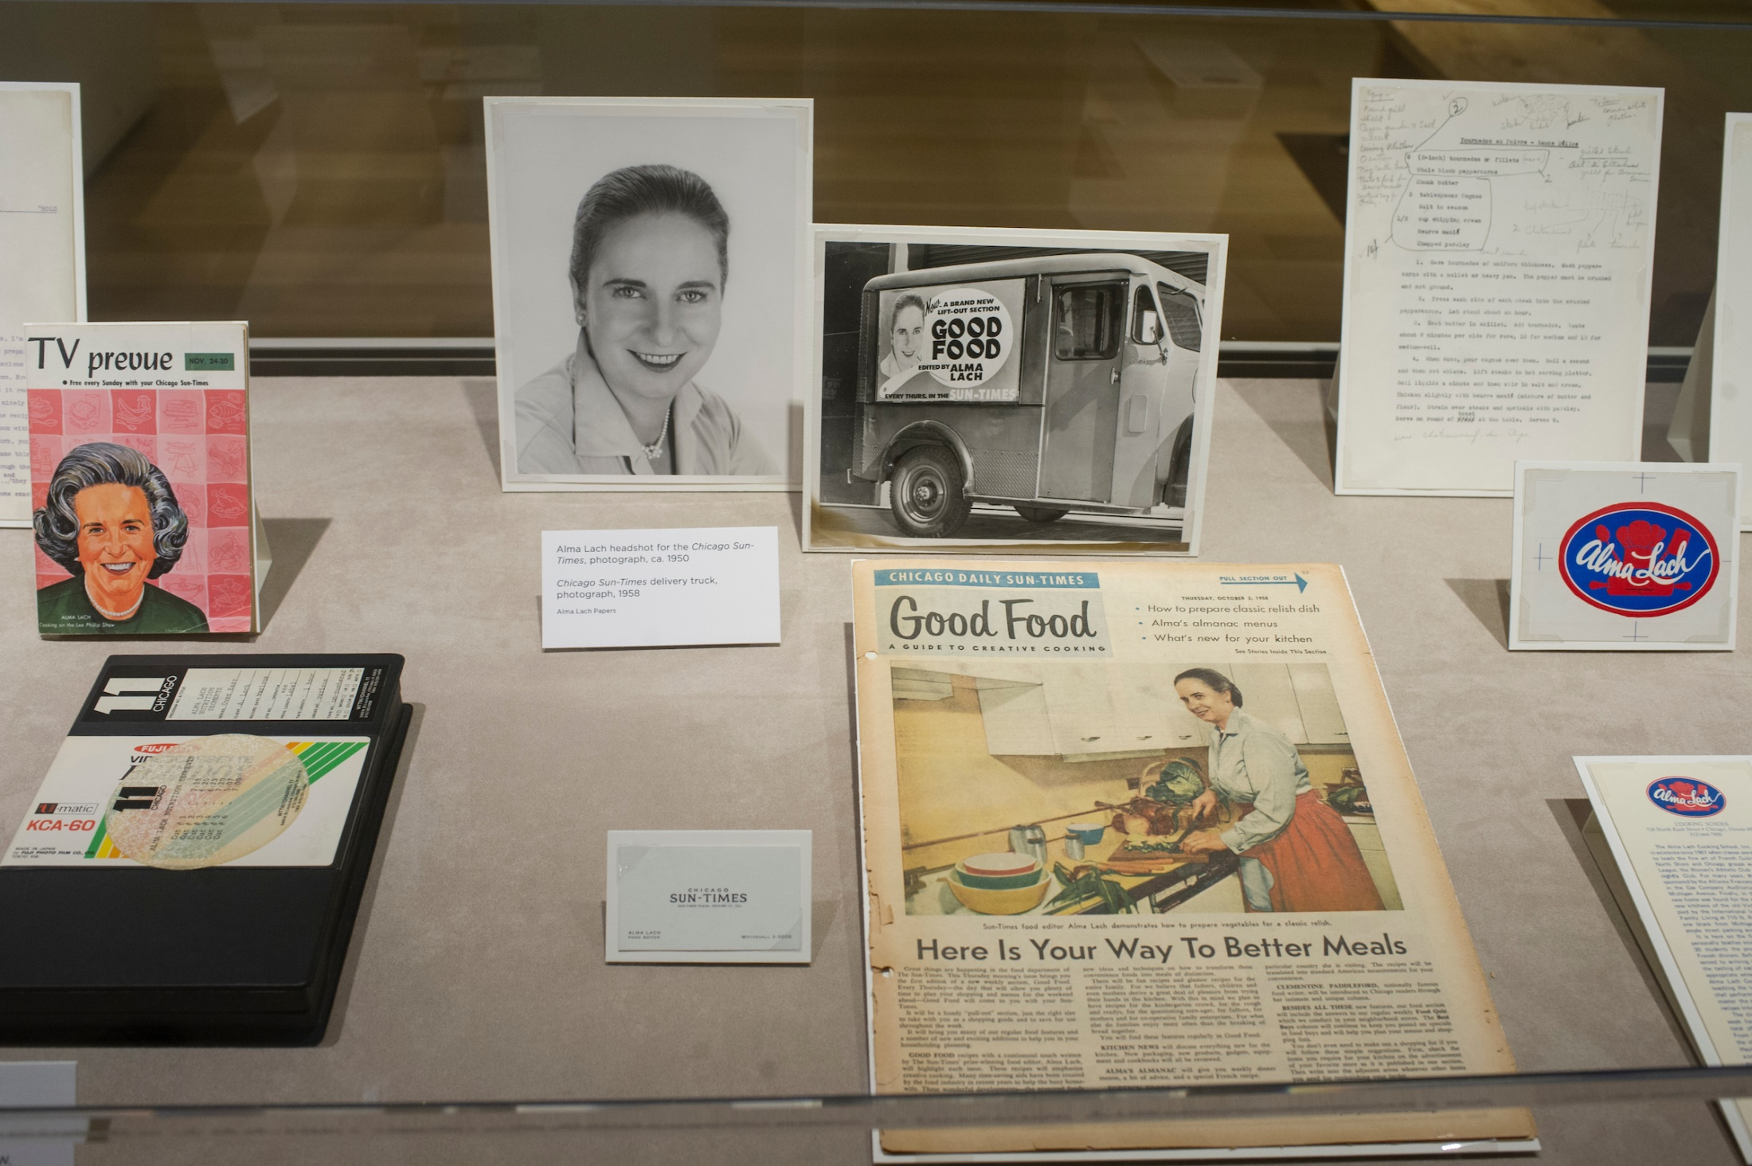

Slide 15
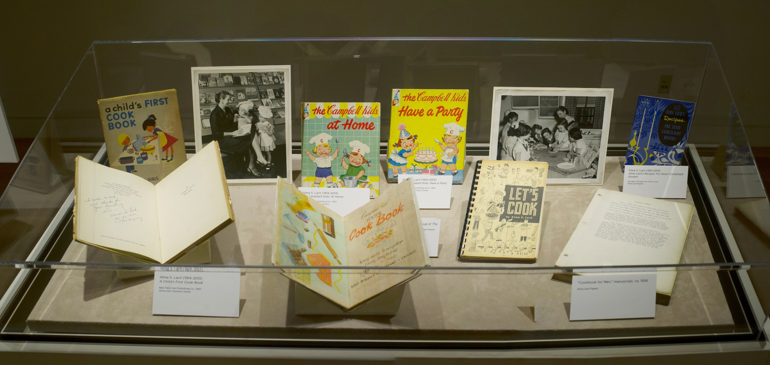

Slide 16
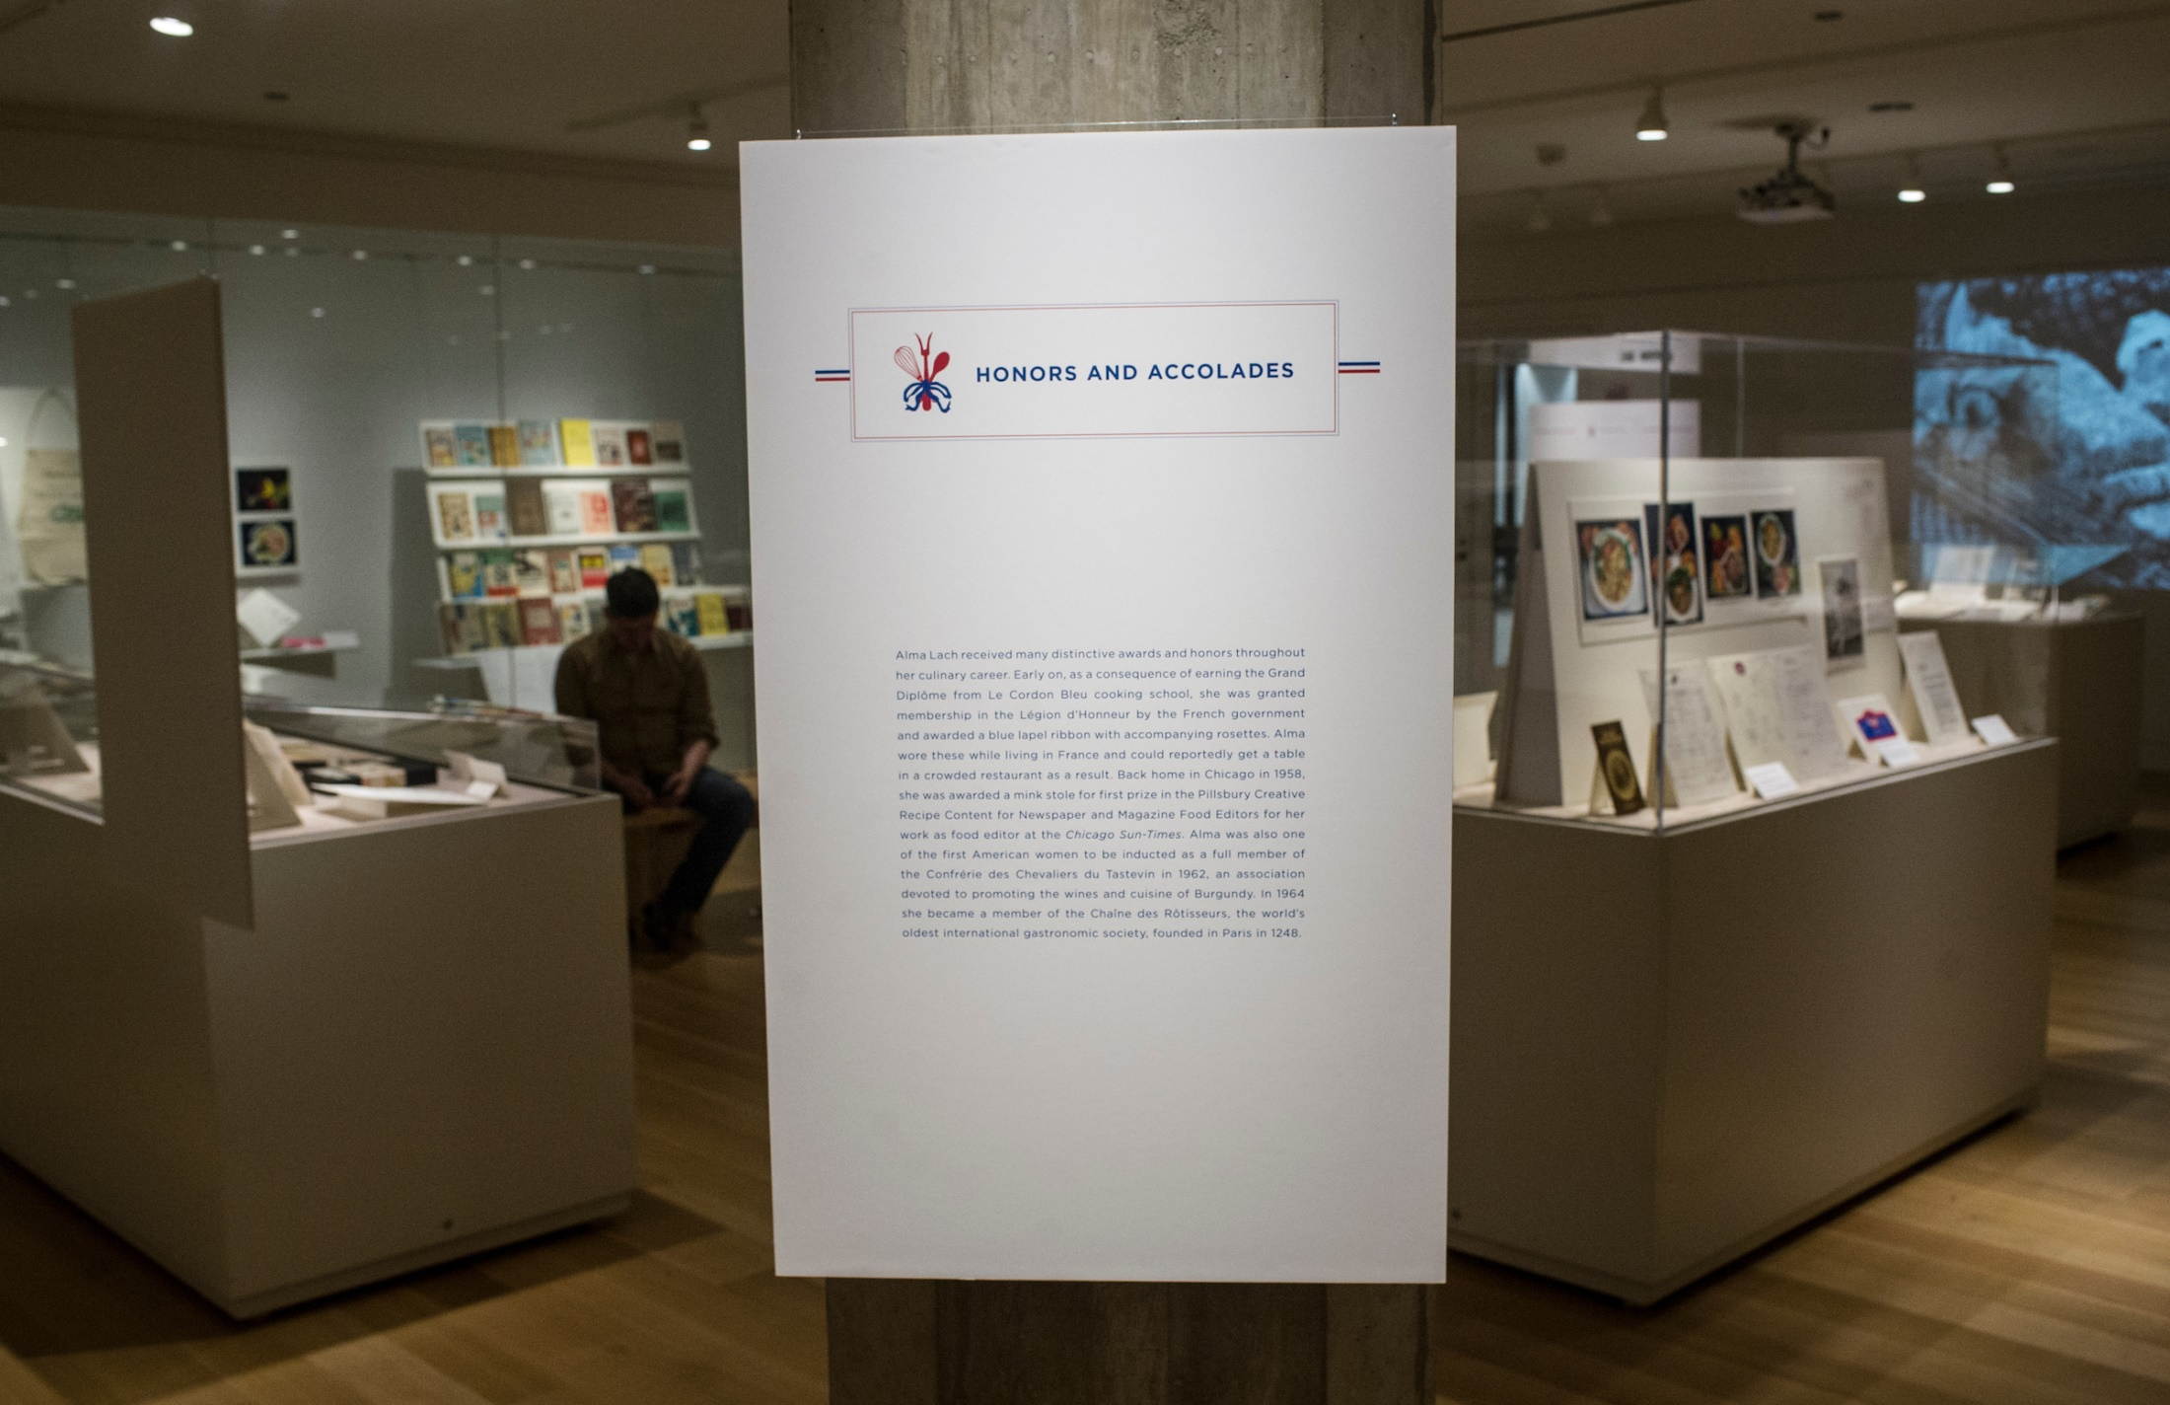

Slide 17
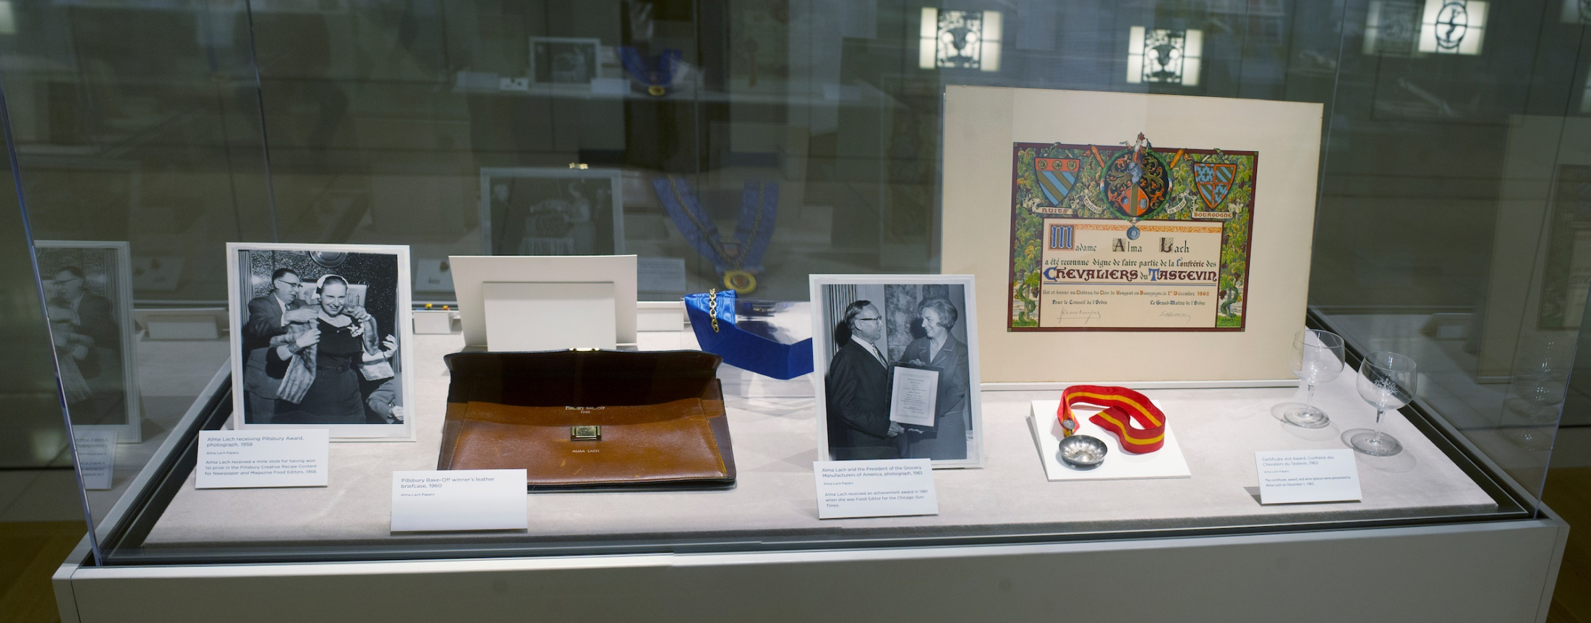

Slide 18
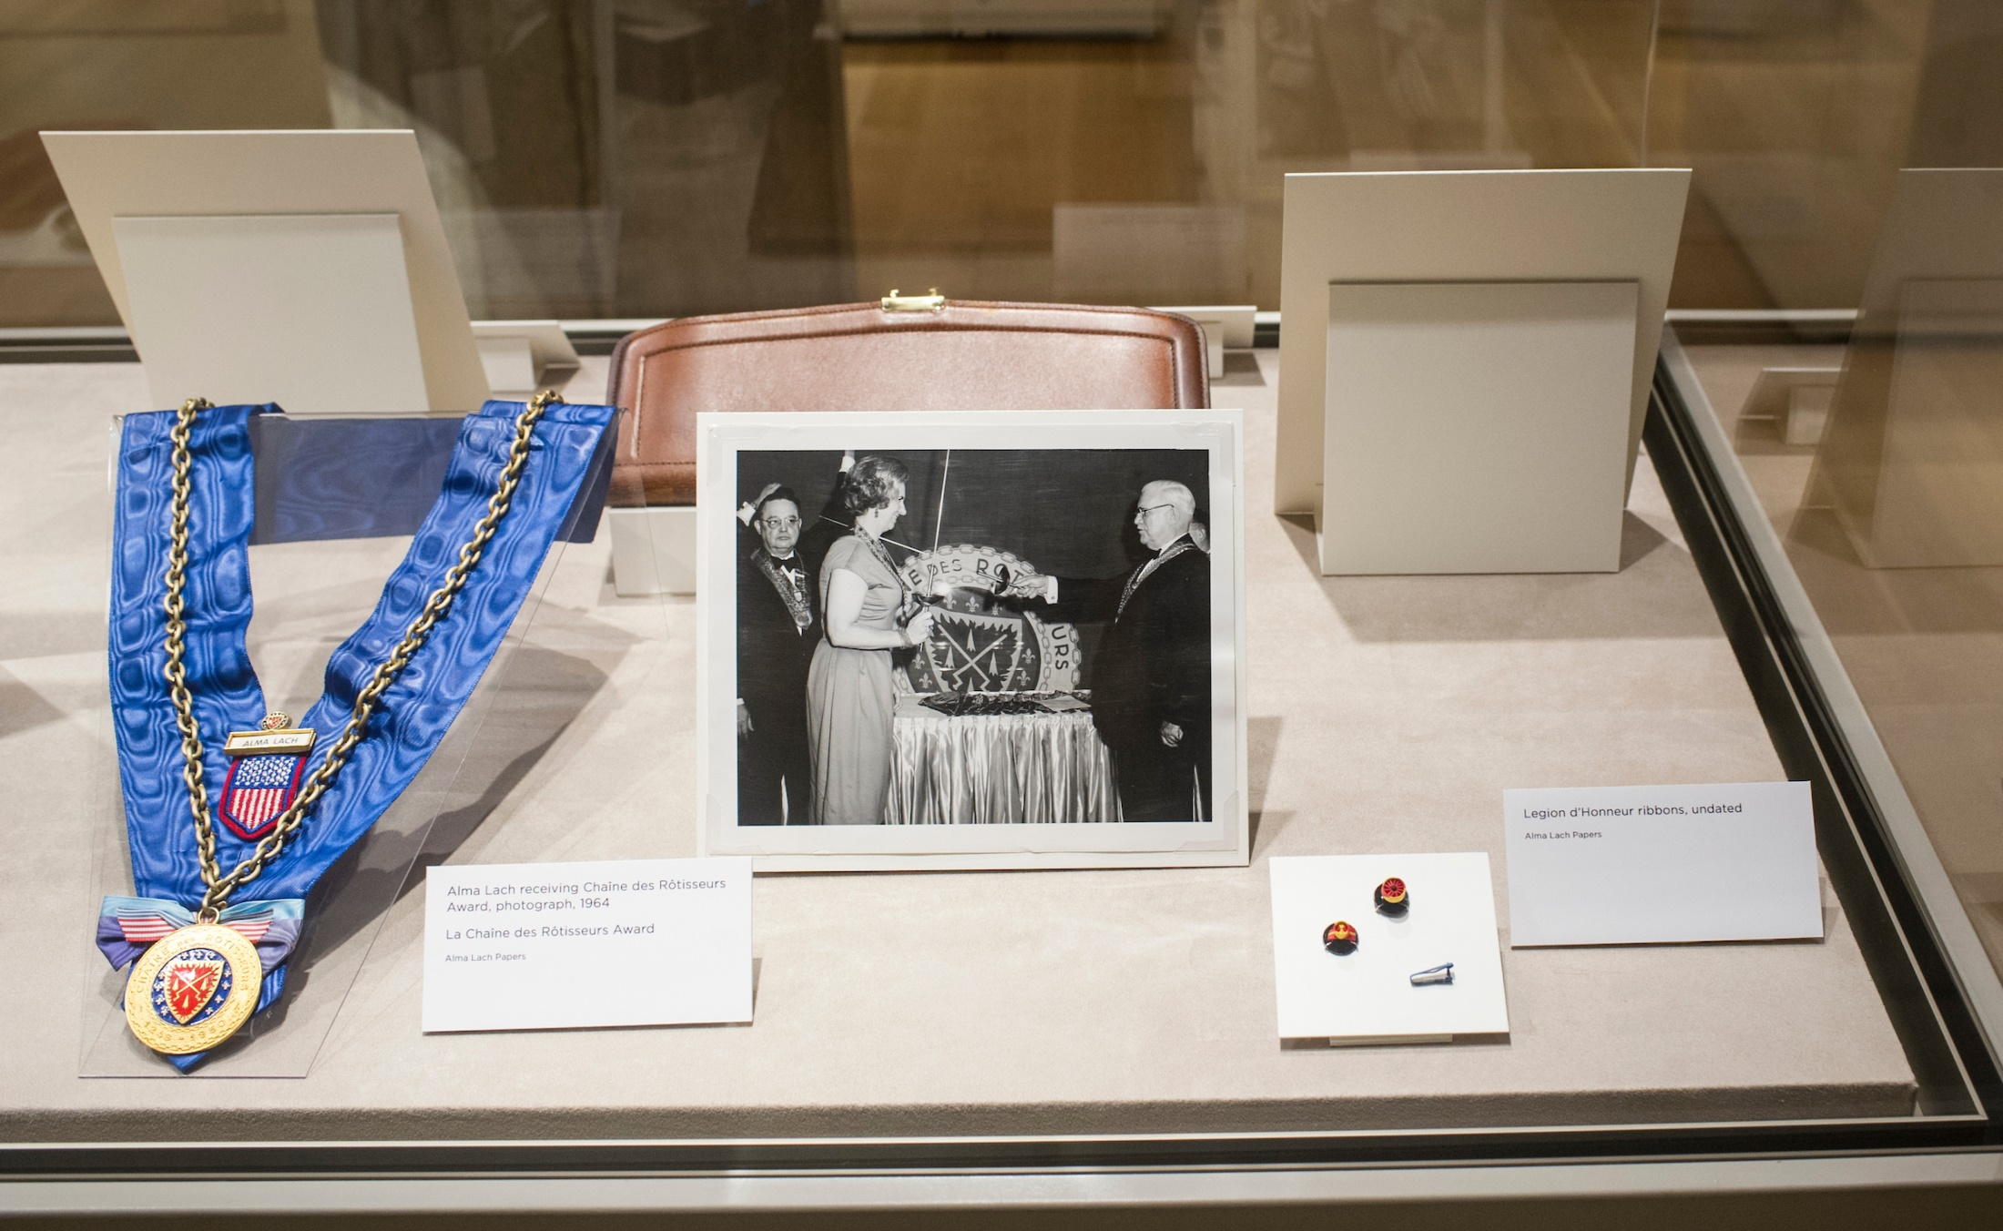

Slide 19
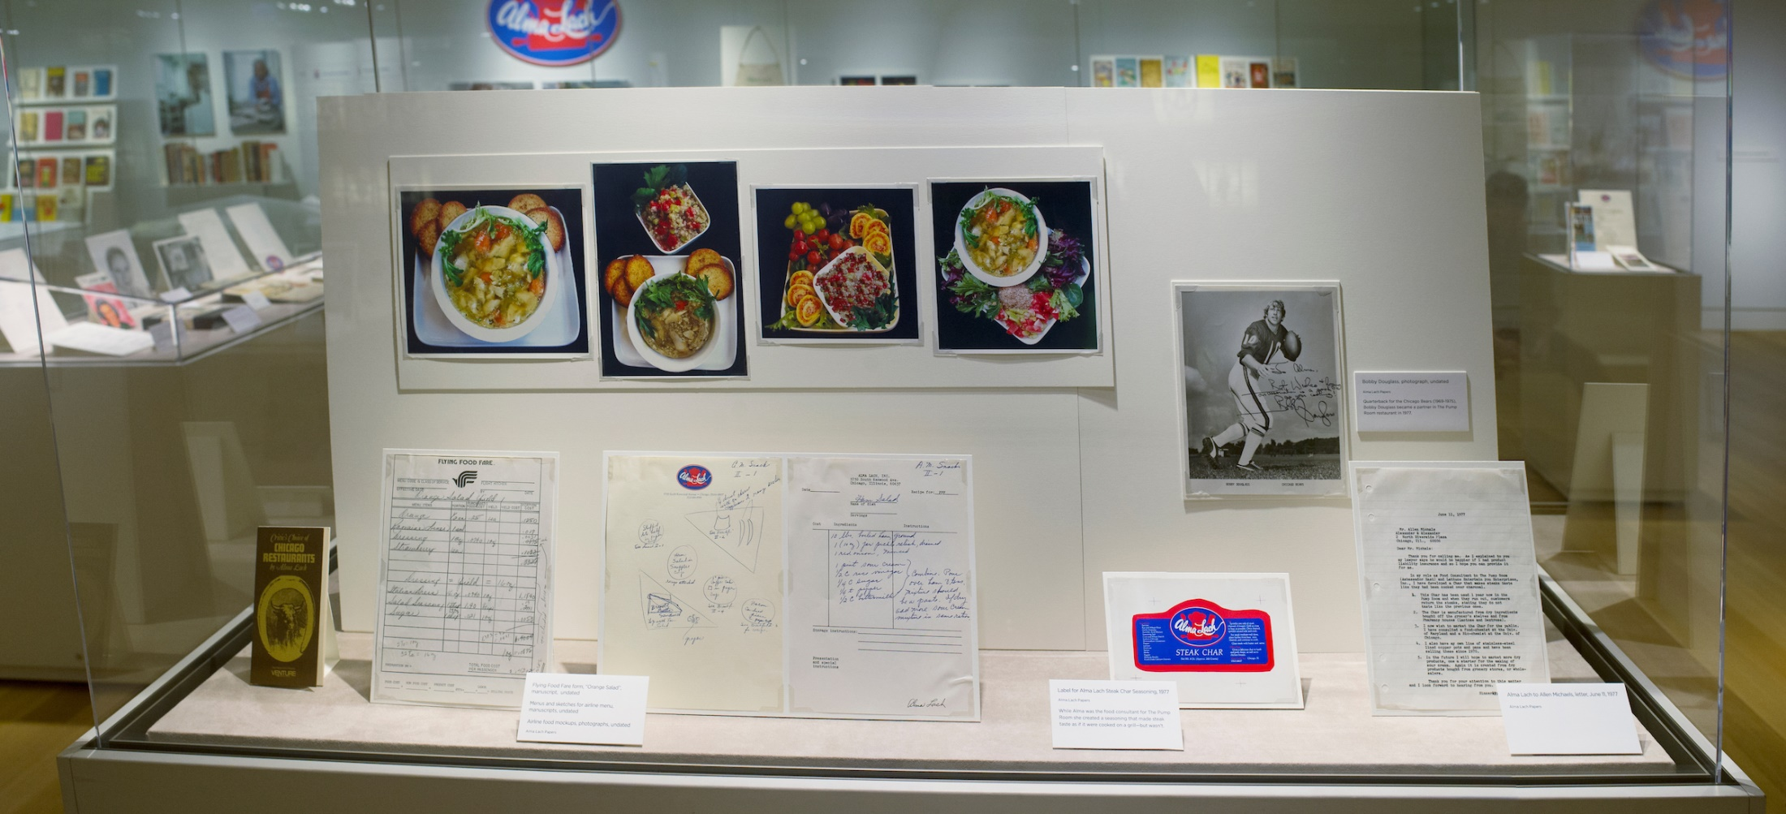

Slide 20
